Slide 1
Revitalization Process
Michele Steinmetz
Member Engagement Coordinator
msteinmetz@legion.org
317-630-1379

Slide 2
Timeline/Schedule of Events
District commander or vice commander works with department to determine need.
Department invites national staff and sets dates for event at least 6-8 weeks in advance.
Primary point of contact is district commander or vice commander.
Home base location identified for 2 to 4-day event.

Slide 3
Timeline/Schedule of Events
Ensure availability of service officer during event.
Department/district ensures all posts in area are made aware of event and names volunteers from each post to participate and allow phone transfers.
National staff member requests listings/data of expired, DMS expired, HQ Post and DMS-admin info from the American Legion IT Division.
National staff prepares postcards to mail to all names prior to event.

Slide 4
Verbal Consent Resolution
NATIONAL EXECUTIVE COMMITTEE
OF
THE AMERICAN LEGION
INDIANAPOLIS, INDIANA
OCTOBER 13-14, 2010
Resolution No. 14: Affirmative Consent For Transfer
Origin: Internal Affairs Commission
Submitted by: Internal Affairs Commission
WHEREAS, The American Legion since 1919 has been an organization of volunteers
tied together by four pillars of service; and
WHEREAS, The American Legion since 1919 is an organization where members are
required to sign volunteer consent for membership; and
WHEREAS, The American Legion is a grass roots community based organization with a
focus on veteran’s service on a voluntary basis; and
WHEREAS, The American Legion encourages individuals to become members of the
post that they desire and that can best serve both that individual’s preference and the overall
goals and objectives of The American Legion; and
WHEREAS, The current, long standing policy of The American Legion is that an
individual member has the right of affirmative consent concerning his or her membership
affiliation with their American Legion post; and
WHEREAS, The strength of The American Legion lies with its individual members and
their dedication and devotion to their selected American Legion post; now, therefore, be it
RESOLVED, By the National Executive Committee of The American Legion in
regular meetings assembled in Indianapolis, Indiana, on October 13-14, 2010, That
before a membership transfer occurs there must be a Member Data Form 30-001
(attached)
provided to National Headquarters, signed by a member or certified by a post
commander or post adjutant, where member has given his or her oral permission to
be transferred.

Slide 5
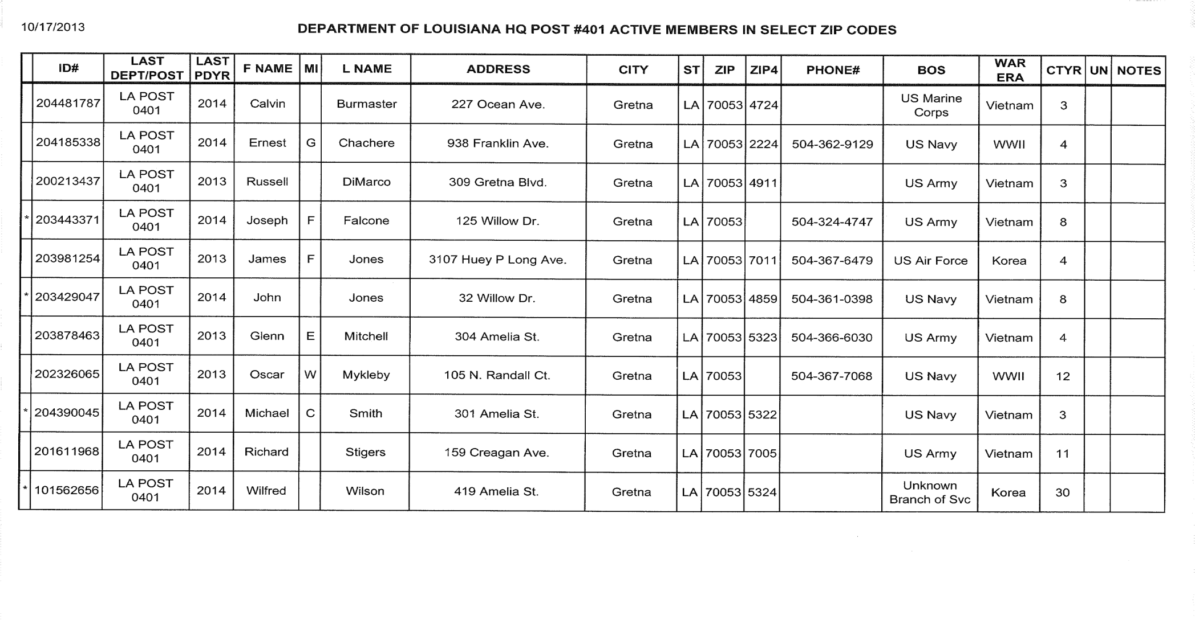
Sample Member Listings

Slide 6
Postcard Mailed Prior to Event

Slide 7
Text on Postcard
COMMUNITY SERVICE TO VETERANS EVENT
November 17, 9 am – 4 pm
November 18, 9 am – 1 pm
Temple City Post 279
9522 Las Tunas Drive
Temple City, CA 91780
Service Officer Info Available
Contact: Dave Whalen
555-555-5555
legion@legion.org

Slide 8
Email Blast
 |  | Dear Wendell King, Military veterans in and around Wewoka are invited next week for a special service session at American Legion Post 122, located at 209 N. Wewoka Avenue in Wewoka. National and State Headquarters staff and local members from The American Legion will be in town to discuss veteran’s benefits and service to the community. All wartime veterans in these areas are invited to American Legion Post 122 to learn more about The American Legion and veteran benefits. Membership and veteran information staff will be available on Thursday, May 26th through Friday, May 27th from 9 am to 5:00 pm along with members of local American Legion Posts in this area to kick off this community and veteran service campaign. A Veteran Service Officer will be on hand to assist any veteran with benefit questions, grant information, and VA registration. Contact: Donald Kuntze at 555-555-5555 or sr.vice@anywhere.net

Slide 9
Press Release
 |  | FOR IMMEDIATE RELEASE American Legion Posts to the West San Gabriel Valley Communities INDIANAPOLIS (Nov. 5, 2018) – Military veterans in and around this region are invited for a special service session at Temple City American Legion Post 279 located 9522 Las Tunas Drive in Temple City, November 17, 2018 from 9 am to 4 pm and November 18, 2018 from 9 am to 1 pm. American Legion staff will be able to discuss veterans’ benefits, The American Legion’s legislative efforts, membership opportunities and service to the community. A veterans service officer will be available to discuss claims and other benefits questions. In keeping with the over 100-year tradition of The American Legion posts in this area will focus on community service and assistance to veterans. The scope and nature of the posts’ community service is determined by its members and with input from local civic and community officials. Since its inception in 1919, The American Legion, the world’s largest veteran service organization, has been a key advocate for veterans and has been responsible for strategic legislative initiatives such as the G.I. Bill and the creation of the Department of Veterans Affairs. In addition to veteran advocacy, The American Legion supports children and youth activities, patriotic American values, a strong national defense and quality-of-life issues for those serving in today’s armed forces. Contact: Dave Whalen, 626-555-5555, e-mail: vice18@Anywhere.com

Slide 10
Timeline/Schedule of Events
National staff prepares press release and Media & Communications staff disseminates to all media outlets in event area.
National staff ships materials, such as member data forms and other membership recruiting material.
Once on site, national staff conducts training the evening before or day of scheduled revitalization event.

Slide 11
Timeline/Schedule of Events
If phone numbers were not looked up previously, have phone books or Wi-Fi available to do so.
anywho.com, 411.com, fastpeoplesearch.com, truepeoplesearch.com
Ensure callers have cell phones AND chargers.
Provide DMS transfer phone script with listings to volunteers.
Ensure volunteers know how to fill out Member Data Form in its entirety.
Provide door knocking teams with expired listings and MapPoint directions.

Slide 12
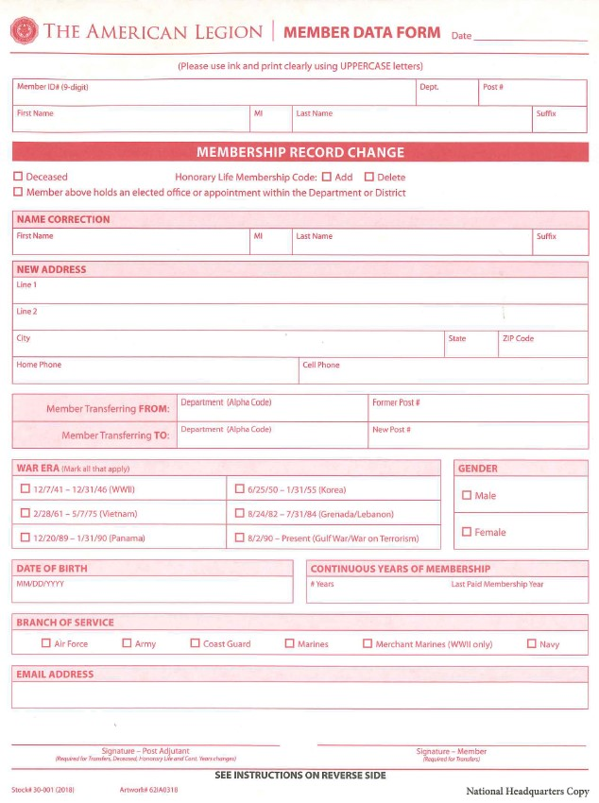
Member Data Form (Transfer Form)
Fill out transfer form entirely to capture the most up-to-date information on member

Slide 13
Phone Script
“Hello, I’m from American Legion (Post, District, Department, etc.) here in the area. We are contacting members of our department (State) Headquarters Post who live in this area.
“Are you ___________________________________________________? You should have received a postcard (and an e-mail if there’s an asterisk in left hand column) about a week ago that we would be in the area working membership. The reason we are contacting you as a Headquarters Post member is to see if you would be interested in transferring your membership into an active post in your community. This way, the dues you pay next year and beyond will stay and help support the community in which you live.”
“We can make the transfer verbally over the phone; all we need is your approval to do so.”
If the member is interested in transferring, complete the Member Data Form, confirming their mailing address, branch of service and war era. If possible, capture their birth date and e-mail address.
In the Member Signature block, print: Verbal approval as per member.
National Staff member or Department, District or Post officer will sign all MDF’s upon completion. Give all MDF’s to National Staff Member before you leave each day. Originals will go back to National to process.
If our data tells us they’re not paid for 2021 yet, ask them if they recently sent in their 2021 membership dues. If not, tell them what their dues amount will be when they renew for 2022 and that they should mail to their new post, not Indianapolis or Department. Provide them with that mailing address. Some dues may be less than HQ dues amount, which is a good selling point. They can also renew on-line direct at www.legion.org/renew.
Advise member that they will need to provide their eligibility paperwork (DD-214 or discharge papers) as soon as possible to the post they are transferring into. If they need help with obtaining their paperwork, have them contact a Department Service Officer (DSO).
Give the member the address for the post, the meeting time and date and point of contact.
Remind the member of the DSO availability on all three days this week to work on any VA issues they may have, including starting claims. Thank member for his/her time and cooperation.

Slide 14
Typical codes for calls and visits
LVM = Left voice message
LMP = Left message person
TFR = Transfer and Post #
NA = No Answer/No Machine
NI = Not Interested
WN = Wrong Number (cross out number on list)
DEC = Deceased
CB = Call Back (make sure you indicate WHEN to call back)
LP = Left Packet (always leave packets at door and NEVER in mailbox, which is illegal)
WA = Wrong address
There will be other situations that we don’t have a code for. Just put as much information as you can pertaining to the phone call or home visit in right hand column of that individual’s listing.

Slide 15
Timeline/Schedule of Events
National staff will be able to do transfers at the event. New cards will be generated from the National Headquarters.
Door-to-door knocking to expired members, if able.
Ensure local authorities know we are going to contact our members.
MapPoint or use GPS to plot addresses on map.
Military outreach with any component if there’s an opportunity.
Build packets for leave behind:
Why You Should Belong
This Is The American Legion
Membership Applications
Member Data Forms
Post/Department newsletter

Slide 16
After the Event
National staff will finish processing transfers, send new card and send follow-up letter indicating transfer has been processed with information about their new post. If necessary, info detailing follow-up event will be included.
Departments and districts will ensure posts engage these newly obtained members immediately!
DMS headquarters post transfers will count on the National Membership Report, and, in some cases, your Department Membership Report (check with your department headquarters).

Slide 17
Follow-up Timeline
Follow up on any messages left or returned calls from the event using the same scripts and protocols supplied during training.
Any transfers made after the event should be processed normally through your department headquarters.
Continue to work listings left with posts and/or districts.

Slide 18
Recognition and Awards
Who to recognize? Volunteers!
Why do we recognize?
How to recognize?
Do certificates of appreciation upon return from event.

Slide 19
Post Membership Success
Develop a Post Membership Committee/Team
Divide up the work…assign specific responsibilities
Involve the entire membership and make membership a continuous American Legion Family project
The American Legion
Auxiliary Legion Auxiliary
Sons of The American Legion
American Legion Riders

Slide 20
Post Membership Success
Post officers must commit to meeting expectations
Organize a motivated committee
Have a written action plan
Engage to retain
Reward successes

Slide 21
Questions?
American Legion
Membership Division
PO Box 1055
Indianapolis, IN 46206
(317) 630-1330
membership@legion.org
Michele Steinmetz
Member Engagement Coordinator
(317) 630-1379
msteinmetz@legion.org

