Slide 1
TRAINING TUESDAY
The American Legion
Legislative Priorities
National Legislative Division
January 25, 2022

Slide 2
Agenda
Washington Conference Update
Legislative Agenda and Wins
Portfolio Snapshots
National Security
Disability Assistance & Memorial Affairs
Healthcare
Education & Employment
National Legislative Council Overview
Grassroots
Questions

Slide 3
Washington Conference Update
Hill Meetings: Meetings with members of Congress and their staff are still expected via zoom, phone, at home district offices, or any other appropriate medium. Legislative Council Vice Chairmen will receive a list of congressional contacts to distribute to Washington Conference call-ins. After meeting with members of Congress and their staff, you will be required to fill out a Congressional Contact Report Form online at: www.legion.org/legislative/aar.
Virtual “Know Before You Go”: This will be conducted, but will be recorded beforehand and published on the Legion Washington Conference webpage. The legislative staff will distribute a preliminary version of our legislative agenda in advance of the broadcast.
Commander’s Testimony: Commander Dillard will still deliver his testimony to a joint session of the House and Senate Committees on Veterans Affairs, but a date has not been confirmed yet. The testimony will be live-streamed, and each American Legion Department will receive notification of how to access it when finalized.
Due to restricted public access to Washington DC congressional offices, The American Legion National Commander Dillard has determined the 2022 Washington Conference will be conducted virtually. Virtual events are currently scheduled to take place from Sunday, February 27 through Thursday, March 2, 2022. Although the Washington Conference will be conducted virtually, it is still expected that all Legionnaires participating should schedule meetings with their members of congress in their district, or virtually.
It is the responsibility of the Departments, with the help of the Legislative Council Vice Chairmen, to schedule meetings with members of Congress and their staff leading up to and during the week of March 1st.

Slide 4
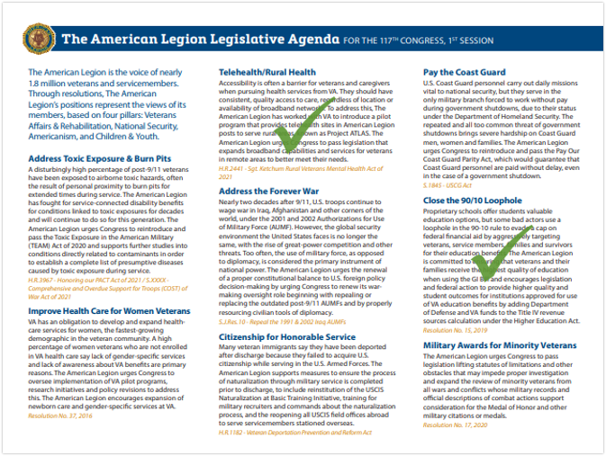
Legislative Agenda and Wins

Slide 5
National Security
Citizenship for Service
H.R. 1182 – Veteran Deportation Prevention and Reform Act – Rep. Takano (D-CA)
S.XX – Naturalization at Training Sites Act of 2021 – Sen. Duckworth (D-IL)

Slide 6
Disability Assistance/Memorial Affairs
Toxic Exposure
H.R. 3967 – Honoring Our PACT Act
Authored by the Chairman of the House Veterans Affairs Committee Rep. Takano (D-CA)
S. 3003 – True COST of War Act
Authored by the Chairman of the Senate Veterans Affairs Committee Sen. Tester (D-MT)

Slide 7
Healthcare
Mental Health
Suicide Prevention (S. 1198)
Peer-to-Peer Support (S. 544, S. 2386, H.R. 1476)
VHA/Miscellaneous
WWII Means Test (S. 1040)
VHA Healthcare Workers (S. 1319, H.R. 1948)
Telehealth
Rural Health (H.R. 2441)

Slide 8
Employment & Education
Education
Guard and Reserve GI Bill Parity Act of 2021 (H.R. 1836)
Homelessness
Building Solutions for Veterans Experiencing Homelessness Act (S. 2172)

Slide 9
One of The American Legion’s strengths is the organization’s ability to mobilize Legionnaires across the country. The ability to mobilize members at the post and department levels was further enhanced during the 1975 spring meeting of the National Executive Committee when American Legion leadership approved Resolution No. 45 establishing the National Legislative Council.
The National Legislative Council is comprised of 535 members – one for each member of Congress. Council members are appointed by the national commander following the recommendations from The American Legion’s departments. Appointments to the council are two years long or until Dec. 31, following the next general election of members of Congress. However, the chairman of the council is appointed annually.
The National Legislative Council is relied upon to reinforce The American Legion's overall legislative efforts, particularly at times when immediate and personal contact with lawmakers is necessary.
Council members receive The American Legion Magazine and consult the Legislative Division webpage at http://www.legion.org/legislative for information on a wide-variety of Legion-supported issues. Council members review these publications thoroughly, paying particular attention to legislative issues addressed and share pertinent information with the assigned lawmaker and his or her professional staff.
National Legislative Council Overview

Slide 10
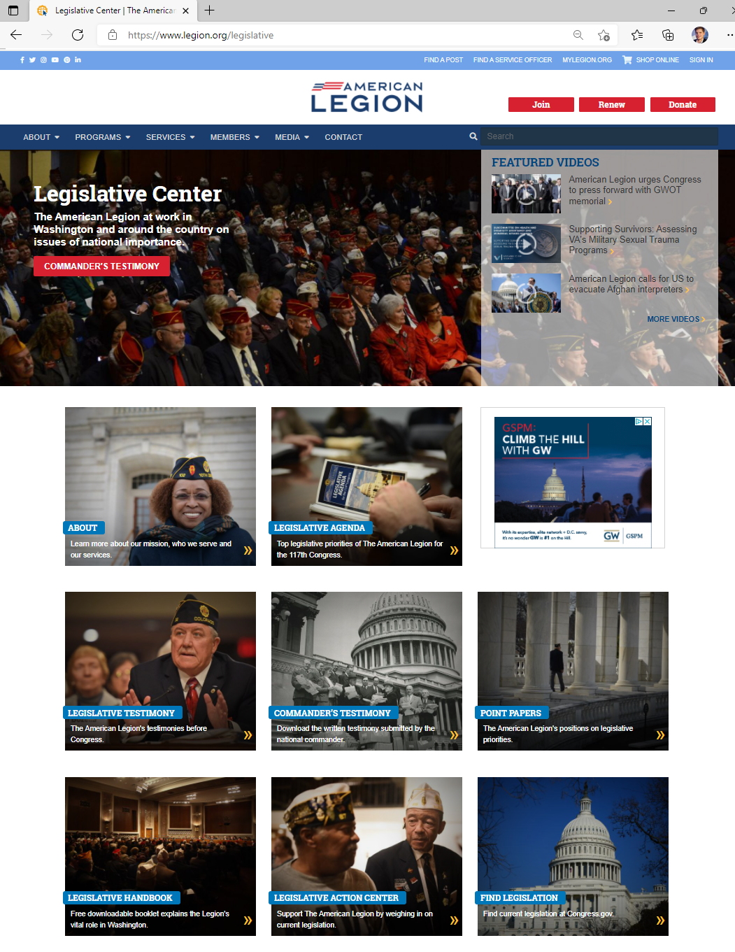
www.legion.org/legislative

Slide 11
Grassroots Overview
The NLD uses VoterVoice as its advocacy platform for connecting American Legion members with members of Congress.
There are currently 30,042 members and supporters signed up to receive action alerts.
NLC Vice Chairs should take active role ensuring NLC participation in action alerts
The American Legion’s VoterVoice page is available at:
https://www.votervoice.net/AmericanLegion/home

Slide 12
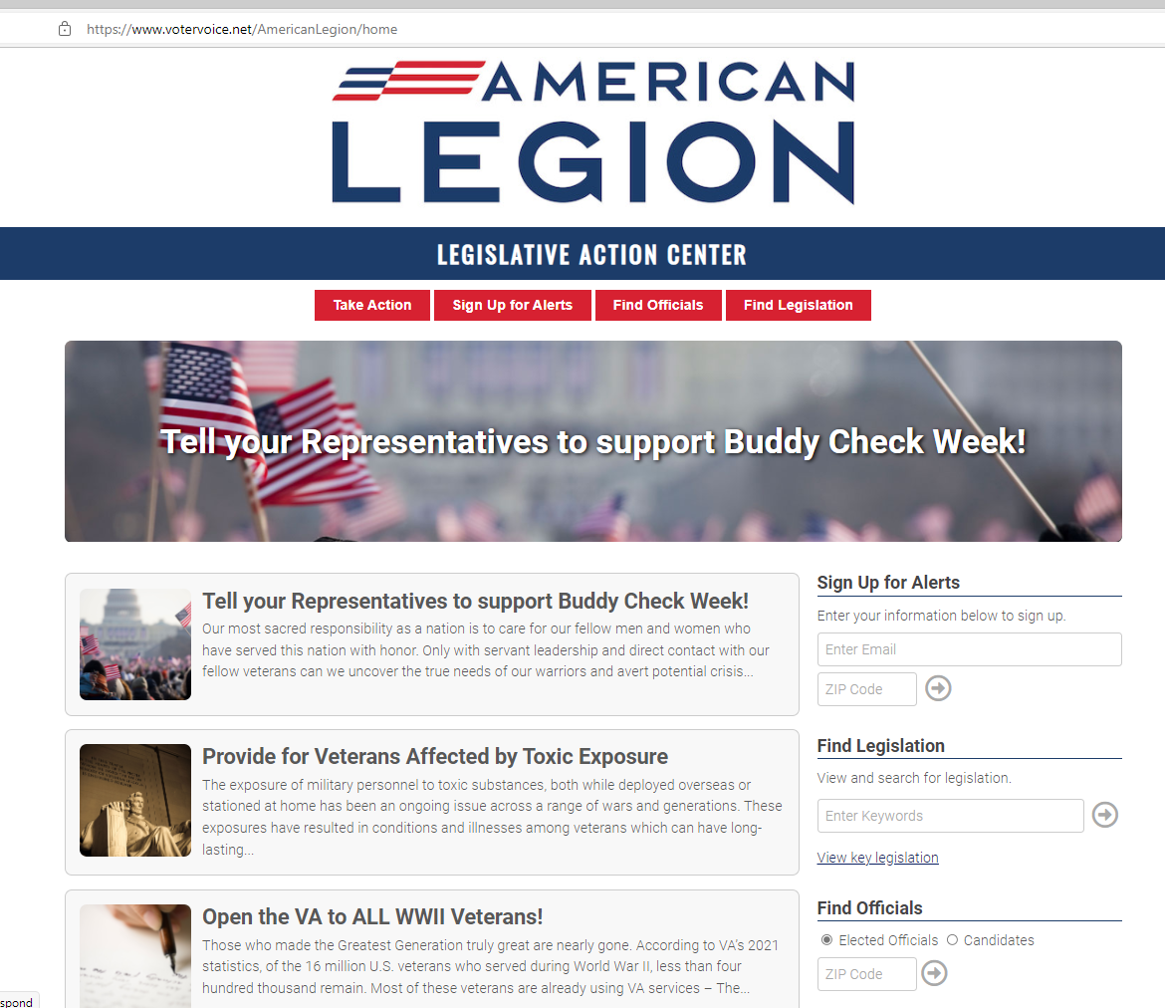
www.votervoice.net/AmericanLegion/home
…or Google American Legion Legislative Action Center

Slide 13
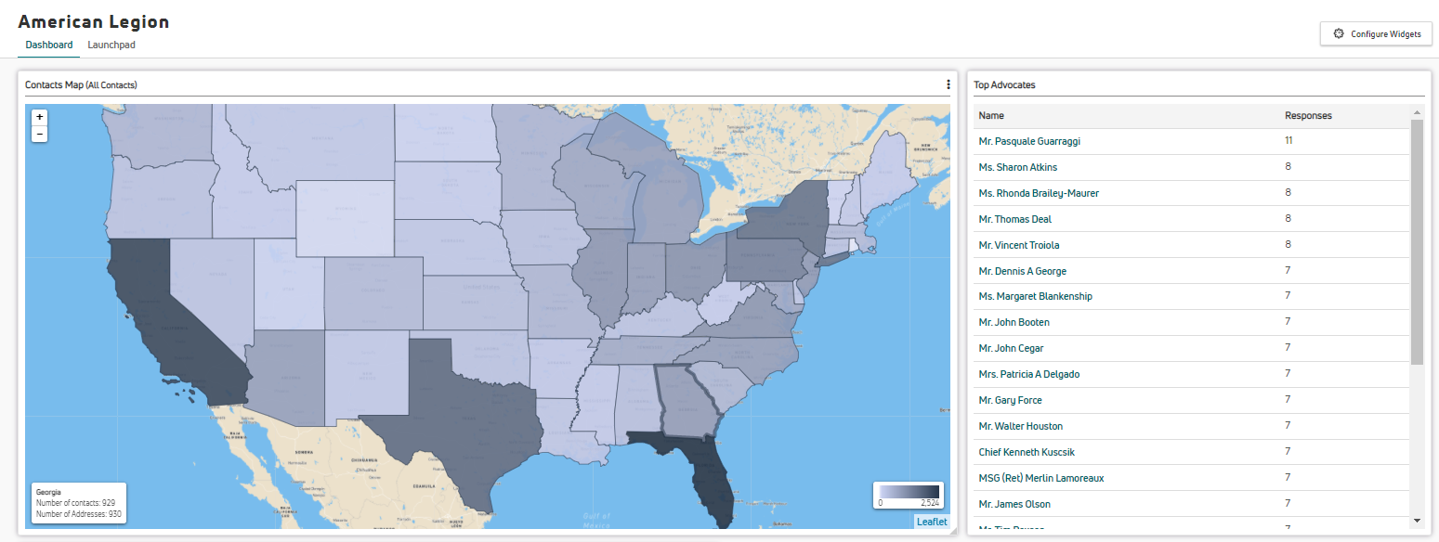
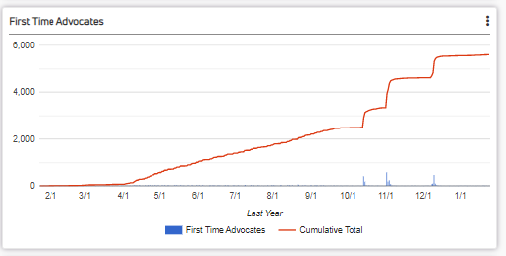
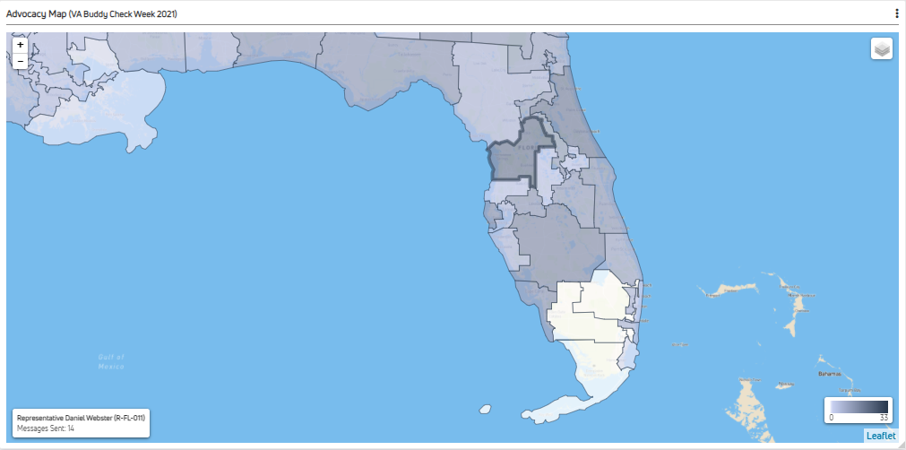
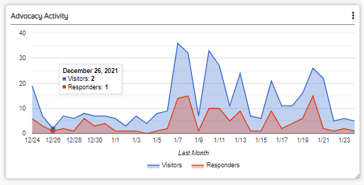

Slide 14
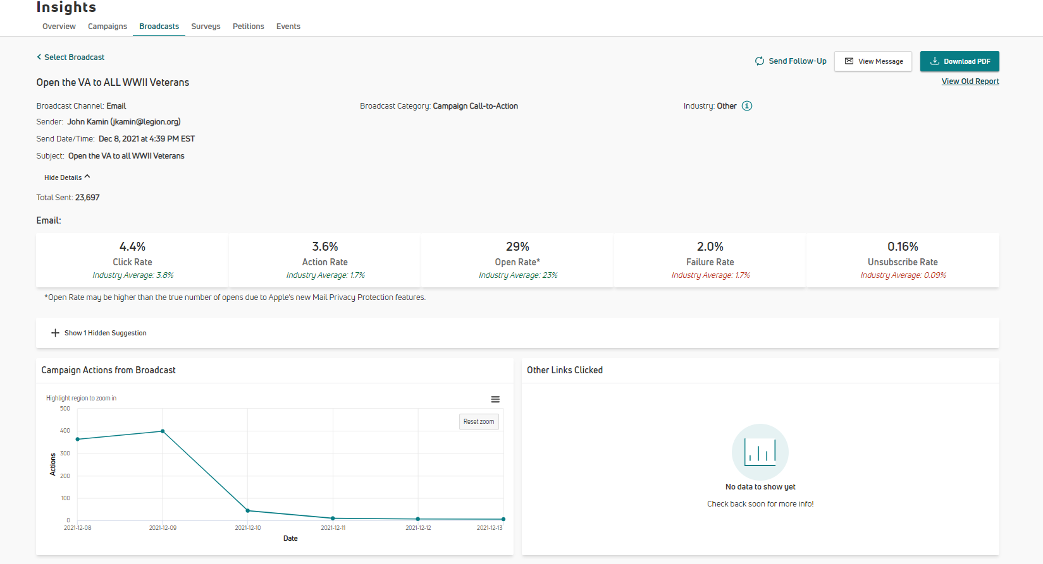

Slide 15
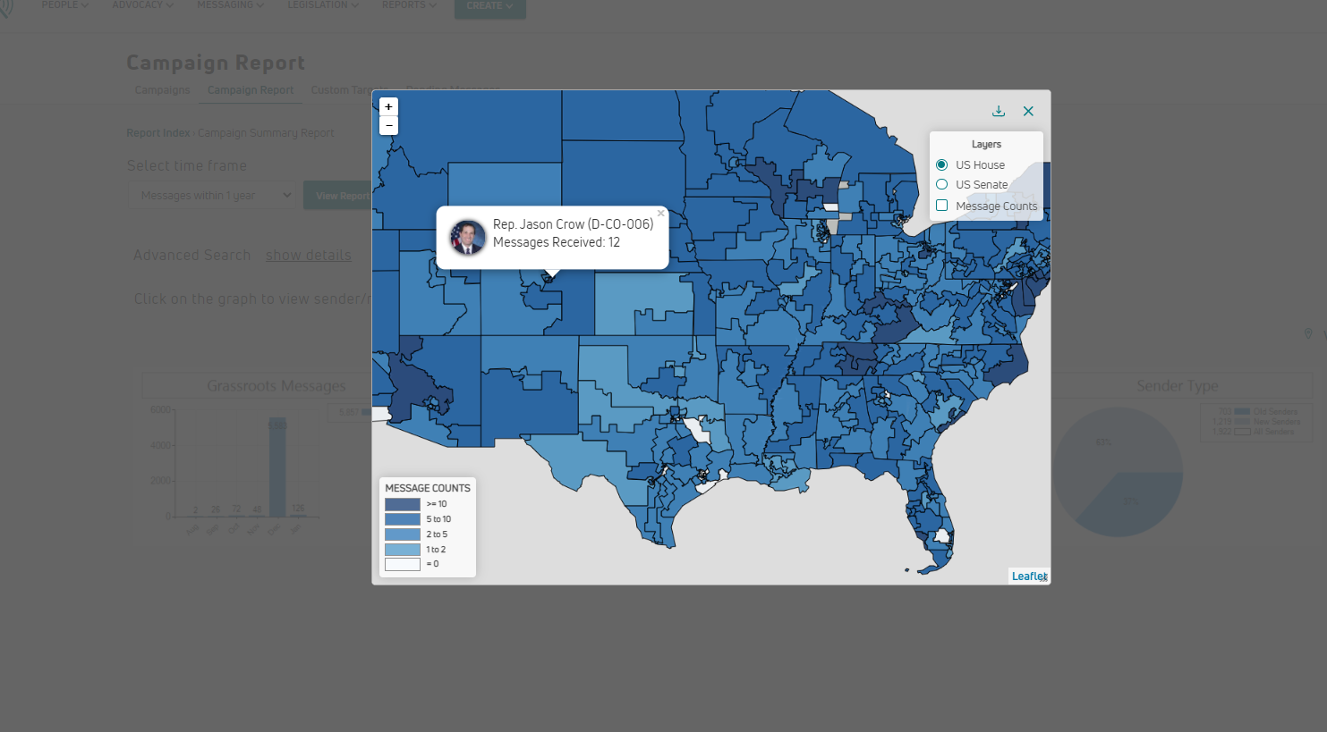

Slide 16
Action Alerts
Call on Congress to save the Troops to Teachers program
Tell your Representatives to support Buddy Check Week!
Open the VA to ALL WWII Veterans!
Total Messages sent: 1,709
Top Activity by States:
New York
California
Florida
Texas
Pennsylvania
Total Messages sent: 2,693
Top Activity by States:
Florida
Ohio
New York
California
Kentucky
Total Messages sent:
2,413
Top Activity by States:
Florida
California
New York
Texas
New Jersey
Total Contacts: 30,042
New Advocates: 3,157
Total Actions: 11,217

Slide 17
Questions
Director, National Legislative Division
Mr. Lawrence Montreuil
Email: lmontreuil@legion.org
Legislative Associate & Grassroots Coordinator
Mr. John Kamin
Email: jkamin@legion.org
Legislative Associate
Ms. Olivia Babine
Email: obabine@legion.org

