Slide 1
MyLegion.org
Manage Groups in MyLegion
April 2022
Notes:
Adjutants and commanders of The American Legion and Sons of the American Legion have access to administrative tools in MyLegion. Through their MyLegion account, adjutants and commanders of posts, squadrons, counties, districts, detachments and departments will have a My Groups area. A group is defined as a Post, Squadron, County, District, Detachment, and Department. Using MyLegion, administrative officers can manage attributes, services, publication tools, and officer materials.

Slide 2
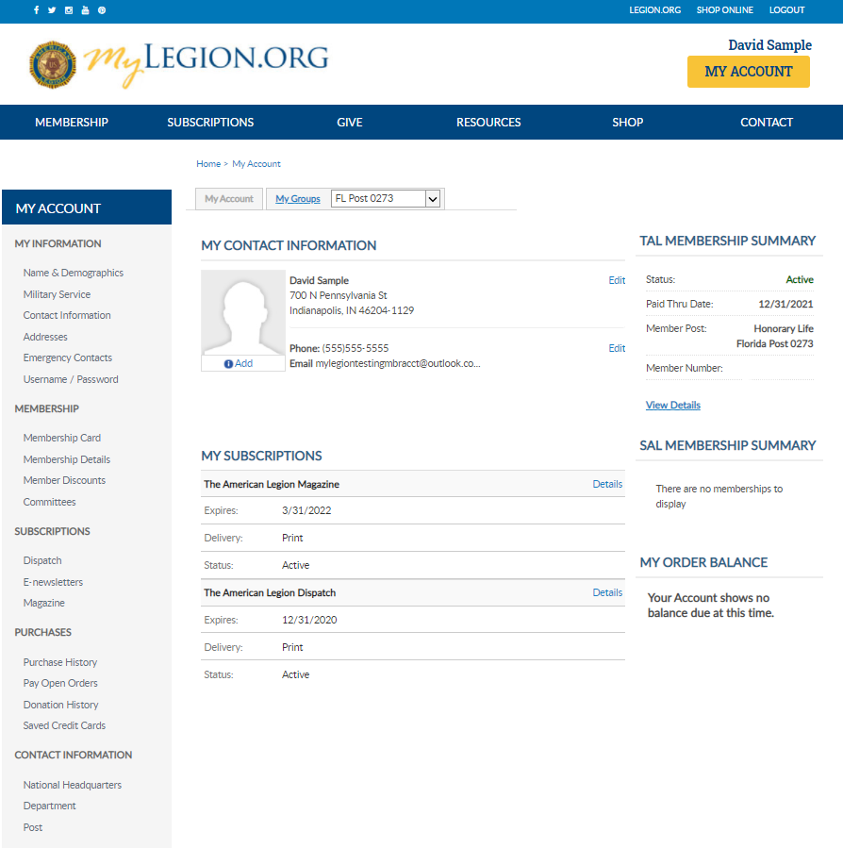
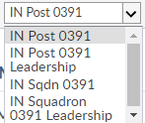
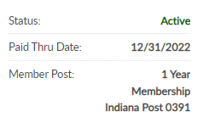
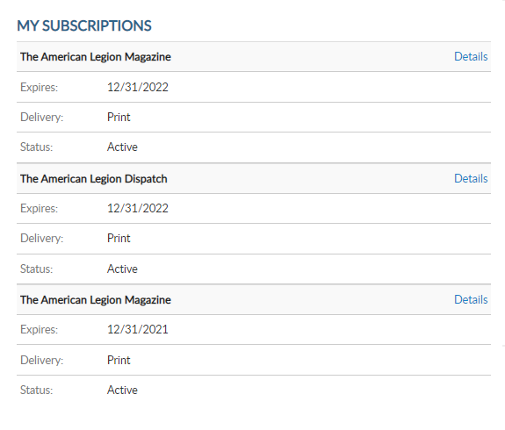
David Sample
123456789
123456789
Notes:
Log into MyLegion and proceed to the My Groups menu. <1>
Post Adjutants and Commanders will have 4 groups. One for the post, post leadership, squadron and squadron leadership. Squadron offices will only have squadron groups, district officers, district groups and county officers, county groups. To view and manage membership, create reports and other administrative tasks, select your group to manage.
Leadership groups lists the officers on file for that group. Officers cannot be updated and are reported through your department headquarters. Leadership groups are view only and not the selection for administrative tools.
To mange your group click on Post or Squadron. <2>

Slide 3
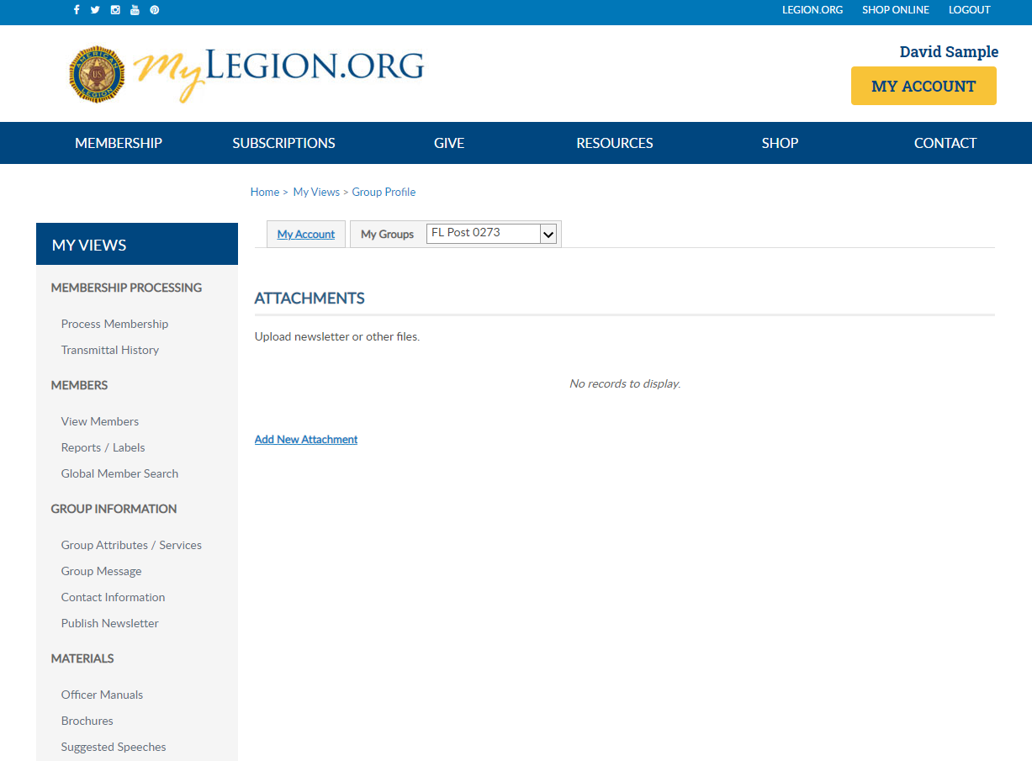
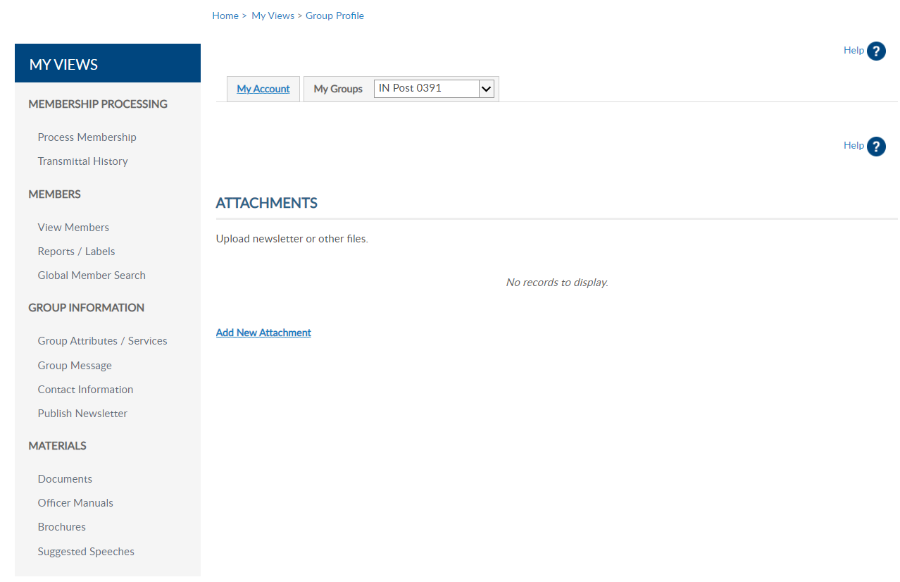
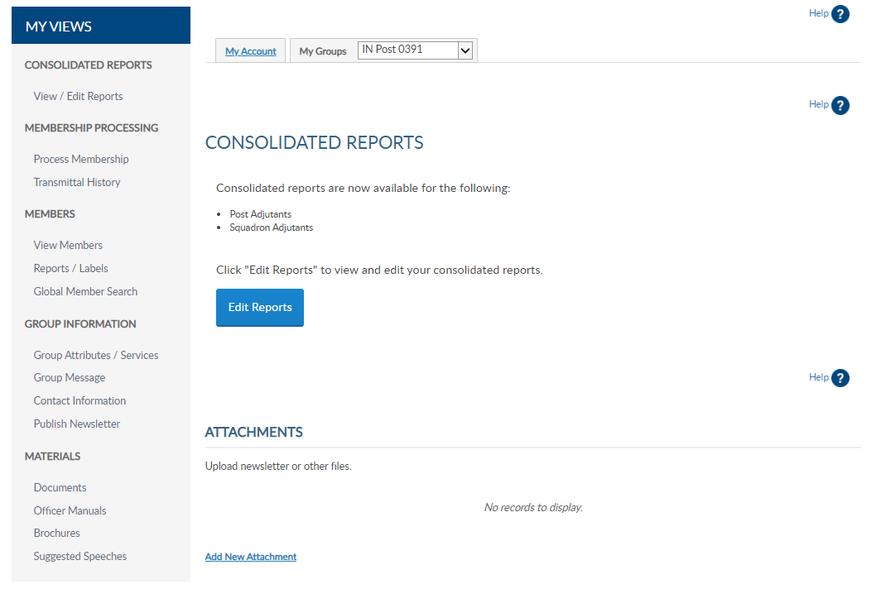
David Sample
Notes:
Selecting the post group takes you to a Group Profile page which is the administrative side of MyLegion. A new left hand “My Views” menu provides tools with a section for Group Information.

Slide 4
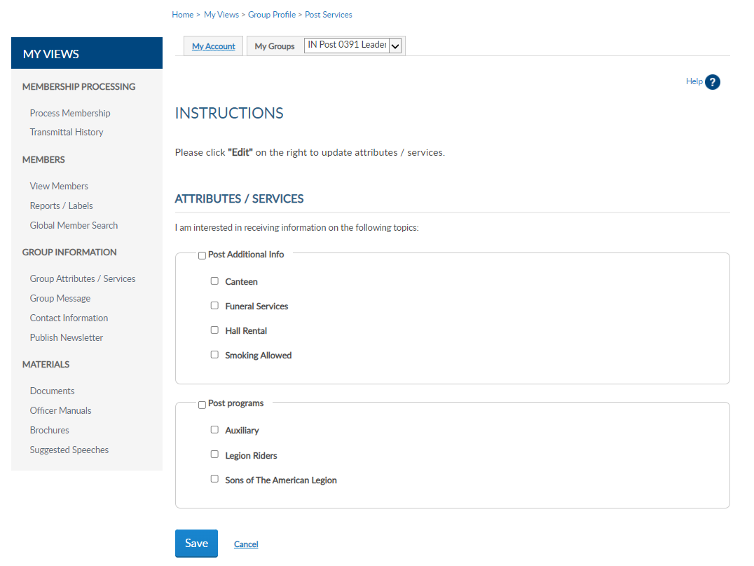
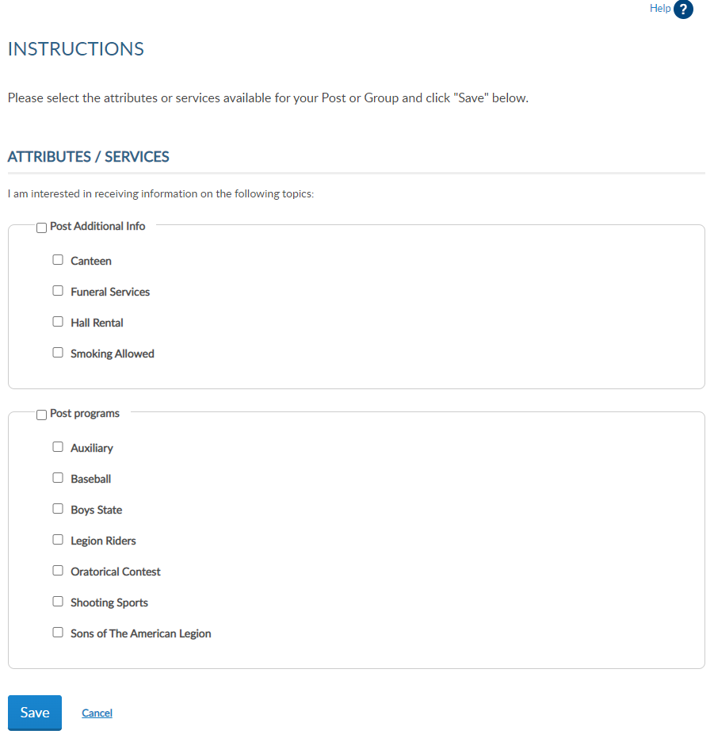
Notes:
Group attributes can assist others interested in The American Legion and Son of the American Legion by providing additional information about your group. This information can be seen through Legion.org Resources find a post tool.
<1> Check the boxes that apply and Save. To remove, simply uncheck the appropriate box and Save.
Updates in Group Information updates within 24 hours.

Slide 5
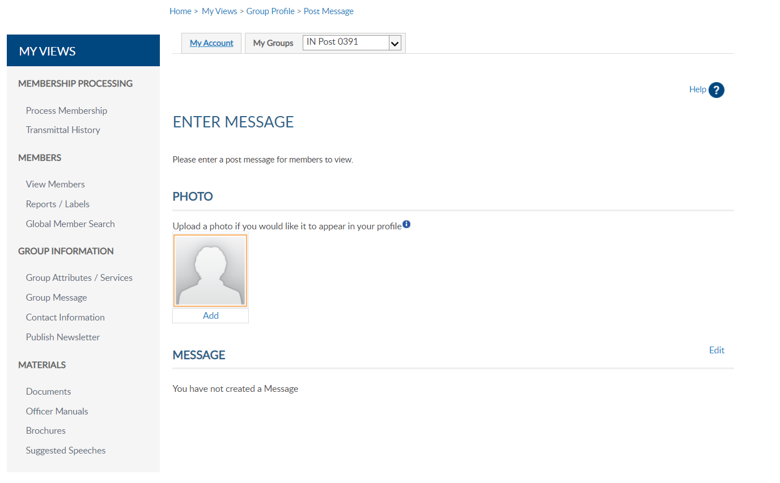
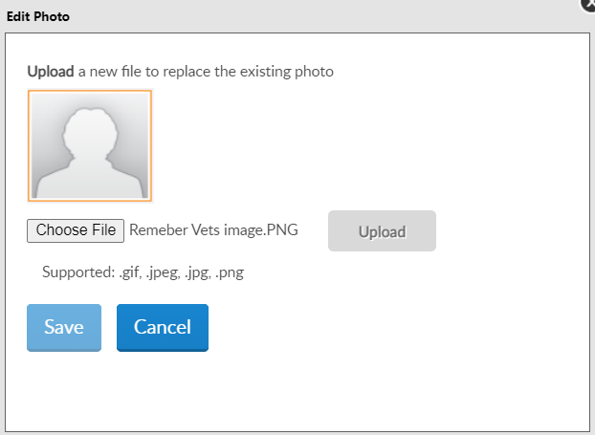
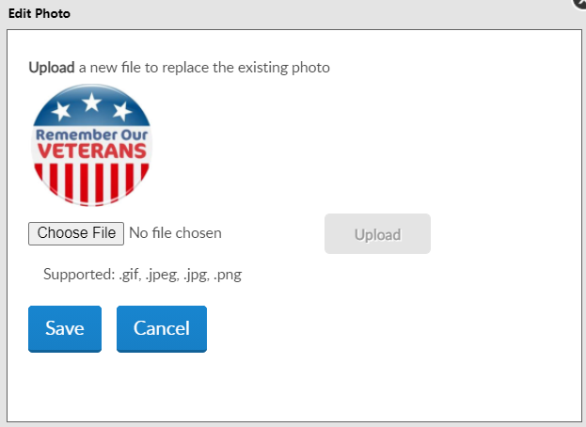
Notes:
Group message includes adding, editing and deleting a message and an image for your group.
<1> Add a photo of your post building, or other image identifying your post. Supported files are gif, jpeg, jpg and png.
Click Add <2>, choose the file and upload. <3> Once an image is added you can delete or replace by uploading a new image to replace it.
To add an image, choose the file and upload.

Slide 6
Notes:
A brief message about meetings, special events or programs your post supports can added to your group information. It is important that if posting a message to keep it current. This message will be published to Legion.org “Find A Post”.
Click Edit to add, update or delete text.

Slide 7
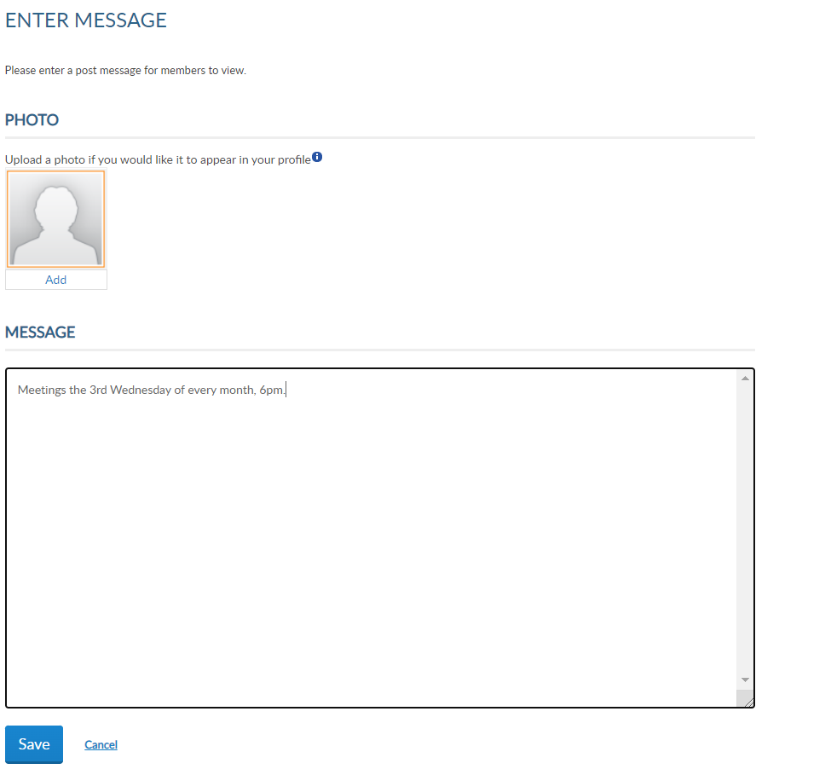
Notes:
Type the message and “save”.

Slide 8
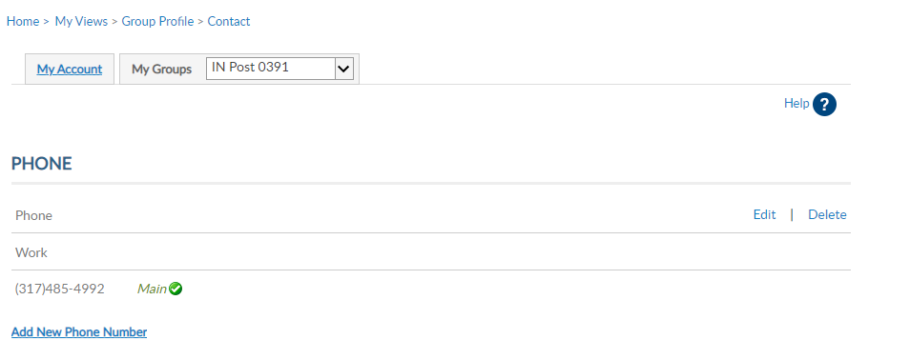
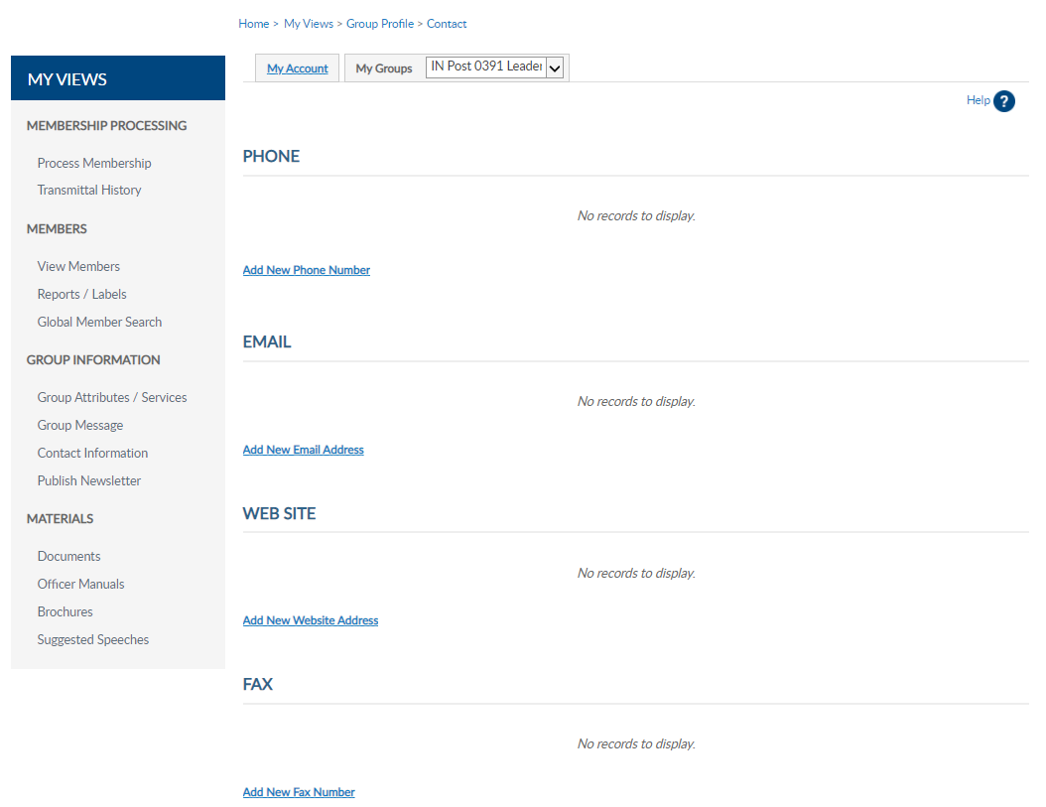
(555) 555-5555
Don’t forget to submit the Annual Post Data Report to Department HQs.
Notes:
Group contact information allows administrators to update contact information including phone, email website and fax. This information can be seen on Legion.org’s Find a Post.
Use the Add, Edit or Delete options to update group contact information.
This does not replace Post Data Reports. In February, the annual Post Data Report is mailed to department headquarters for distribution to posts. Each form is pre-printed with current contact information form National HQ’s data system. This pre-printed form for t he post is sent for annual spring reporting. When there is a change, notify department headquarter. All changes must first go through department headquarters for processing. Any changes received by NHQs directly from a post will be returned with no action taken.(1)
Footnote: Post Adjutant’s Manual 2021

Slide 9
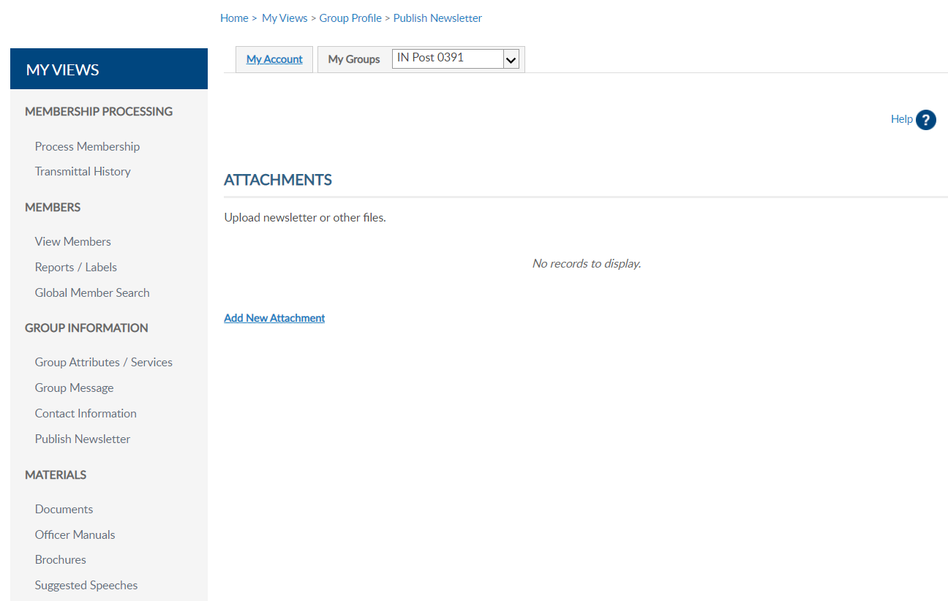
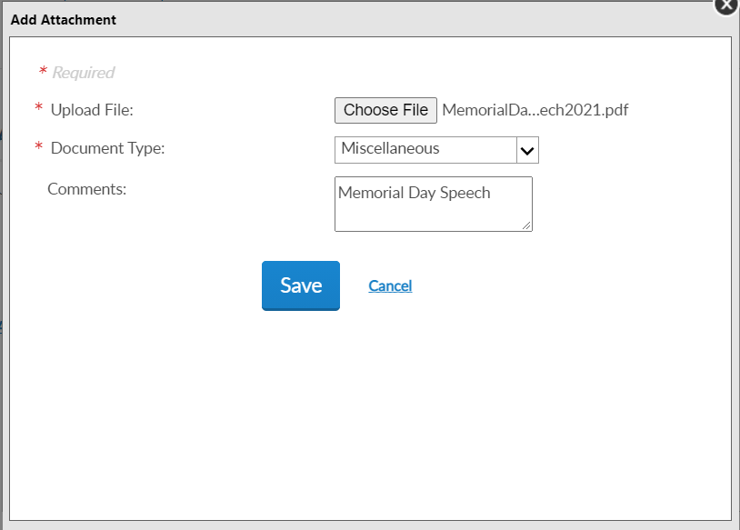
Notes:
Published newsletter allows administrators to publish a newsletter for members of your group.
Attachments uploaded in this area display as the group profile dashboard and multiple attachments can be uploaded.
After creating the document go to Add New Attachment. <1> In the add window choose the file to attach. The document type options include Charter and Miscellaneous.
A brief comment box allows you to make a note about the attachment. Attachment information is displayed on your Group Profile dashboard. You can use this comment to view date or as a reminder when to update or delete. Once all information is entered, click Save.

Slide 10
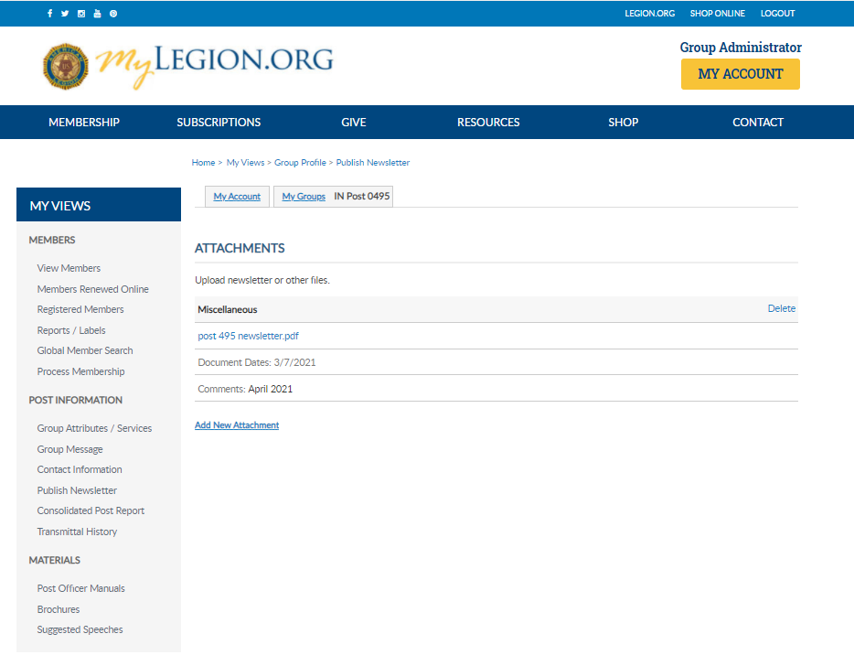
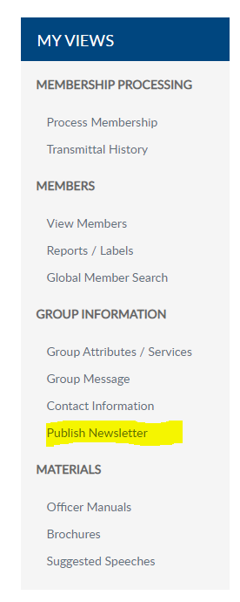
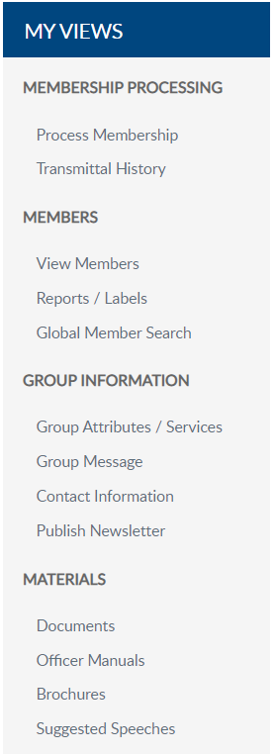
David Sample
Notes:
After saving, attachment information and details can be seen on the group dashboard. When uploading documents online it is important to maintain and keep information current. Delete outdated publications routinely.

Slide 11
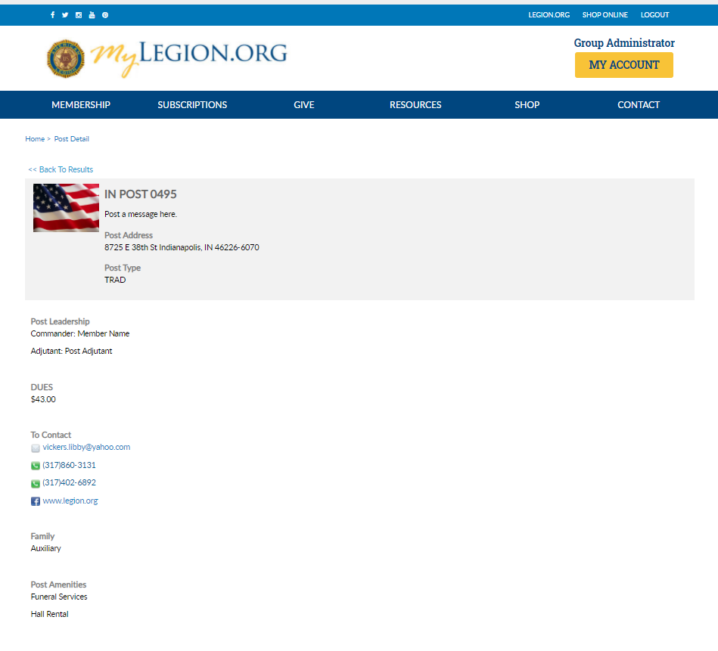
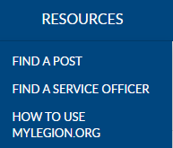
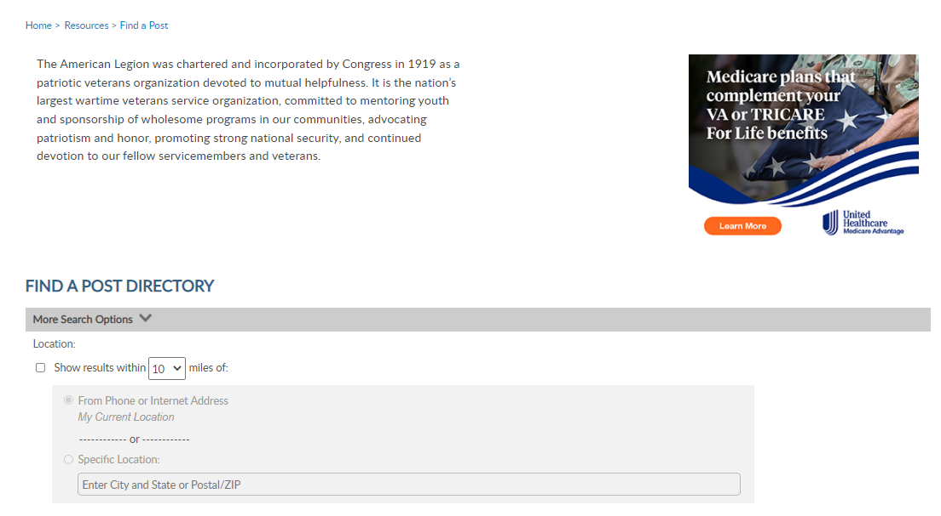
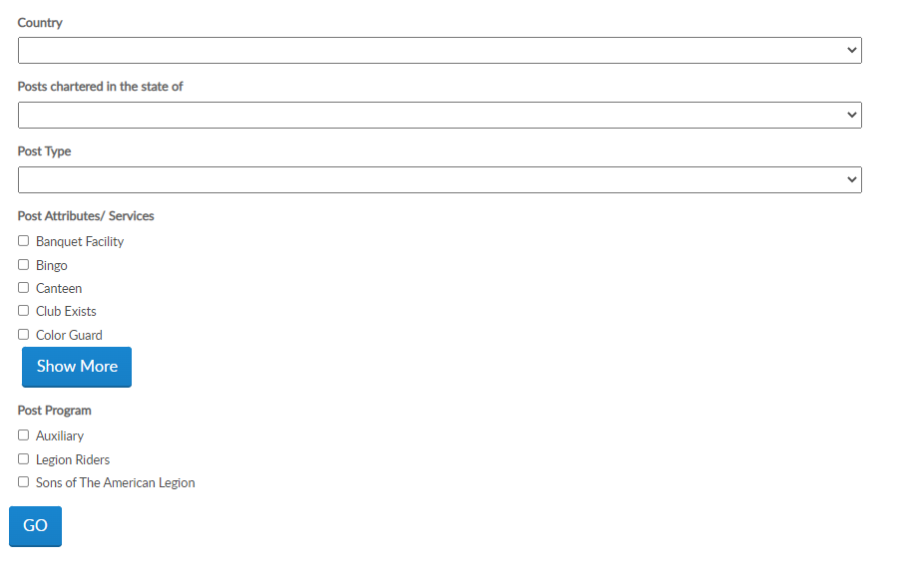
David Sample
Notes:
MyLegion publishing tools are visible in Resources <1> Find A Post accessed through MyLegion and Legion.org. Find a post allows search of a post or squadron by location. <2> Additional search options include country, state, type, attributes, services and programs.

Slide 12
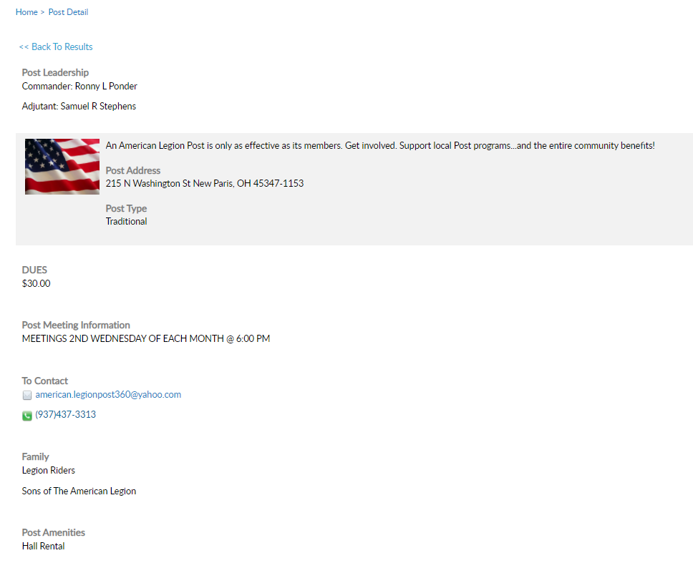
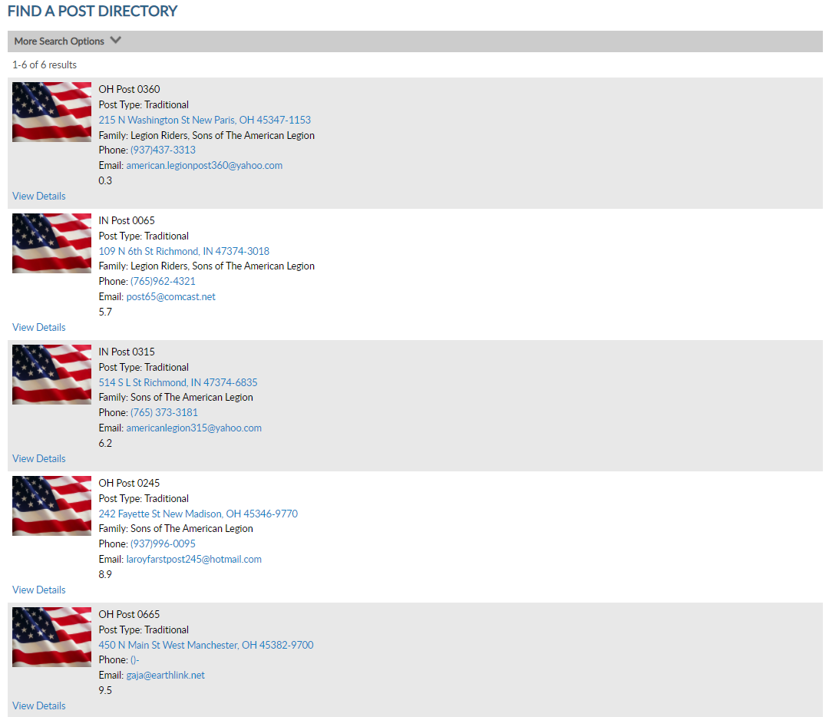
Notes:
The post directory provides group information. View details opens group detail. Images, attributes, services and messages published in My Groups are included in this location.

Slide 13
Officer Materials
Notes:
Officer materials include post, squadron and district manuals, brochures and suggested speeches.

Slide 14
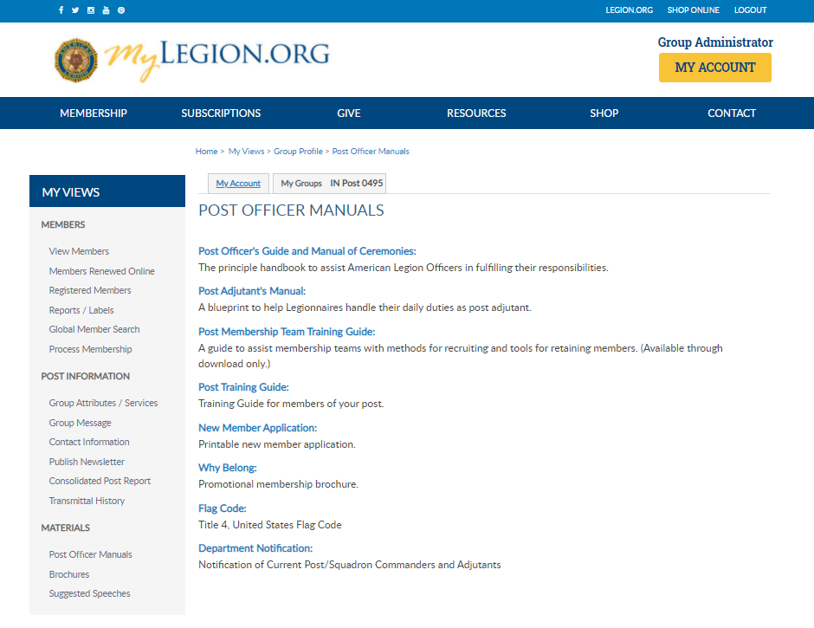
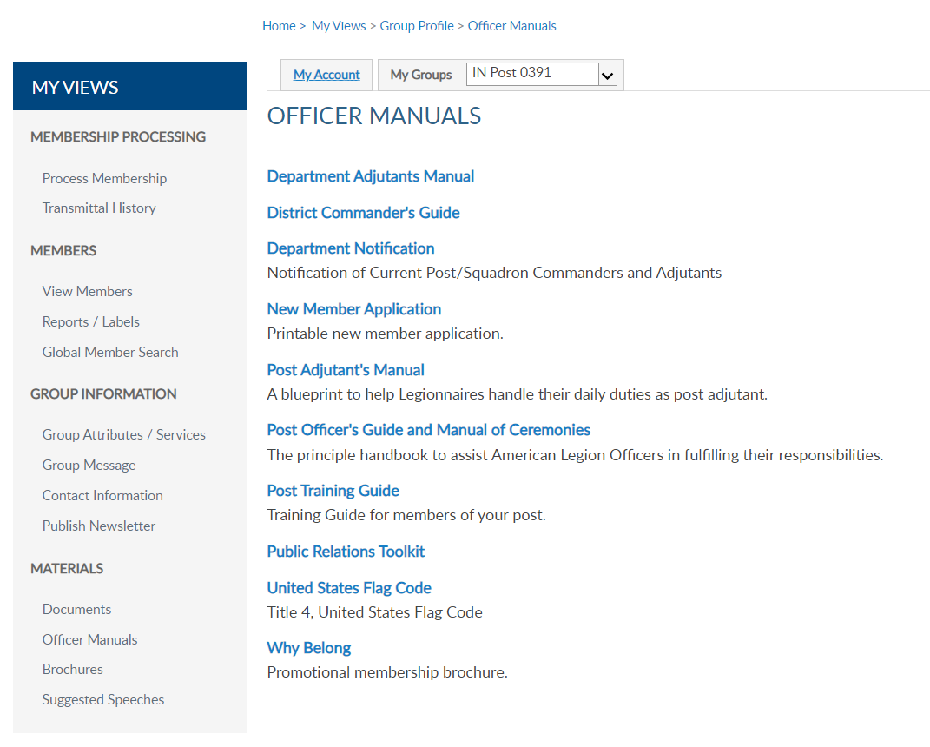
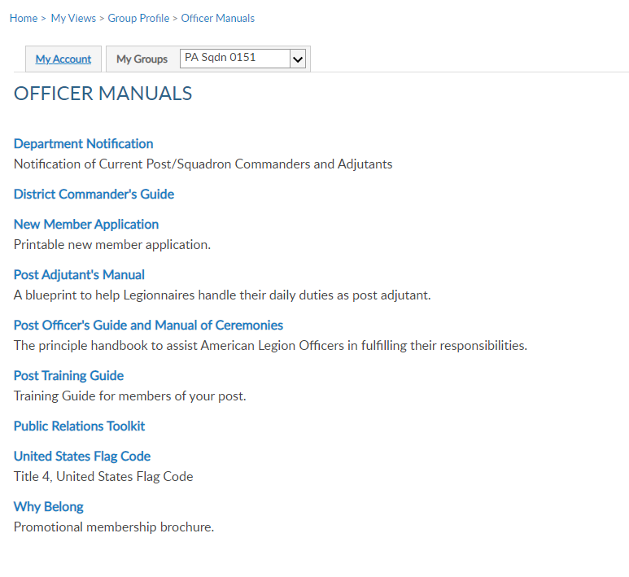
David Sample
Notes:
Select the title to link to publications on Legion.org to download.

Slide 15
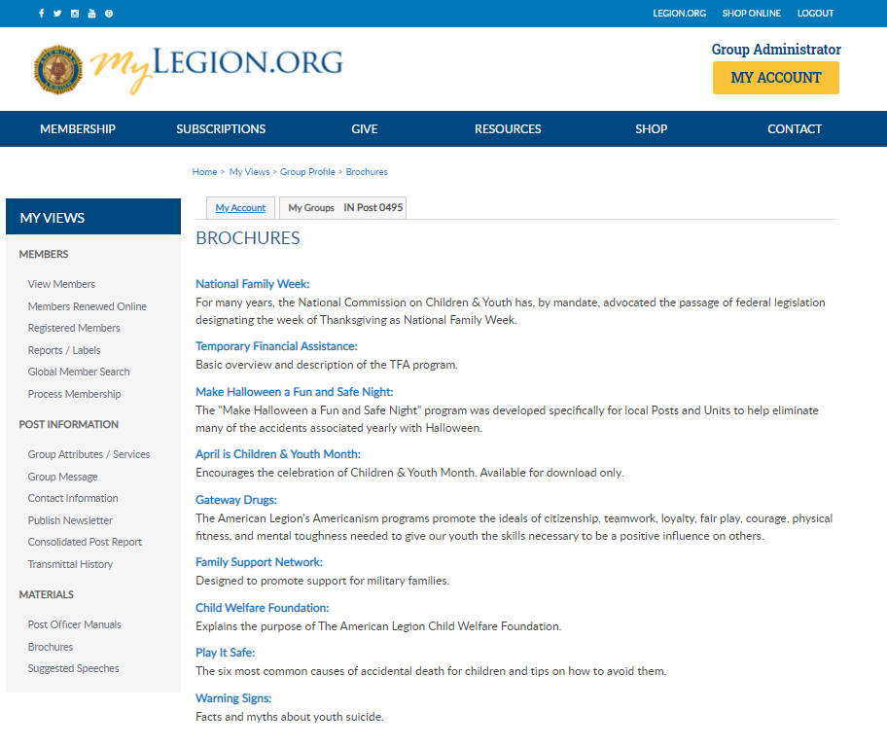
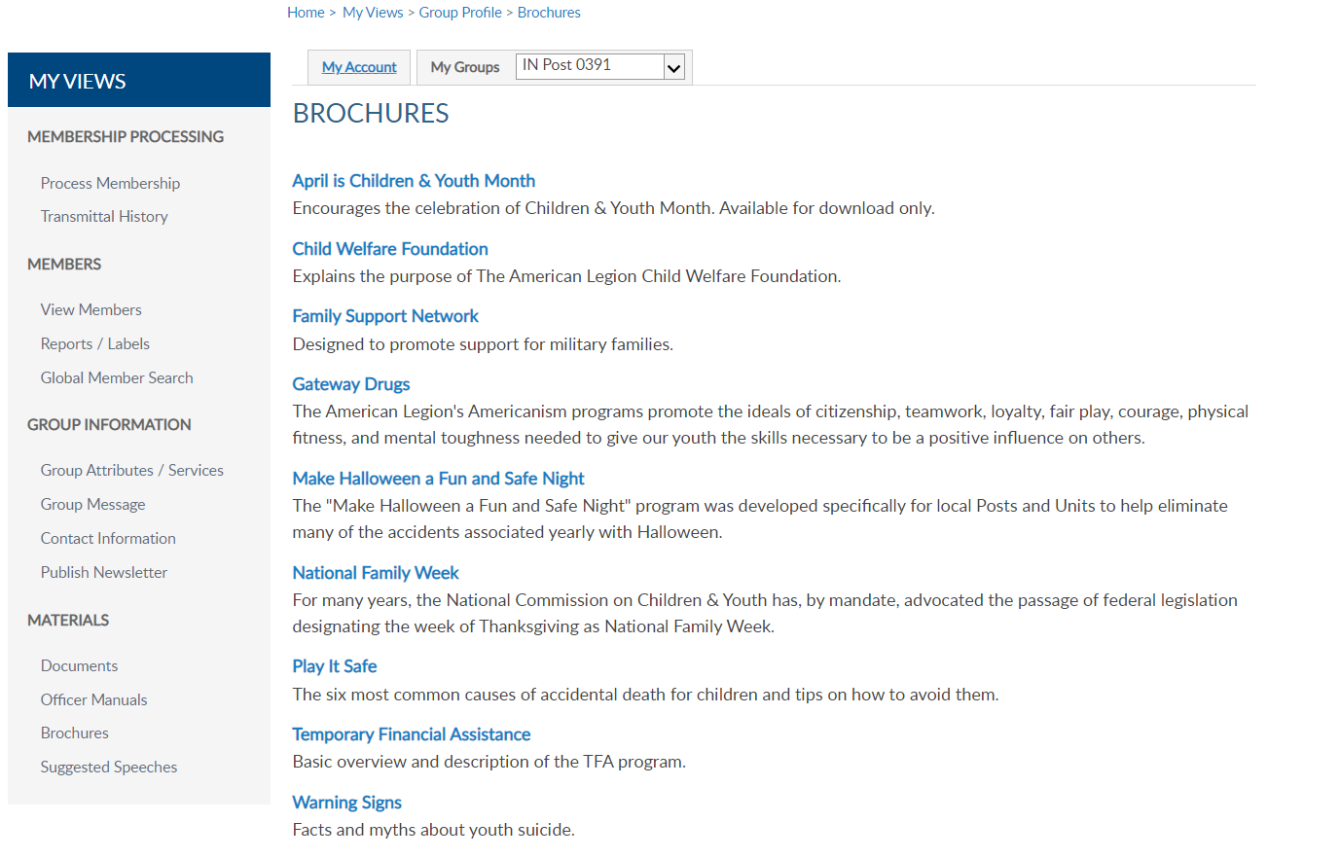
David Sample
Notes:
Brochures are national publications related to Americanism and Children & Youth services.

Slide 16
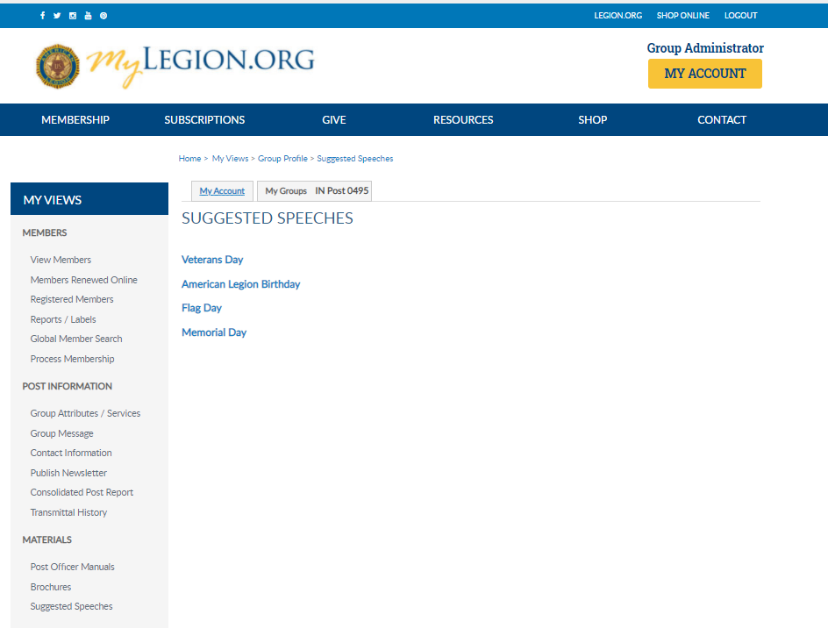
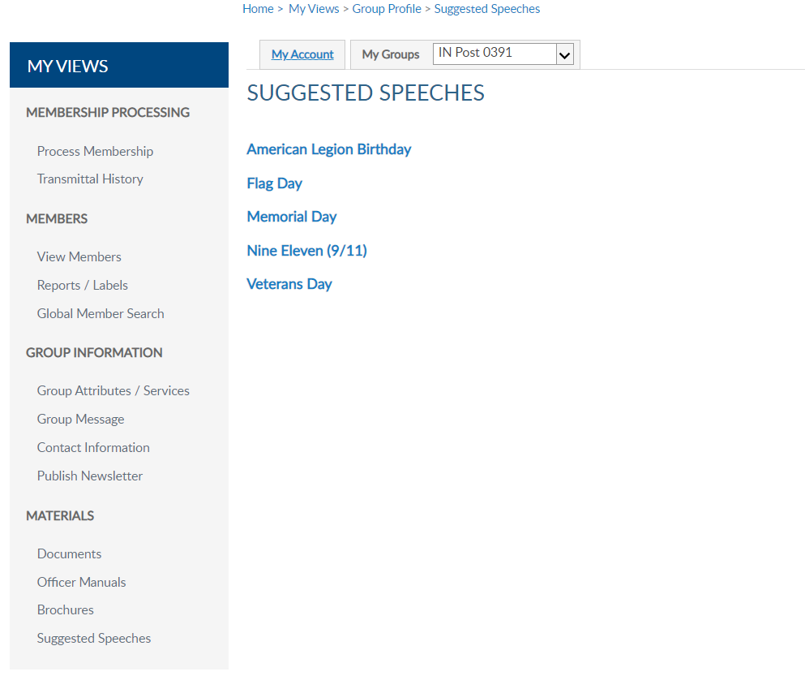
David Sample
Notes:
Every year The American Legion provides speeches to use as a guideline during events and observances. These speeches can be downloaded in the myLegion Group Profile only.
Return to the Group Profile by clicking Group Profile. Return to your account using the MY ACCOUNT button.

Slide 17
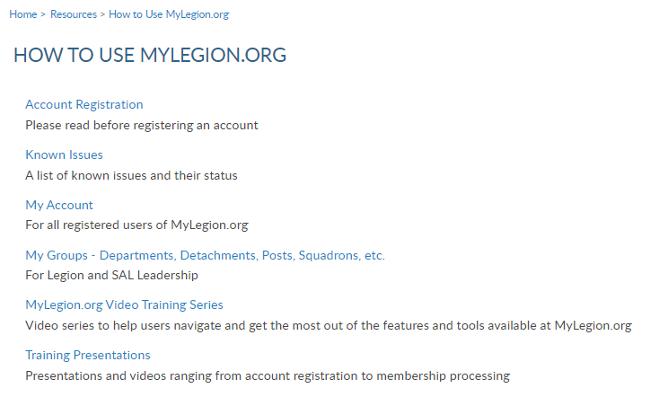
Online Help
Notes:
Online help is available from the Resources Menu.
Step by step instructions, videos and training presentations will assist with how to manage groups in MyLegion.

Slide 18
Email:
mylegion@legion.org
Phone:
833.253.9995
Notes:
Your National support staff is available Monday through Friday, 8-4:30pm Eastern.

