Slide 1


Welcoming New Members
First Impressions Matter

Slide 2




First Impressions
Notes:
Do you remember your first impression of The American Legion? How about the first time you entered a post? This is not limited to entering your own post but, posts in the area or even around the country. There are posts that are well thought out and planned buildings that have a very friendly and inviting environment.
There are also posts that are dark, dreary, and dismal representations of their former selves. An older post may have fallen into dis-repair with problems that have been ignored or for that matter, the post just can’t afford to keep it updated. There are other posts that don’t have a physical building that meet at a community center, restaurant or some other convenient location.
The American Legion has either left a good or bad impression on each of us. Now take a second to consider what a prospective member sees and how they are greeted and treated when they first walk into the doors of a post or attend their first meeting.

Slide 3



How about you?
Notes:
Does this look familiar?
Have you ever been to a post that when you enter, everyone in the building stops what they are doing and stares? How about the first time you attended a meeting? What about being told a chair is “reserved” for someone?
At some locations there are those that feel the chairs occupied by non-veterans should be given up to veterans, thus making someone feel uncomfortable. What would you do?

Slide 4
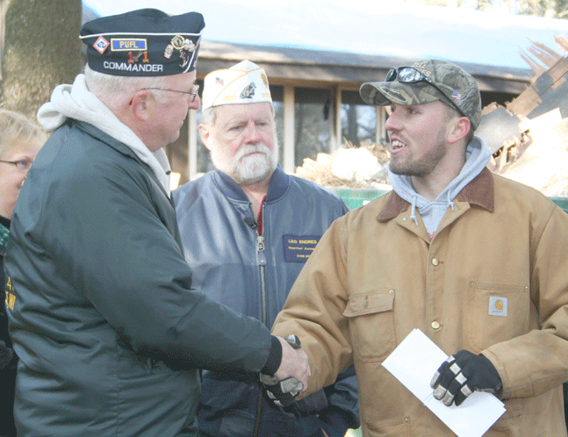
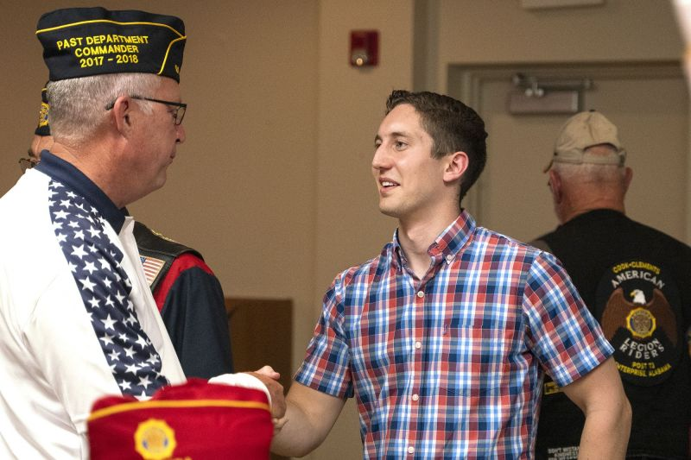
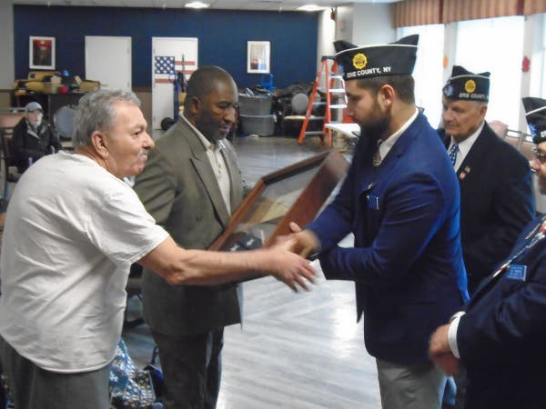
Welcome them
Notes:
The American Legion is not like a franchise type establishment like McDonald’s. There you can park on the right side of the building and always find the restrooms on that side.
Each of our Legion posts are stewards of their own meeting, facility and operations. There is no ability to maintain a franchise like cookie cutter environment however, interacting with prospective or new members can and should be.
Right off the bat we need to welcome that prospective or new member. Make them feel at home! That doesn’t require a hug or handshake but at least acknowledge their presence.
How do you make a first impression if you don’t have a building? (Events, Website, Social Media)
How did your serve? (Veteran, SAL, AUX) Everyone's story is different.

Slide 5
Engage Them
Oratorical
Junior Shooting
Scholarships
Baseball
Flag retirement
Memorial Day program
Scouting programs
Boys State
Youth Cadet Law Enforcement
Baseball
Veterans Day program
Notes:
The best way to garner involvement with a prospective or new member is to engage them. Don’t just tell them about the programs ask them to assist. I challenge you to explain Oratorical without using the word Oratorial. I say that because we are really good at talking to ourselves but imagine that prospective or new member when we talk about Oratorical. After you explain what an Oratorical is, ask that new person to be a judge or time keeper. Sure you may already have a “team” of people but you can always use more. Expose them to a program.
Although I really only brought up Oratorical, I don’t what to insult our intelligence an read all the other programs available. Just know that somewhere out there, someone is interested, you just haven’t asked yet.

Slide 6
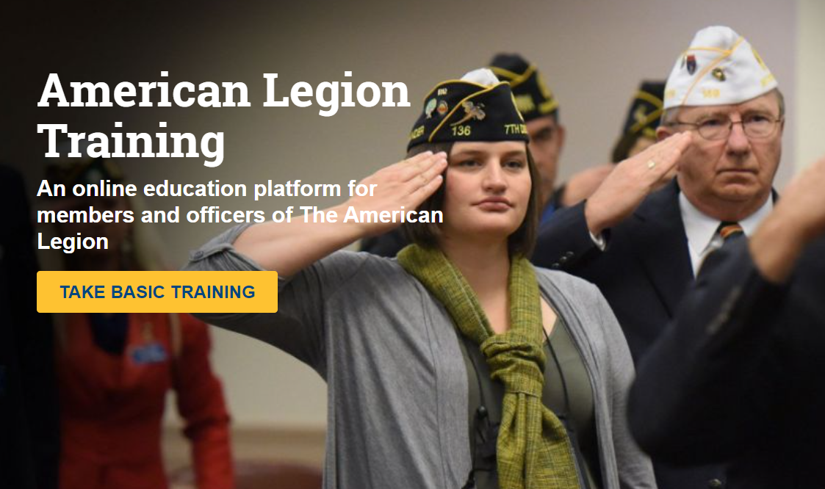
Basic Training
Notes:
How many have taken Basic Training? How do you attract new members if you don’t know that basics?
To assist with training new members there is also the Online Basic Training that was made available for free to all Legion Family members in 2017. It’s had two updates since then – most recently in February of this year. In the past year, 1,640 members have taken the online course.
The class is a fantastic way to educate prospective or new members and it doesn’t cost anything. I’ve taken the class two or three times and I learn something new every time.

Slide 7
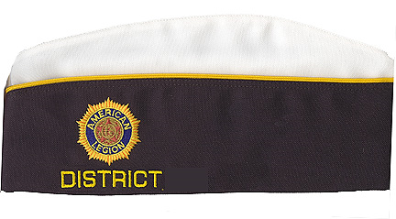
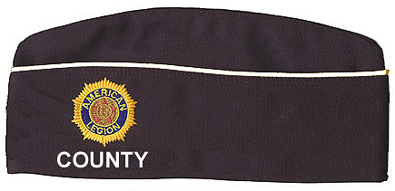
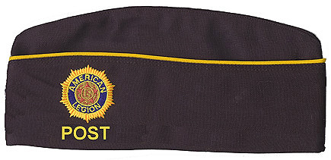
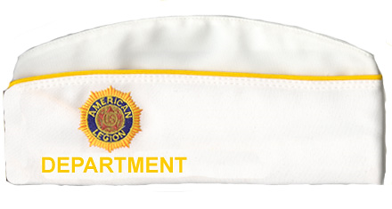
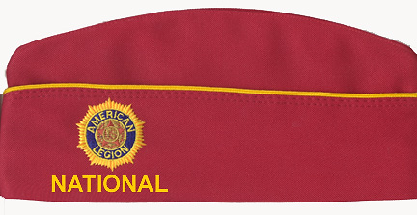
Uniform
Notes:
Take the time to Explain the differences in the colors of the official cap. The more a new member knows, the more empowered they are.

Slide 8
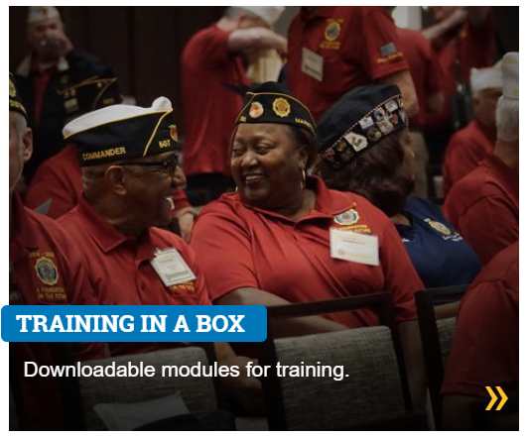
Training in A Box
legion.org/training
Notes:
Ask about training resources on website.
Podcast, Hometown Hero’s, Department Colleges
Since the pandemic, a lot of time was devoted to creating and improving the training modules.
Sixteen complete training modules are available for download via the training webpage covering 35 topics. These include PowerPoints, lesson plans, and any supplemental materials necessary to conduct training at the local level.
Some of these lessons were used during the 2020 Virtual Membership Workshop.
The 2021 Membership Workshop materials and program specific modules will be added as they are developed.
To find them, go to Legion.org/Training and look for Training in a Box.

Slide 9
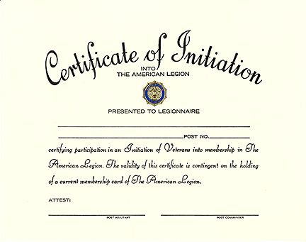
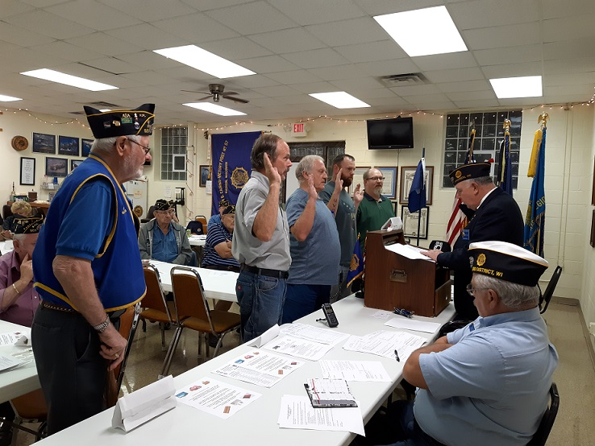
New Member Initiation
Notes:
How many of you have been initiated into the American Legion.
For the sake of time, we have gotten away from some of our time-honored traditions. A great way of letting a new members know they are part of your Post and a viable member of the team. would be to go through the initiation process.
The initiation program is available in the Officers Guide & Manual of Ceremonies.
The regular (longer) version starts on page 50
The shorter version starts on page 54 (In the 2021 version)
The program is also available in the older versions of the Guide.
After installation it is advised that an individual be assigned as their sponsor. That way if they had any questions, they could feel comfortable asking the sponsor. The sponsor should be someone that has an idea of what the Post does and how to contact others in the post. It doesn’t have to be one of the Post officers. Being a sponsor and being involved could also breed future post leadership.

Slide 10
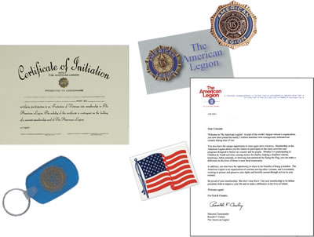
New Member Kit
Welcome letter from the National Commander
Certificate of Initiation
Gold-plated .475" membership lapel tack
American flag window sticker
Legion removable window decal
Legion key ring
Notes:
The New Member kit while trivial is something tangible a member can take home on the day they are accepted into the Post. On the day you were voted in did you get anything? Would it be nice to know you are welcome?

Slide 11
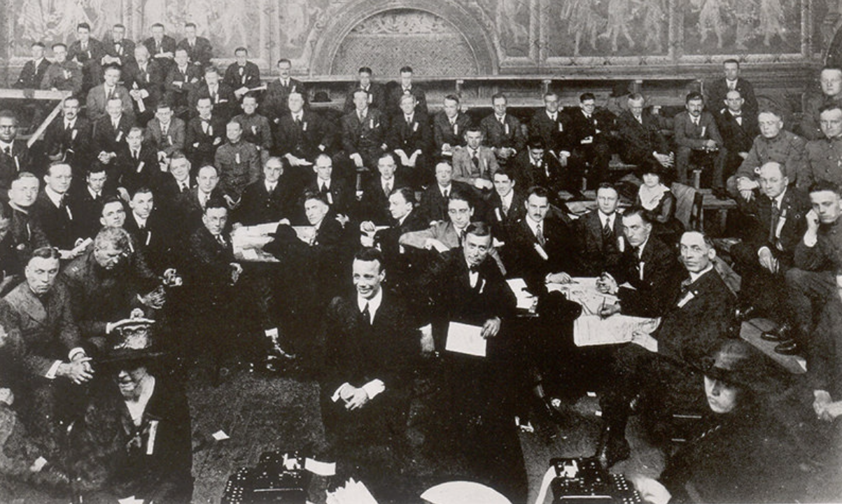
History
Established in 1919
Almost 2 million members strong
Over 12,000 Posts around the world
Instrumental in creation of the GI Bill
Assisted with the creation of the VA
Continued advocate for Veteran rights
Notes:
The text of this slide speaks for it’s self. The American Legion has been around even before it was officially chartered by Congress.
That had to be a humbling experience to be elected as the first national Commander.

Slide 12
Four Pillars
Veterans Affairs & Rehabilitation
Children & Youth
National Security
Americanism
Notes:
Be sure and tell the new member that The American Legion was founded upon four pillars of service in 1919. Today we continue to pledge ourselves to... Our Veterans… Our Youth… A Strong National Defense… And Americanism. These four pillars guide our missions nationally and in our local communities.

Slide 13
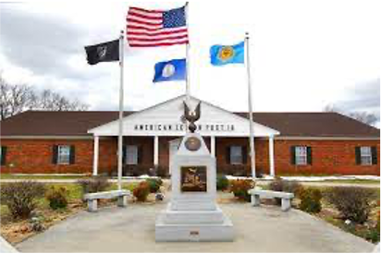
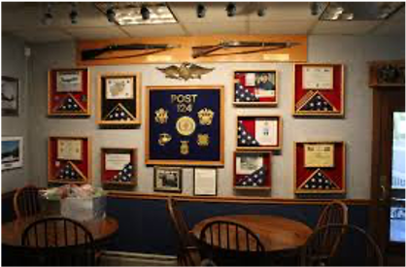
Service
Notes:
Whether you were excited to walk away from a life in the military or were dreading the inevitable (because it’s a young person’s game), is there just something missing since the last time you took your uniform off?
Continuing your service through membership in The American Legion means that you may volunteer to assist with the burial of a fallen hero! It also means that on Memorial Day and Veterans Day, you proudly place flags at the gravesites of our heroes proving that ‘we will never forget.’
Maybe, due to a busy life’s schedule---work and family---you can’t participate in many post activities… but you love that your membership dues go to support programs of The American Legion. And, you know that your membership number has extraordinary value in the sheer size of our Legion that grants the huge voice in D.C.

Slide 14
Communication
First Month:
Call from Post Commander - Email about post activities - Introduction to all post officers and key volunteers - myLegion.org
Second-Third Month:
Commander/Adjutant sit with the member at meetings/events
Invite the new member to participate in post activities
Explain renewal process so member understands the system
Notes:
Welcome Packet. Questionnaire that helps identify a committee to place you on.
Take the time to explain the renewal process. The renewal notes are generated months ahead of time. There may be a chance they will receive a renewal notice. There is a good possibility their payment and that notice crossed each other.
The bottom line is there is a greater chance of capturing the attention of a new member if they are educated, welcome and know what to do next.
Keep them involved
Keep them informed
Call and check on them

Slide 15
RESOURCES
2023 Membership Workshop Dropbox
Use your smartphone camera to scan the code and access the presentations and other documents presented during the workshop.
SCAN THE CODE

Slide 16
Welcoming New Members
First Impressions Matter
Dr Bobbi Kimmel (AZ)
Department Vice Commander, Area B
Ace Tounsel (AZ)
Department Vice Commander, Area A
Any Questions?
Notes:
Do you remember your first impression of The American Legion? How about the first time you entered a post? This is not limited to entering your own post but, posts in the area or even around the country. There are posts that are well thought out and planned buildings that have a very friendly and inviting environment.
There are also posts that are dark, dreary, and dismal representations of their former selves. An older post may have fallen into dis-repair with problems that have been ignored or for that matter, the post just can’t afford to keep it updated. There are other posts that don’t have a physical building that meet at a community center, restaurant or some other convenient location.
The American Legion has either left a good or bad impression on each of us. Now take a second to consider what a prospective member sees and how they are greeted and treated when they first walk into the doors of a post or attend their first meeting.

