Slide 1
RESOLUTIONS
DEPARTMENT OF NEW YORK
DEAN ERCK

Slide 2
RESOLUTIONS AGENDA
IMPACT
WHY
WHAT’S THE USE
HOW
IDEAS
METHOD

Slide 3
RESOLUTIONS WHY

Slide 4
All 3 Families utilize resolutions as a tool.
So do all our programs.

Slide 5
RESOLUTIONS HOW
HOW TO GET PEOPLE TO LISTEN
Many know this importance of this tool. The Consolidated Post Report remains the American Legion’s bag of influence on law makers and elected leaders. Reflects the depth and breadth of our organization’s CONTINUED service to America.

Slide 6
RESOLUTIONS WHY
Honor
People, places, things
Changes
To better serve membership and our programs
Communicates
To different organizational levels
Guides
Government leadership on legislatives issues
Declares
The American Legion position on issues of the day

Slide 7
RESOLUTIONS IDEAS
Whereas, Commander Richard Drake became commander in May of 2011 and has successfully started and maintained a Red Cross Blood program.
Whereas, Commander Drake oversaw the completion of a remodel of the Post's memorial park including a memorial stone program that will continue for years to come.
Whereas, Commander Drake's term included the paying off of Post 904's dining room and kitchen mortgage.
Whereas, Commander Drake's support of the formation of a New Junior Shooting program has become the model for the county on how to start a program.
Whereas, Commander Drake's work in securing many grants for the shooting program has offset costs to Post 904 for support of Junior Shooting Sports.
Whereas, Commander Drake's Executive Committee is also responsible for the finishing construction of the Post home including a shooting range, storage, armory and downstairs restroom.
Whereas, Commander Drake's command has seen a large increase in participants in Boy's State Program, the oratorical contest and other programs with our selections finishing at the highest levels of competition within the American Legion.
Resolved, by John B. Lyman Post 904, the American Legion Department of New York, in regular membership meeting assembled in Post 904 on March 16th, 2016
Commander Richard Drake is recognized for his outstanding efforts supporting the mission of Post 904 and the American Legion.

Slide 8
RESOLUTIONS IDEAS
Whereas, Vice Commander Beers became Vice Commander in May of 2011, and has served for the entirety of Commader's Drake tenure.
Whereas, Vice Commander Beers was part of the completion of a remodel of the Post's memorial park including a memorial stone program that will continue for years to come.
Whereas, Vice Commander Beers advocacy to payoff of Post 904's dining room and kitchen mortgage was a driving force for its accomplishment.
Whereas, Commander Drake and Vice Commander Beer's Executive Committee is also responsible for the finishing construction of the Post home including a shooting range, storage, armory and downstairs restroom.
Whereas, Commander Drake and Vice Commander Beers has seen a large increase in participants in Boy's State Program, the oratorical contest and other programs with our selections finishing at the highest levels of competition within the American Legion.
Resolved, by John B. Lyman Post 904, the American Legion Department of New York, in regular membership meeting assembled in Post 904 on March 16th, 2016 Vice Commander Paul Beers is recognized for his outstanding efforts supporting the mission of Post 904 and the American Legion.

Slide 9
RESOLUTIONS IDEAS
Whereas, Paul Sherbino is a 25-year continuous member of The American Legion and a member of Son’s of The American Legion Squadron 904 for 21 years; and
Whereas, Paul Sherbino has demonstrated great leadership for Post 904 serving as an officer, chairing committees and completing projects that support the American Legion Family, Post 904, the community and the 4-pillars of The American Legion; and
Whereas, Paul Sherbino has served with distinction as SAL Advisor for many years and has helped Squadron 904 achieve recognition for their achievements and dedication to their support of The American Legion, The Son’s of The American Legion and all the programs of The American Legion Family; and
Whereas, Paul Sherbino has helped Squadron 904 make their membership goals, (DECADES) achieving both State and National recognition for their efforts; and
Whereas, Post 904 Executive Committees and many Commanders have relied on Paul’s ability to speak to the ENTIRE American Legion family to foster cooperation, understanding and resolution to any problem or help with mission; and
Whereas, the community has benefited from Paul’s efforts to support many programs but to also bring NEW things to enjoy that invoke pride and instill Americanism. Banner Programs, Veteran’s Day celebrations, new scholarships, children & youth and the Cranberry Creek Battlefield projects succeed because of Paul’s ability to bring the post family, community and government entities together; and
Whereas, Post 904 Legion FAMILY membership view Paul Sherbino with the highest esteem, greatest respect and sincerest love reserved for leaders of the Post family; there for, be it,
Resolved, by John B. Lyman American Legion Post 904, in a special meeting of on May 17th 2023, witnessed by Officers and members of The American Legion, The American Legion Auxiliary and Son’s of The American Legion be it known that Paul Sherbino is recognized as an Honorary Post 904 Commander of John B. Lyman American Legion Post 904.

Slide 10
RESOLUTIONS IDEAS
POST, UNIT, SQUADRON LEVEL
Whereas, Comrade Richard Kavanaugh is a WW II veteran who served our Country in the United States Navy,
Whereas, Comrade Richard Kavanaugh has been a member of John B. Lyman Post 904 in Alexandria Bay, NY for over 50 years,
Whereas, Comrade Richard Kavanaugh served on the Post executive committee for decades in every officer billet except Commander, including over a decade as Post Adjutant
Whereas, Comrade Richard Kavanaugh still attends American Legion birthday dinners, Memorial Day parades, Veteran’s Day and supports Post operations. Be it therefore
Resolved on this Day April 18th, 2018 at a post membership meeting of John B. Lyman Post 904 in Alexandria Bay, NY the membership bestows the title Honorary Post Commander and will be referred to as a Past Post Commander

Slide 11
RESOLUTIONS IDEAS
COMMUNITY RECOGNITION
Whereas, Army Navy American Legion Post 61 needed a partner in Watertown to be able to conduct an American Legion Post/School Oratorical contest, and
Whereas, Immaculate Heart School (IHC), agreed to promote, support, and encourage their students to participate in the Post 61, American Legion Oratorical Contest, and
Whereas, Mr. William Dulmage a teacher at IHC worked with Post 61 Oratorical Chairman Bill Flynn and the Post 61 Oratorical committee to inform, support, coach and recruit students to participate in the American Legion Post/School Oratorical contest, and
Whereas, those students were awarded prizes, and the opportunity to participate in the Jefferson County American Legion Oratorical contest, and
Whereas, Katherine Probst and Magdelana Johnson finished 1st and 2nd and were awarded cash prizes and the opportunity to participate in Fifth District American Legion Contest, and
Whereas, those students finished 1st and 2nd and were awarded prizes and the opportunity to represent the Fifth District in the Zone level of The American Legion Oratorical contest, and
Whereas, IHC stepped in and agreed to host the Fifth District American Legion Oratorical contest at IHC to allow these busy students the opportunity to participate and represent the Fifth District, be it
Resolved, Mr. William Dulmage, the IHC Faculty, Staff and School Board are recognized for their support of students seeking opportunities and willingness to step in and make sure those opportunities are available, and be it further
Resolved, by membership of Army Navy American Legion Post 61, at membership meeting on February 21, 2023, we thank IHC for its outstanding service to its students, the community, and America.
Post Adjutant Dave Vandermark Commander Wayne Sibley

Slide 12
RESOLUTIONS IDEAS
COMMUNITY RECOGNITION
Whereas, WWNY Channel 7 News Anchor Jeff Cole participated in the Honor Flight Syracuse Mission #6, which departed for Washington, DC on Saturday, October 3, 2015 with Jefferson County WWIT Veterans.
Whereas, Mr. Cole interviewed the veterans prior to the flight capturing their personal stories, accompanied them on the entire trip providing interviews the morning of departure, during the flight and the during visit to Washington D.C. t the places of memorial.
Whereas, this coverage and the homecoming events in Syracuse became a WPB special, documentary, Public Eye, also hosted by Jeff Cole which was broadcaste on Veteran's Day, 11/11/15.
Whereas, the experience for these veterans was a fitting tribute to their service to the United States of America and its importance was conveyed to the citizens and veterans because of Jeff Cole's efforts to share our mission of Americanism.
RESOLVED, by Jefferson County, the American Legion Department of New York, ir regular meeting assembled in John B. Lyman Post 904, Alexandria Bay, New York on April 7th, 2016 that Jeff Cole is recognized for his outstanding work and great effort supporting two of the four pillars of the American Legion, Americanism and service to our veterans.

Slide 13
RESOLUTIONS IDEAS
COMMUNICATE
LEADERSHIP TO MEMBERSHIP
MEMBERSHIP TO LEADERSHIP
Whereas, The American Legion Boys State executive board of directors, authorized the use of cell phones by the citizens during the Boys State program, and Whereas, the citizens of Boys State need to understand the rules for cell phone use, and Whereas, the understanding of Boys State counselors and staff of the rules for cell phone use is inconsistent, and Whereas, a written policy has not been provided to the citizens or counselors, and Whereas, some citizens were told by their American Legion County Boys State chairman that Cell Phone use by citizens, was not allowed at Boys State, then Be it resolved, by the citizens of American Legion Boys State held at Morrisville college on June 25 through June 30, 2023 that a policy is to be written and adopted by The American Legion and the Boys State executive board directors for Cell Phone use, and further Be it resolved, that the policy be communicated to both the American Legion County Boys State chairmen and communicated to the incoming Boys State citizens, and further Be it resolved, that that policy be also included in the Boys State citizens handbook for uniform understanding of both the citizens and the counselors of future Boys State programs

Slide 14
RESOLUTIONS IDEAS
SHARE AND SOCIALIZE NEW IDEAS
WHERE AS, By Post 904, The American Legion, Department of New York, in regular meeting assembled in John B. Lyman Post, Alexandria Bay, New York April 18th, 2015 recognizes that an automated external defibrillator or (AED) is a life saving device that automatically diagnoses the life-threatening cardiac arrhythmias of ventricular fibrillation and ventricular tachycardia in a patient, is able to treat them through defibrillation, the application of electrical therapy which stops the arrhythmia, allowing the heart to reestablish an effective rhythm. And
WHERE AS, that (AED)s are being placed in buildings and public spaces throughout the nation and are required in many due to proven success in saving lives. And
WHERE AS, availability and access to an AED, can factor into the possibility of success saving a life. And
WHERE AS, AEDs are simple to use with little or no training and are covered un
Good Samaritan protection laws. And
WHERE AS, American Legion, American Legion Auxiliary, Sons of the American Legion members and many civic groups, youth groups and scout troops use our post home may come to need an ABD in an emergency. Now, therefore be it
RESOLVED, that the American Legion, Department of New York in convention assembled July 14, 15, 16 in Binghamton, New York encourage all American Legion Posts in the Departmentto locate an AED in their Posts, and be finally
RESOLVED that the American Legion, Department of New York support and promote any fund raising efforts to help cover the cost of, maintenance of, AED': in their Post homes.

Slide 15
RESOLUTIONS IDEAS
SHARE AND SOCIALIZE NEW IDEAS
WHERE AS, By Post 904, The American Legion, Department of New York, in regular meeting assembled in John B. Lyman Post, Alexandria Bay, New York April 18th, 2015 recognizes that an automated external defibrillator or (AED) is a life saving device that automatically diagnoses the life-threatening cardiac arrhythmias of ventricular fibrillation and ventricular tachycardia in a patient, is able to treat them through defibrillation, the application of electrical therapy which stops the arrhythmia, allowing the heart to reestablish an effective rhythm. And
WHERE AS, that (AED)s are being placed in buildings and public spaces throughout the nation and are required in many due to proven success in saving lives. And
WHERE AS, availability and access to an AED, can factor into the possibility of success saving a life. And
WHERE AS, AEDs are simple to use with little or no training and are covered un
Good Samaritan protection laws. And
WHERE AS, American Legion, American Legion Auxiliary, Sons of the American Legion members and many civic groups, youth groups and scout troops use our post home may come to need an ABD in an emergency. Now, therefore be it
RESOLVED, that the American Legion, Department of New York in convention assembled July 14, 15, 16 in Binghamton, New York encourage all American Legion Posts in the Department to locate an AED in their Posts, and be finally
RESOLVED that the American Legion, Department of New York support and promote any fund raising efforts to help cover the cost of, maintenance of, AED': in their Post homes.

Slide 16
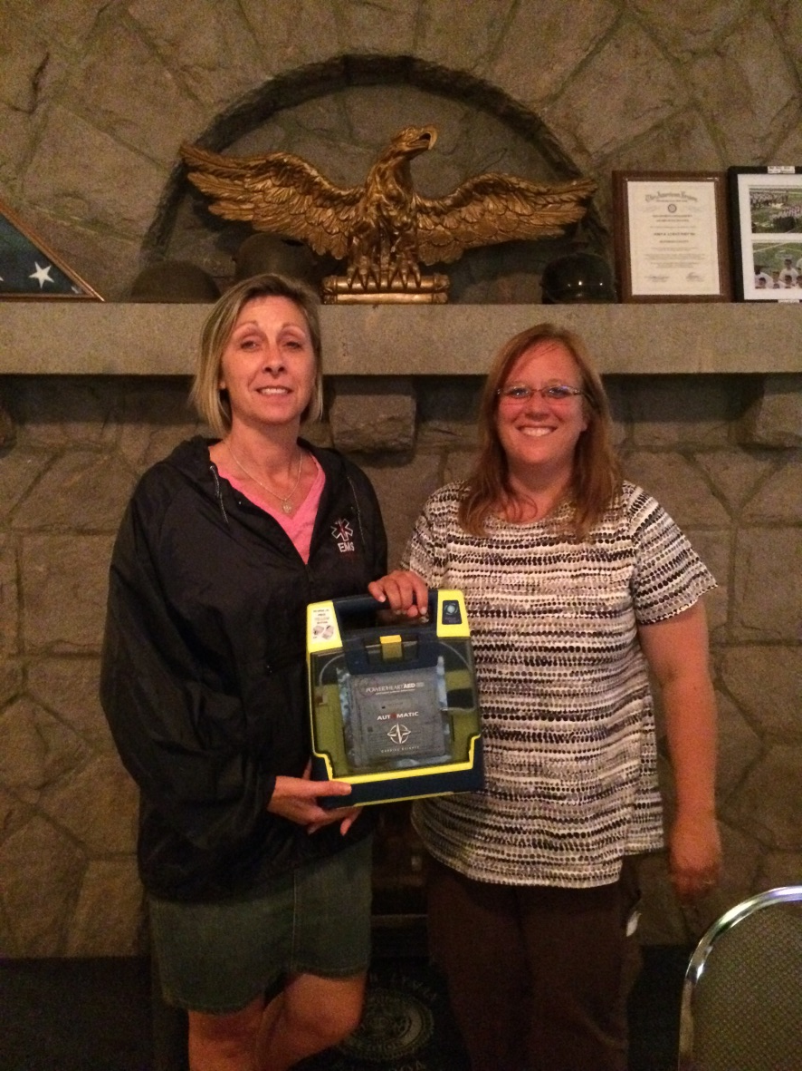
RESOLUTIONS IDEAS
PASSION DRIVING CHANGE
Angela Hunter, a New York Post 904 Auxiliary member and EMT for the Village of Alexandria Bay, and Shawn Jensen, a former Post Commander of New York Post 904 and EMT for the Village of Redwood, were instrumental in advocating for AEDs in American Legion posts, emphasizing their critical role in saving lives.

Slide 17
RESOLUTIONS IDEAS
TRENDING AND SHARING
A local post drafts a resolution addressing a topic. Other posts see the resolution and know they have a similar issue. Then it expands to the Department and sometimes National because other Departments are trending the same issue.
Resolution No. 11 Subject AED’s in Post Homes
Referred to Convention Resolutions Committee WHEREAS, by Post 904, The American Legion, Department of New York, in regular meeting assembled in John B. Lyman Post, Alexandria Bay, New York on April 18th, 2015 recognizes that an automated external defibrillator (AED) is a life saving device that automatically diagnoses the life-threatening cardiac arrhythmias of ventricular fibrillation and ventricular tachycardia in a patient, and is able to treat them through defibrillation, the application of electrical therapy which stops the arrhythmia, allowing the heart to reestablish an effective rhythm, and
WHEREAS, that AED’s are being placed in buildings and public spaces throughout the nation and are required in many due to proven success in saving lives, and
WHEREAS, availability and access to an AED, can factor into the possibility of success saving a life, and
WHEREAS, AED’s are simple to use with little or no training and are covered under Good Samaritan protection laws, and
WHEREAS, The American Legion, American Legion Auxiliary, Sons of The American Legion members and many civic groups, youth groups and scout troops use our post homes may come to need an AED in an emergency, now, therefore, be it
RESOLVED, by the American Legion, Department of New York, in convention assembled July 14, 15 and 16, 2016 in Binghamton, New York encourage the installation of AED’s in all Post homes in the Department of New York.
Approved ___X____ Rejected _______

Slide 18
RESOLUTIONS IDEAS
GRASSROOTS LEGISLATION
Department of Veterans Affairs S.A.V.E. Training at Posts Origin:
Resolution No. 40 (NY) 2023 National Convention Submitted by: Veterans Affairs & Rehabilitation Commission
WHEREAS, the rate of suicide for veterans is more than 50 percent higher than that of nonveteran adults; and
WHEREAS, the stigma associated with mental health issues is a barrier to veterans seeking assistance as they fear loss of job, think they can handle the situation themselves, or don’t believe others will understand their situation; and
WHEREAS, The American Legion is the nation’s most influential, effective and dependable advocate of veterans; and
WHEREAS, The American Legion has activated a national platform to reduce the rate of veteran suicide titled, “Be the One” campaign to destigmatize asking for mental health support, create opportunity for those with mental health issues to speak freely, provide peer-to-peer support and resources and deploy FDA-approved therapeutics for veterans to identify issues and find resources for support; and
WHEREAS, this sacred duty has now become the obligation of every American Legion post and its membership; and
WHEREAS, our members need training in preparation to identify, encounter and approach a veteran suffering from mental health issues or worse, showing signs of suicidal thought; and
WHEREAS, The Department of Veterans Affairs (VA) provides a training program to identify Signs of suicidal thinking, Ask the most important question – “Are you thinking of killing yourself?”, Validate the veteran’s experience, Encourage treatment, and Expedite getting help (VA S.A.V.E.), to provide the knowledge and resources needed to ensure a veteran at risk of hurting themselves or others can get connected with appropriate services and resources; and
WHEREAS, American Legion posts can host VA S.A.V.E. training classes contacting their local VA Medical Center’s Suicide Prevention Team, allowing anyone access to training; and WHEREAS, The goal of The American Legion is to reduce veteran suicide by saving at least one life each day by using every department, every post, every resource, and the entire American Legion Family to do so; and WHEREAS, Post training classes may be open to local communities making the training a true community, state, and nation Be the One program; now, therefore, be it
RESOLVED, By the National Executive Committee of The American Legion in regular meeting assembled in Indianapolis, Indiana, on October 11-12, 2023, That The American Legion strongly encourages American Legion posts to host Department of Veterans Affairs (VA) S.A.V.E. training classes; and, be it finally
RESOLVED That The American Legion encourages American Legion posts to invite local community, government agencies, not-for-profits and businesses to participate in the VA S.A.V.E. training classes.

Slide 19
RESOLUTIONS IDEAS
RESOLUTIONS GIVE YOU A VOICE!
FROM POST TO DISTRICT TO DEPARTMENT
Whereas, The American Legion’s strength comes from its membership numbers, and
Whereas, The National American Legion, The Departments of The American Legion and individual American Legion Posts spend a great deal of time and money to achieve membership goals, and
Whereas, there are incentives, monetary rewards, distinction and accolades for achieving membership goals by milestone dates, and
Whereas, Membership Workshops, Teams and efforts are developed and executed to achieve membership goals, and
Whereas, It is communicated to American Legion membership how important it is to work on membership goals and milestones, and
Whereas the Department of New York has report card system that is over 2 months old in most cases throughout the reporting year, and
Whereas many other Departments use better, more up to date and complete membership reporting to their membership, and
Whereas, incentive programs, goals, milestones and programs are COUNTER productive without fair and current report cards,
Be It Resolved at Jefferson County American Legion meeting held on April 4th, 2019, Jefferson County is requesting that the Department of New York utilize a ‘best practice’ of report card scoring and reporting like other Departments such as Department of Maryland utilizes and improve the results of its membership efforts in the Department of New York.

Slide 20
RESOLUTIONS IDEAS
ADOPTED AT NATIONAL
NATIONAL EXECUTIVE COMMITTEE
OF
THE AMERICAN LEGION
October 11-12, 2023
Indianapolis, Indiana
Resolution No. 9: Department of Veterans Affairs S.A.V.E. Training at Posts
Origin: Resolution No. 40 (NY) 2023 National Convention
Submitted by: Veterans Affairs & Rehabilitation Commission
WHEREAS, The rate of suicide for veterans is more than 50 percent higher than that of non-veteran adults; and
WHEREAS, The stigma associated with mental health issues is a barrier to veterans seeking assistance as they fear loss of job, think they can handle the situation themselves, or don’t believe others will understand their situation; and
WHEREAS, The American Legion is the nation’s most influential, effective and dependable advocate of veterans; and
WHEREAS, The American Legion has activated a national platform to reduce the rate of veteran suicide titled, “Be the One” campaign to destigmatize asking for mental health support, create opportunity for those with mental health issues to speak freely, provide peer-to-peer support and resources and deploy FDA-approved therapeutics for veterans to identify issues and find resources for support; and
WHEREAS, This sacred duty has now become the obligation of every American Legion post and its membership; and
WHEREAS, Our members need training in preparation to identify, encounter and approach a veteran suffering from mental health issues or worse, showing signs of suicidal thought; and
WHEREAS, The Department of Veterans Affairs (VA) provides a training program to identify Signs of suicidal thinking, Ask the most important question – “Are you thinking of killing yourself?”, Validate the veteran’s experience, Encourage treatment, and Expedite getting help (VA S.A.V.E.), to provide the knowledge and resources needed to ensure a veteran at risk of hurting themselves or others can get connected with appropriate services and resources; and
WHEREAS, American Legion posts can host VA S.A.V.E. training classes contacting their local VA Medical Center’s Suicide Prevention Team, allowing anyone access to training; and
WHEREAS, The goal of The American Legion is to reduce veteran suicide by saving at least one life each day by using every department, every post, every resource, and the entire American Legion Family to do so; and
WHEREAS, Post training classes may be open to local communities making the training a true community, state, and nation Be the One program; now, therefore, be it
RESOLVED, By the National Executive Committee of The American Legion in regular meeting assembled in Indianapolis, Indiana, on October 11-12, 2023, That The American Legion strongly encourages American Legion posts to host Department of Veterans Affairs (VA) S.A.V.E. training classes; and, be it finally
RESOLVED That The American Legion encourages American Legion posts to invite local community, government agencies, not-for-profits and businesses to participate in the VA S.A.V.E. training classes.

Slide 21
RESOLUTIONS IMPACT
ADDRESSING SOCIETAL ISSUES THEN…
Passed during the 1923 American Legion National Convention in San Francisco, a lasting resolution upholds unwavering support for equal rights and opportunities, explicitly rejecting discrimination based on race, color, creed, or class. This resolution unequivocally condemns any entity fostering racial, religious, or class-based divisions and admonishes actions that usurp law enforcement, guilt determination, or punishment imposition as un-American, posing a threat to our liberties and undermining our fundamental laws.

Slide 22
RESOLUTIONS IMPACT
AND NOW!
"Instituting the LEGION Act (Let Everyone Get Involved In Opportunities for National Service Act) extends access to American Legion programs and benefits to approximately 6 million veterans previously ineligible. National Commander Brett Reistad hailed this recognition as long overdue, emphasizing the importance of acknowledging the service and sacrifices of these veterans, including those who were killed or wounded in wartime acts. With the legislation's signing, the American Legion's eligibility criteria shifts immediately, broadening from seven war eras to two specific periods, expanding membership without altering any other membership restrictions."
Secretary of Homeland Security Alejandro Mayorkas and Secretary of Veterans Affairs Denis McDonough unveiled a plan on July 6, 2021, to support non-citizen servicemembers, veterans, and their families. McDonough emphasized the commitment to honoring their service, while Mayorkas pledged to bring back unjustly removed military members and ensure their entitled benefits. The American Legion reiterated its century-long advocacy for immigrants seeking citizenship through military service, urging for measures to prevent deportation of veterans and their families, highlighting the plight of deported veterans and the need to rectify their citizenship status.

Slide 23
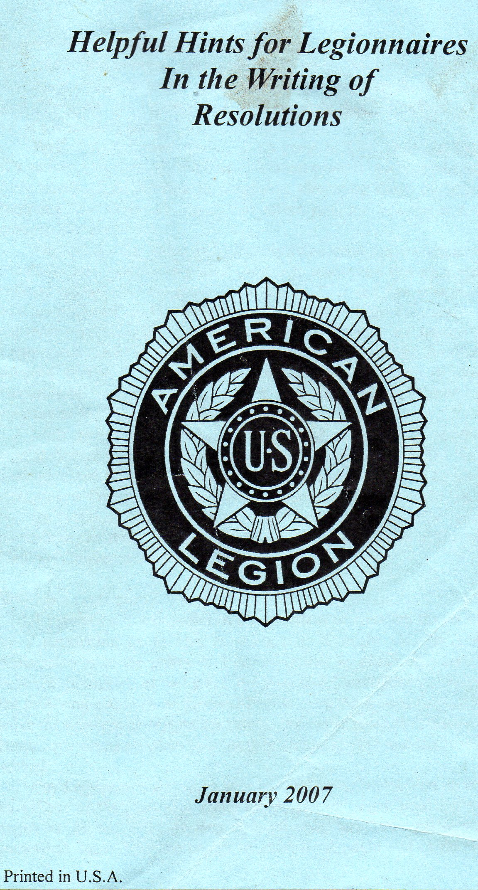
RESOLUTIONS METHOD
Available on www.legion.org

Slide 24
RESOLUTIONS METHOD
Subject Matter
Relevance
Resolutions must align with American Legion Family activities, guided by the Preamble.
Research
Check if the American Legion holds a stance on the subject.
Format
Ensure the resolution follows the correct structure.
Simplicity
Support
Standalone
Each part of the resolution should make sense independently.
Solve it!
Aim for simplicity, focusing on a single subject per resolution.
Include factual statements supporting the resolution's necessity.
Provide a recommended solution or action to address the issue at hand.

Slide 25
RESOLUTIONS METHOD
ELEMENTS
“RESOLVE”
Clause or paragraph
MUST state desired action to achieve change
“WHEREAS”
Background
Facts
Title
Clear
Concise
3-5 words

Slide 26
RESOLUTIONS IMPACT
FROM YOUR HOME TO CAPITOL HILL
Idea Generation
Department Convention Adoption
The written resolution is first accepted at the Department convention.
National Convention Review
National Convention Approval
Transition to Legislation
Ideas originate at the grassroots level within local Posts/Units/Squadrons.
A delegate from each Department, along with expert advisors, reviews the resolution at the National Convention Committee. Detailed study, suggestions, and recommendations follow.
The resolution is presented, explained, debated, and ultimately adopted at the National Convention, thereby becoming an official legislative mandate of the American Legion.
Legislative Committees work on converting the resolution into a Bill. Persistent lobbying efforts are undertaken until the Bill successfully transforms into law.

Slide 27
RESOLUTIONS IMPACT
What is good for Veterans is good for America
The American Legion played a pivotal role in the creation of the G.I. Bill, hailed as a landmark in social legislation. Despite facing staunch opposition, this bill, crafted from numerous resolutions and congressional efforts at the Mayflower Hotel in DC, encompassed ten crucial provisions. It sent veterans to school, facilitated home purchases, and enabled business startups, ultimately fostering the rise of the American Middle Class.

Slide 28
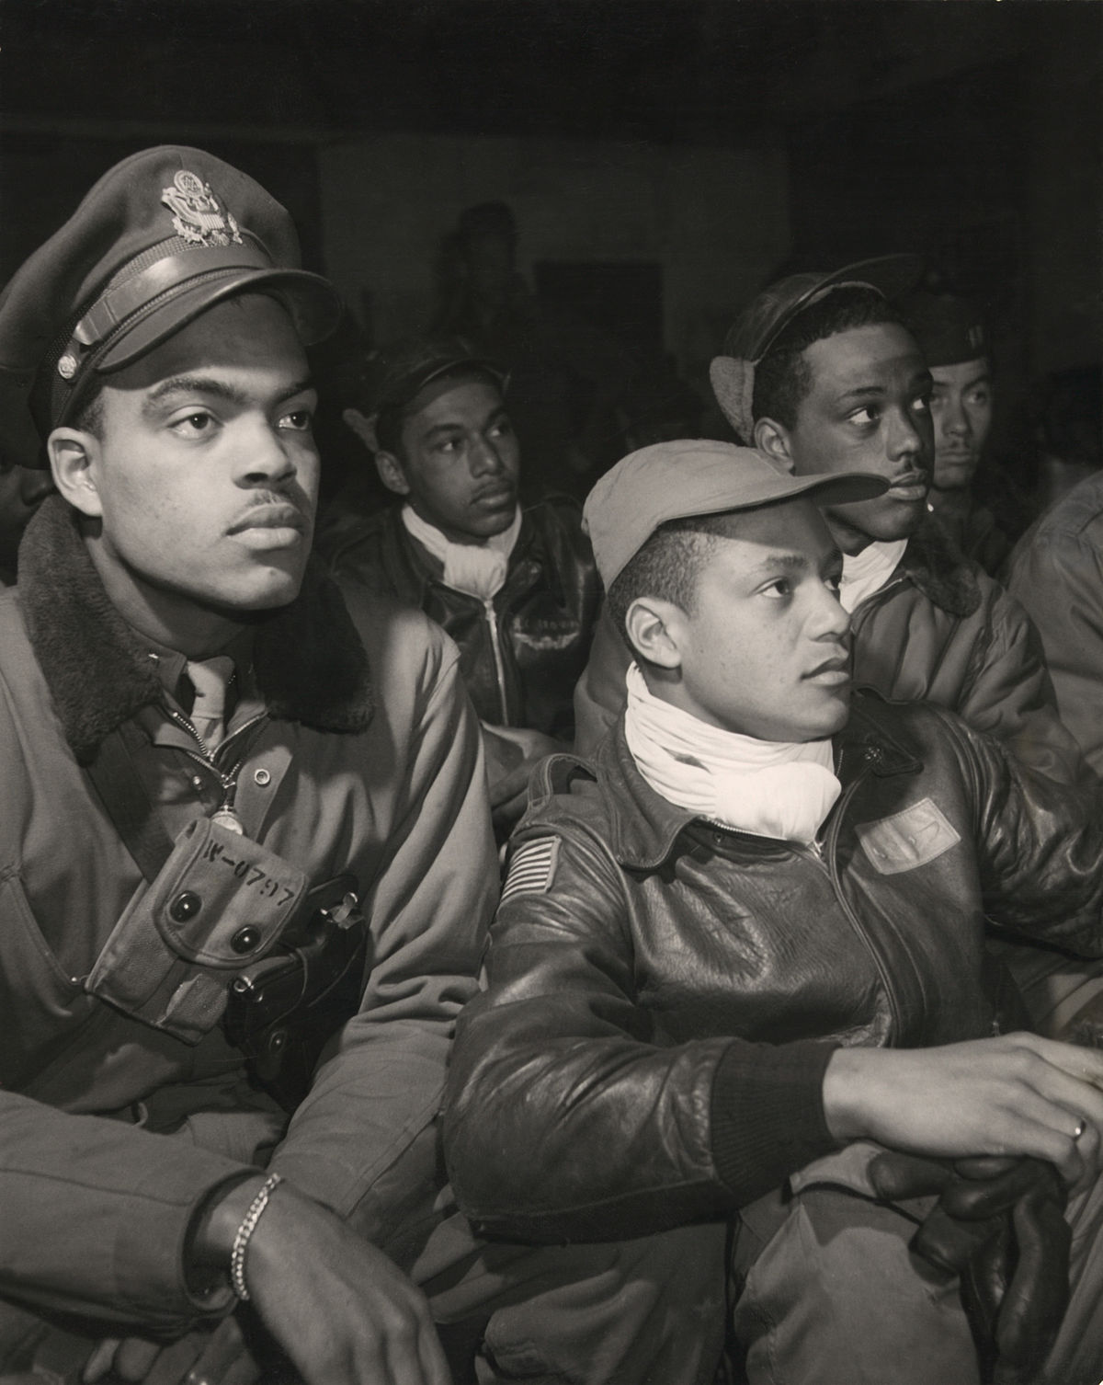
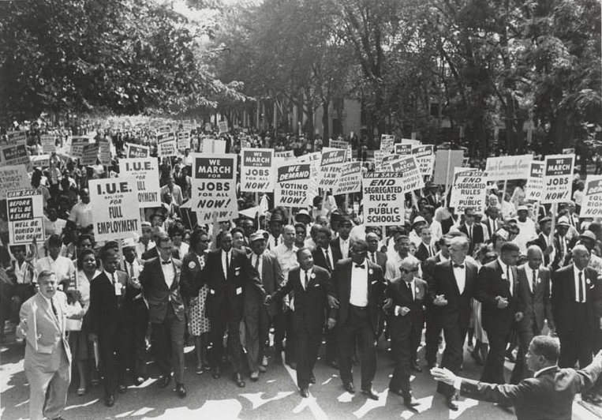
RESOLUTIONS IMPACT
VETERANS SHAPE AMERICA
Black Veterans who served in WWII and Korea did not believe they were “second class” citizens.
Many of those SAME veterans started the civil rights movement

Slide 29
RESOLUTIONS
https://archive.legion.org/handle/20.500.12203/1
https://www.legion.org/legislative
www.legion.org/Voters Voice
Legislative Agenda Weekly Update (PDF) http://capwiz.com/legion/issues/
National Legislative http://www.burnpit.us/
National Resolutions https://www.legion.org/resolutions

Slide 30
A Veteran is not only important because they were once willing to shed their blood for the nation. A veteran is important because they come home from war and teach that nation what it means to be a citizen.

