Slide 1
GET IT DONE: CPR/CSR
Training Tuesday – May 2025
PRESENTED BY: Nick Arnett,
Staff Liaison (Midwest Region) & CPR/CSR Program Administrator

Slide 2
AGENDA
Overview & Goals
CPR/CSR Timeline
CPR/CSR Form Section Review
MyLegion Submissions
Awards & Recognitions
Training & Mentorship
Conclusion & Review

Slide 3
GOALS & OVERVIEW
INTENT & BACKGROUND

Slide 4
TRAINING GOALS
POSTS/SQUADRONS
DEPARTMENTS/DETACHMENTS
CONTEXT OF SIGNIFICANCE
ADMINSTRATIVE TIMELINE OF EVENTS
FOUNDATIONAL KNOWLEDGE
AWARDS & RECOGNITION PROGRAMS
COMPLETION GUIDE
MENTORSHIP/TRAINING GUIDANCE
100% SUBMSSION RATE

Slide 5
AUTHORITY
NEC Resolution No. 7: Consolidated Post Reporting System Established
October 9-10, 1974, submitted by the Internal Affairs Commission
“RESOLVED, By the National Executive Committee of The American Legion in regular meeting assembled in Indianapolis, Indiana, October 9-10, 1974, That the National Headquarters provide a report form suitable for use by all American Legion posts in reporting their major activities and that all posts be urged to submit reports on this form to National Headquarters through the various Department Headquarters to report their major activities for the twelve-month period June 1, 1974, through May 31, 1975…”
Outline of Authorization
To formulate and recommend policies and to oversee the implementation of adopted policies relating to activities conducted for organizational purposes, including but not limited to such policies as do not properly come within the scope of any other national commission.
To review and give guidance to the necessary administrative operations of the National Headquarters.
Such other purposes as may be assigned to it by the National Executive Committee.

Slide 6
PURPOSE & INTENT
CAPTURE DATA: “To assist departments in the documentation of the various activities a specific post has done during the twelve-month reporting period, June 1 through May 31.”
CONGRESSIONAL REPORTING: To provide information to the National Commander and others testifying on Capitol Hill “as mandated by our federal charter.”
… TO TELL
THE AMERICAN LEGION
STORY!

Slide 7
CPR/CSR TIMELINE
DATES & DEADLINES

Slide 8
TIMELINE – POST/SQDN
JUNE 1 THROUGH MAY 31
CPR/CSR REPORTING TIMEFRAME
ALL POST/SQDN EVENTS WITHIN THIS TIME
NOVEMBER/DECEMBER
CPR/CSR ACTIVE IN MYLEGION;
AVAILABLE AT LEGION.ORG
DIGITAL SUBMISSIONS THRU MYLEGION;
FORMS AVAILABLE FOR PRINT & MAIL, SCAN & EMAIL
FEBRUARY/MARCH
PRINTED COPIES AVAILABLE AT DEPARTEMNT
DISSEMINATED BY DEPARTMENT FOR TRADITIONAL SUBMISSIONS
JULY 1
CPR/CSR SUBMISSION DEADLINE
DUE DATE FOR DEPARTMENT
AWARD CONSIDERATIONS FOR
NATIONAL CONVENTION
SEPTEMBER 1
END OF CPR/CSR SUBMISSIONS
MYLEGION SUBMISSION CLOSES; MAILED SUBMISSIONS NO LONGER PROCESSED

Slide 9
ADMIN TIMELINE
JUNE 1 THROUGH MAY 31
CPR/CSR REPORTING TIMEFRAME
ALL POST/SQDN EVENTS WITHIN THIS TIME
OCTOBER
FORM REVIEW & CHANGES
COMMISSION/SUBCOM RECOMMENDS/APPROVES CHANGES; EDITS SENT TO MEDIA & COMM DIV
NOVEMBER
FORM IMPLEMENTATION
DIGITAL FORMS TO LEGION.ORG; IT DIV ADJUSTMENTS IN MYLEGION; PREVIEW & PRINT REQUEST TO DEPARTMENTS
DECEMBER 31
PRINT REQUEST DEADLINE
DEPARTMENTS REQUEST FOR PRINTED CPR/CSR FROM NATIONAL
JANUARY/FEBRUARY
PRINT ORDERS
PRINT ORDER MADE, RECEIVED & MAILED
MAY/JUNE
CPR/CSR SUBMISSION PROGRESS
WEEKLY SUBMISSION UPDATES TO NATIONAL COMMANDER AND DEPARTENTS
JUL 1
CPR/CSR SUBMISSION DEADLINE
REPORT RAN FOR AWARDS

Slide 10
ADMIN TIMELINE
AUGUST
CPR AWARDS
100% SUBMISSION AWARDS TO QUALIFYING DEPARTMENTS
SEPTEMBER
REPORTING POST ACTIVITY
CPR/CSR DATA SUBMITTED FOR FALL MEETINGS STAFF REPORT, CONGRESSIONAL REPORTS
PROCESS REPEATS….

Slide 11
CPR/CSR FORM
SECTION REVIEW

Slide 12
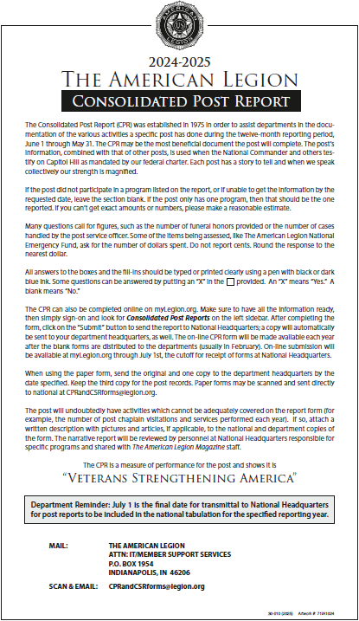
COVER PAGE
SUMMARY:
Do you have the right form? CHECK THE YEAR
Blanks lines and sections are ok… BLANK FORMS ARE NOT OK
Some fields are for numbers; ROUND TO THE WHOLE DOLLAR
Others are for yes/no; “NO” = BLANK, “YES” = NOT BLANK
Do yourself a favor: TRY MYLEGION…
MyLegion submissions: SAVE DRAFT vs SUBMIT
Paper submissions:
ONE FOR POST/SQDN, TWO FOR DEPTARMTENT/DETACHMENT
DEPARTMENT/DETACHMENT SNAIL MAIL OR SCAN/EMAIL
Uncommon, but accepted: ADDTITIONAL. DOC. FOR ANYTHING NOT COVERED.

Slide 13
ADMIN INFO
Final 2023-204 membership = total number of active 2024 members by 12/31/2024
If the reporting entity is District/Detachment, the report ONLY INCLUDES data approved/expended by Officers and Members of that entity.
These ARE NOT cumulative of the Squadrons/Districts that they represent.

Slide 14
VA & R SECTION - CPR
7. “Cases” include specific interaction between the post service/resource officer and a member/veteran/service member/military family in reference to a benefit. Ex. Claims/disability/appeals, GI Bill/education, military burial/funeral benefits, etc.
8. Whole dollar donation from post to individual. Not TFA, NEF or any other dept./natl. program. Whole dollar.
9. Any and all volunteer time of members/officers at any VA facility; round to whole hour.
10. Total financial contribution to this program only.
11. “NO” = BLANK, “YES” = NOT BLANK.
12. Total number of post participants in this program only.
13. “NO” = BLANK, “YES” = NOT BLANK.
14. Total number of post participants in this program training only.
15. Total number of events. Ex. Training/briefing/info session, promotions, activities, etc.

Slide 15
VA & R SECTION - CSR
Odds: Total amount of donations provided to each of these facilities, organizations, projects, programs, or events.
Evens: Total number of volunteer hours associated with each one of these programs; round to whole number.
If a donation doesn’t fall into one of these, then add it to “11. Other VA&R Projects” instead.

Slide 16
NATL. SECURITY SECTION
16. Total number of blood units donated by post members/officers during blood drives.
17. Total number of blood donors from the post during blood drives.
If purchased from emblem sales and presented by post officer/member, then count it.
19-26, 29. “NO” = BLANK, “YES” = NOT BLANK.
27. If a single post member/officer participates in an official capacity, then count it.
28. All costs spent on these services; flower arrangements/bereavement gifts count; round to whole dollar.
30. These include indoors and outdoors. Ex. Weapons, vehicles, military equipment.
*Section not applicable to CSR.

Slide 17
MEDIA & COMM SECTION
31 – 35. “NO” = BLANK, “YES” = NOT BLANK.
36 – 38. Post members, officers, programs/services, or the post itself.
*Section not applicable to CSR.

Slide 18
VE & E SECTION - CPR
39, 40, 45-53. “NO” = BLANK, “YES” = NOT BLANK.
39-40. If the position was filled at anytime during the reporting year and reported to department.
41. Even one participant counts as participating in this event.
42. Referrals to these programs.
43-44. If you helped a veteran find a job or a training program, then it counts.
45. Advertised/promoted or recommended for award. Does the post award this?
46-48. Award recommendations submitted through proper channels.
49-54. Awarded by post.

Slide 19
VE & E SECTION - CSR
Odd: Total amount of donations provided to any and all VE&E Projects.
Even: Total number of volunteer hours associated with to any and all VE&E Projects.
If it was VE&E related and done by the squadron, then count it.

Slide 20
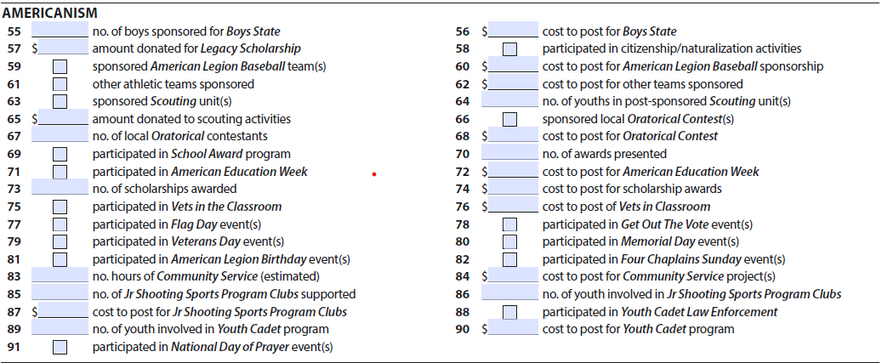
AMERICAN. SECTION - CPR
58, 59, 61, 63, 66, 69 & 71. “NO” = BLANK, “YES” = NOT BLANK.
55. How many boys did the post send to Boys State? Partial sponsorships count.
56. Total cost of Boys State sponsorship; round to whole dollar amount.
57 & 65. Total donation; round to whole dollar amount.
60 & 62. Total cost to sponsor Legion baseball team(s); any other youth teams
64. Get the troop membership counts of units sponsored.
67. Number of contestants in post sponsored oratorical.
68 & 72. Any costs to the post associated.
70. Total number of school awards presented. Students, teachers and administrators.

Slide 21
AMERICAN. SECTION - CPR
75, 77-82, 88 & 91. “NO” = BLANK, “YES” = NOT BLANK; if at least one member participated, count it.
73. Total number of scholarships from post. Partial scholarships count.
76. Cost to participate/sponsor this program; round to whole dollar amount.
83. Total number of any and all community service hours performed by members/officers; count each “man hour”…
84. Include all related costs to community service projects. Post projects do not count. round to whole dollar amount.
86 & 89. Total count of youth participants; not volunteers.
87 & 90. Total cost to post with participating/sponsoring these programs; round to whole dollar amount.

Slide 22
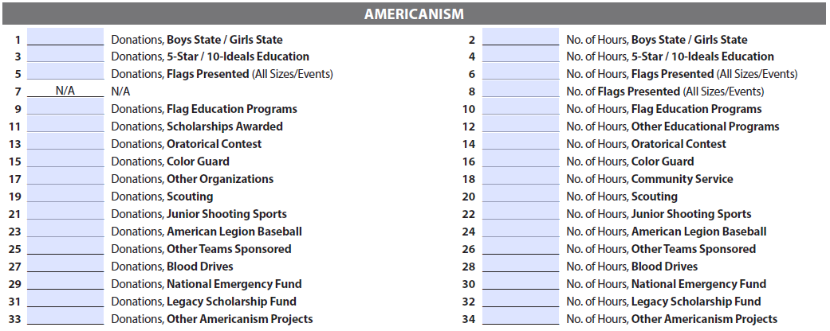
AMERICAN. SECTION - CSR
Odds: Total amount of donations provided to each of these facilities, organizations, projects, programs, or events.
Evens: Total number of volunteer hours associated with each one of these programs; round to whole number.
*These are from the squadron ONLY. Make sure the post & squadron are only counting their own donations and hours served.

Slide 23
CHILDREN & YOUTH - CPR
97-99, 100 & 102. “NO” = BLANK, “YES” = NOT BLANK; if at least one member participated, count it.
93. This is for children ONLY. Do not double count VA&R #8 emergency aid given to veterans.
94. This is an approximate value of items/goods donated. Ex. Toys for Tots, etc.
95. Include an approximate number of children helped from both cash and item donations.
96. Total volunteer hours served within any of the programs or activities in this section.
101, 103-106. This falls into a “gray area”… use your best judgement… whole dollars, please.
107. Just cost to Veterans & Children Foundation stuff; round to whole dollar.

Slide 24
CHILDREN & YOUTH - CSR
Odds: Total amount of donations provided to each of these facilities, organizations, projects, programs, or events.
Evens: Total number of volunteer hours associated with each one of these programs; round to whole number.
*These are from the squadron ONLY. Make sure the post & squadron are only counting their own donations and hours served.

Slide 25
INTERNAL AFFAIRS - CPR
108, 112, 114, 117, 119, 121 & 123. “NO” = BLANK, “YES” = NOT BLANK; you either have it or you don’t; if at least one member participated, count it.
109 & 113. This is your total ALR/SAL membership number at the end of the calendar year. Ex. 2024 counts for the 2024-2025 CPR.
110. Funds raised by ALR events.
111, 115 & 118. What did the post spend for these operations/programs?
116. Only post donations to the national program.
122. How many Legion Family Days hosted? Ex. Any post sponsored family event for the community.
124. Any and all other fundraising not specifically addressed.
125. Any and all other volunteer hours not specifically addressed.

Slide 26
INTERNAL AFFAIRS - CSR
Odds: All other donations not specifically addressed.
Evens: All other volunteer hours not specifically addressed.
*These are from the squadron ONLY. Make sure the post & squadron are only counting their own donations and hours served.

Slide 27
POST/SQDN CERTIFICATION
Post Commander or Adjutant can certify this form.
Fillable PDF allows for an electronic signature; acceptable to print, sign & scan/mail to department.
Certify each page!
Digital submission through MyLegion. “SUBMIT”
Squadron Commander or Adjutant can certify this form.
Fillable PDF may allow for an electronic signature; acceptable to print, sign & scan/mail to department.
Certify each page!
Digital submission through MyLegion. “SUBMIT”

Slide 28
MYLEGION SUBMISSIONS
REPORTING DONE EASY

Slide 29
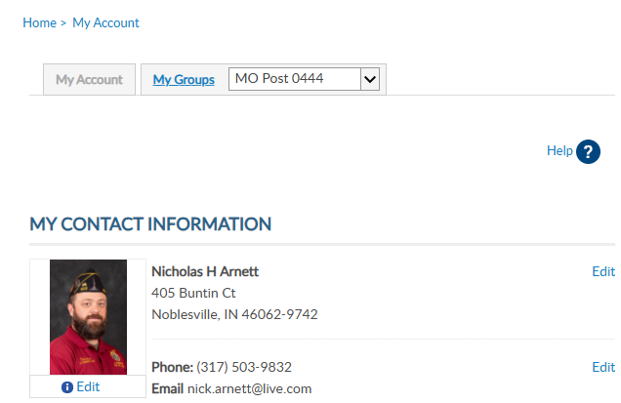
MYLEGION
3
Pre-requisite: Register with MyLegion and gain reporting access (*Adjutant/Commander)
Login
“MY ACCOUNT”
“My Groups” & select post in drop down menu
4

Slide 30
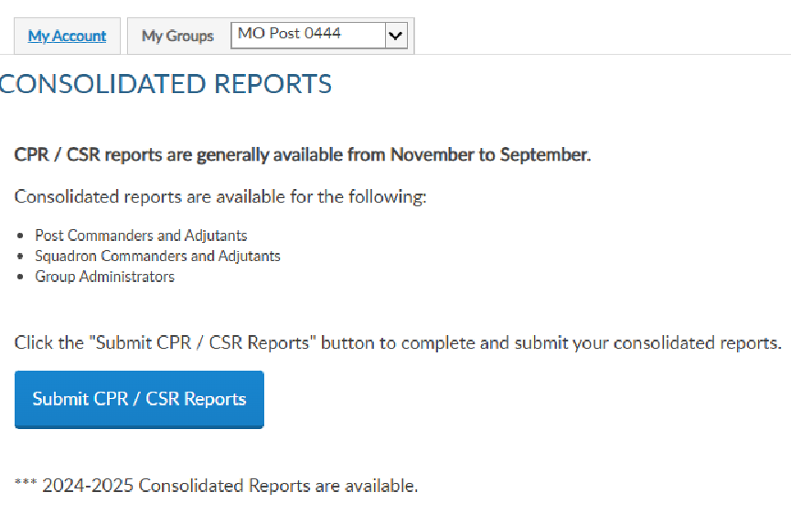
MYLEGION
Select “Submit CPR/CSR Reports”
Ensure “OPEN” is selected
Locate the report for the current year
Select “Edit”
note “Draft” vs “Submitted” status
5
6
8

Slide 31
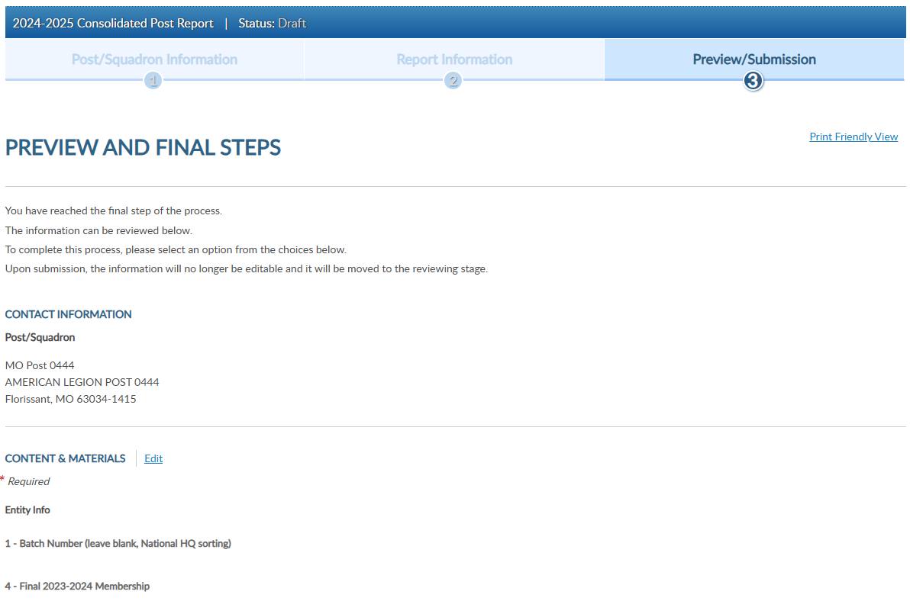
MYLEGION
Select “Edit”
Contact Information should be auto-generated
9

Slide 32
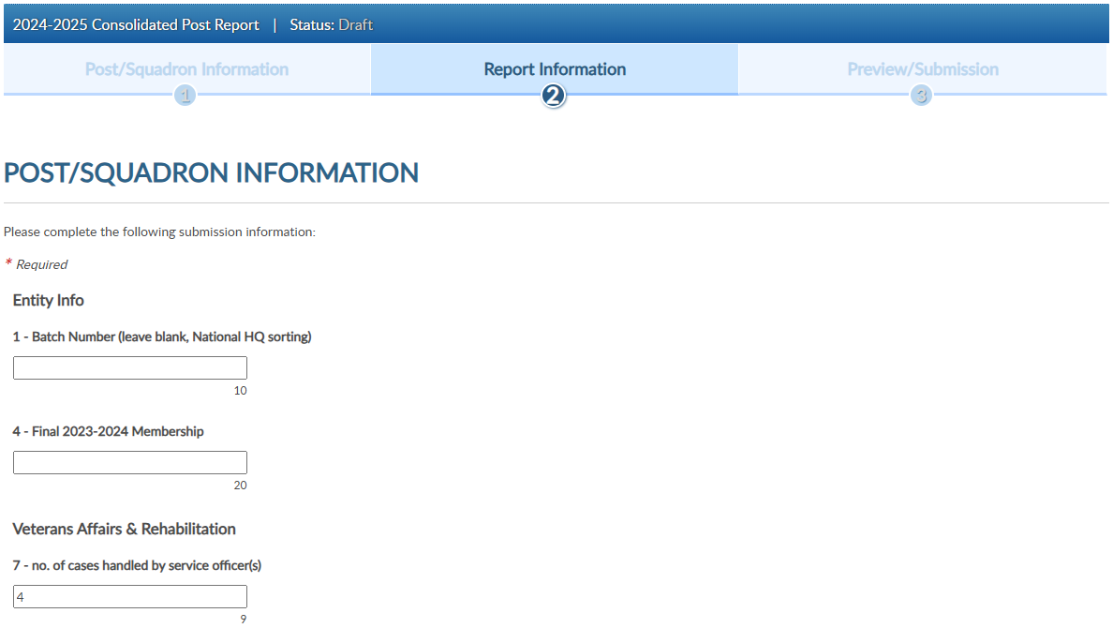
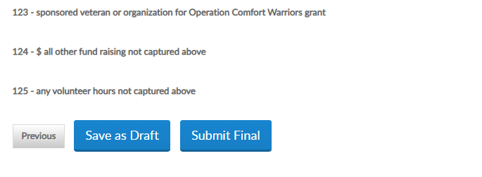
MYLEGION
Complete each field
“Save as Draft” if NOT READY TO SUBMIT; otherwise, “Next”
“Submit Final” when ready
10
10
10
12
11

Slide 33
AWARDS & RECOGNITIONS
APPRECIATING EXCELLENCE

Slide 34
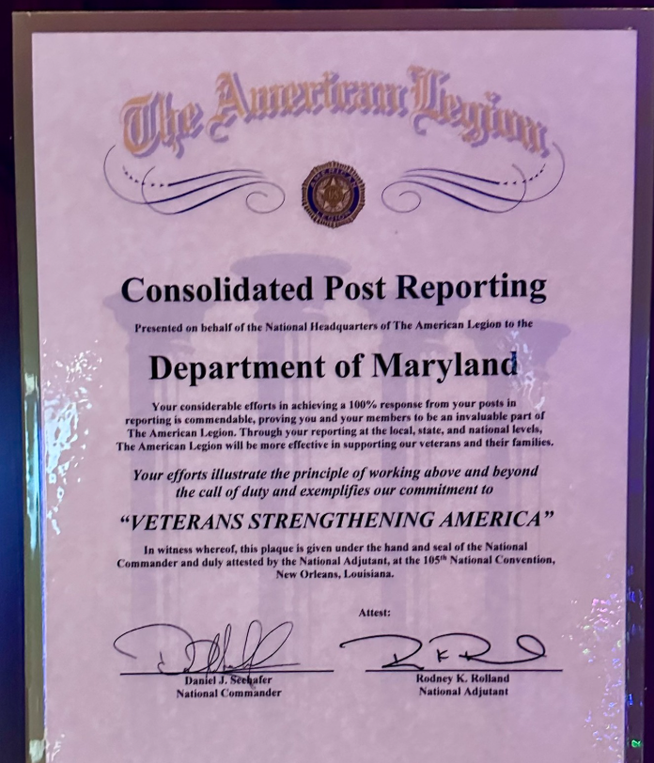
AWARDS
DEPARTMENT 100% CPR AWARD
Plaque awarded to any department on stage at national convention that achieves 100% post reporting by July 1.
*Administrative post submissions do not count for nor against department figures.
*MyLegion CPR and paper submissions are included in these figures.

Slide 35
AWARDS
100% CHILDREN & YOUTH POST NARRATIVE REPORTING AWARD
For a department to qualify for this award, the department chairman must have received a copy of a narrative report from each of his or her posts.
These in turn are compiled by the chairman into a single department narrative report, which is mailed to the Americanism Division, separate from the CPR.
When you have determined that your department has achieved 100% C&Y narrative reporting, fill out the appropriate form, attach a copy of each report and forward it to the Americanism Division.
Only those departments having 100% Children & Youth post reporting should submit this report for verification.
Information can be found in the Children & Youth Department Chairman Program Guide at legion.org.

Slide 36
TRAINING & MENTORSHIP
GETTING TO 100%

Slide 37
TRAIN & MENTOR
Ensure posts/squadrons have access to the CPR/CSR:
Distribute paper copies
Share fillable pdf and/or location on legion.org
Adjutant/commander rights to MyLegion
Provide training/education opportunities
New post/squadron adjutant/commander and district officer training
Encourage good administrative practices
Keep & organize records/documentation
Make it easier with MyLegion
Set expectations & provide feedback
Communicate deadlines; Periodic reminders; Send status updates
Use district commanders/officers to directly assist posts
One-on-one assistance will be required for some posts/squadrons

Slide 38
CONCLUSION & REVIEW
SUMMARY & TAKEAWAYS

Slide 39
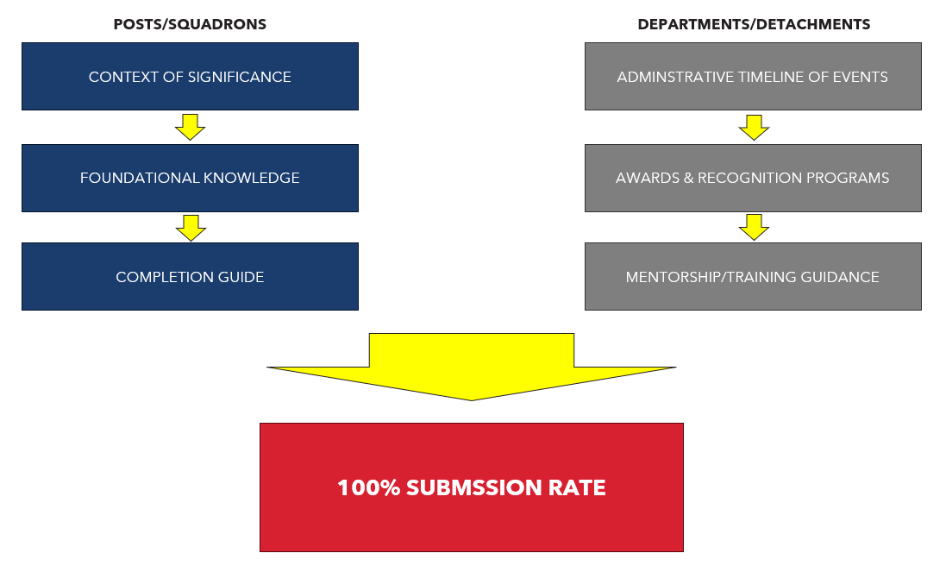
REVIEW
Overview & Goals
CPR/CSR Timeline
CPR/CSR Form Section Review
MyLegion Submissions
Awards & Recognitions
Training & Mentorship
Conclusion & Review

Slide 40
KEY TAKEAWAYS
CPR/CSR are due July 1 (but accepted until September…)
Do yourself a favor: TRY MYLEGION…
Good administrative practices reduce headaches…
Training & Mentorship, use your districts
Better data + Higher reporting rates = Legion Impact

