Slide 1
How to Run a Post
James A. Bryant Sr.
Department of Alabama

Slide 2
Overview
KEY TOPICS
An Effective Post meeting
Officer roles and responsibilities
Program implementation and engaging members
Best practices for financial and administrative oversight

Slide 3
An Effective Post Meeting
Preparation is key!

Slide 4
Post Meetings: Why They Matter
Get the Information out to the Membership
Recognition-Awards
Decisions-Decisions-Decisions
Tradition

Slide 5
Post Meeting
Purpose of an Agenda:
It can all be found in the:
Provides structure for the meeting (fleshing out the skeleton from the Manual of Ceremonies).
Helps focus on priorities and keeps discussions on track.

Slide 6
Post Meeting
Key Elements of an Effective Agenda:
How to make it Work:
Committee Reports
Budget Discussions
Old and new income
Estimated expenditures
How are we financing things?
Post Business
Unfinished business
New business
Announce the meeting multiple ways
Get RSVPs
Send out read ahead material
Include qualified speakers and briefings
Don’t neglect social interaction and member engagement

Slide 7
Post Meeting
Quorum
Definition of Quorum: The minimum number of members required to conduct official business at a meeting.
Importance of Quorum:
Ensures decisions are legitimate and represent the majority.
Avoids delays in post operations and program planning.
Tips for Maintaining Quorum:
Set clear attendance expectations for members.
Coordinate closely with officers and committee chairs to ensure presence.
Incorporate engaging agendas to encourage attendance.
Key Practice:
Follow the Manual of Ceremonies once quorum is achieved.

Slide 8
Post Meeting
Why RSVPs Matter:
Helps plan effectively for quorum and participation.
Allows adjustment of the agenda based on expected attendees.
Best Practices for Gathering RSVPs:
Communicate Early: Share the agenda and RSVP request well in advance.
Use Multiple Channels: Email, phone, or text reminders to maximize responses.
Track Responses: Monitor RSVPs to anticipate attendance and address potential quorum issues.
Encouragement:
Emphasize the importance of active participation and the role of members in decision-making.

Slide 9
Officer roles and responsibilities
Every Post is different

Slide 10
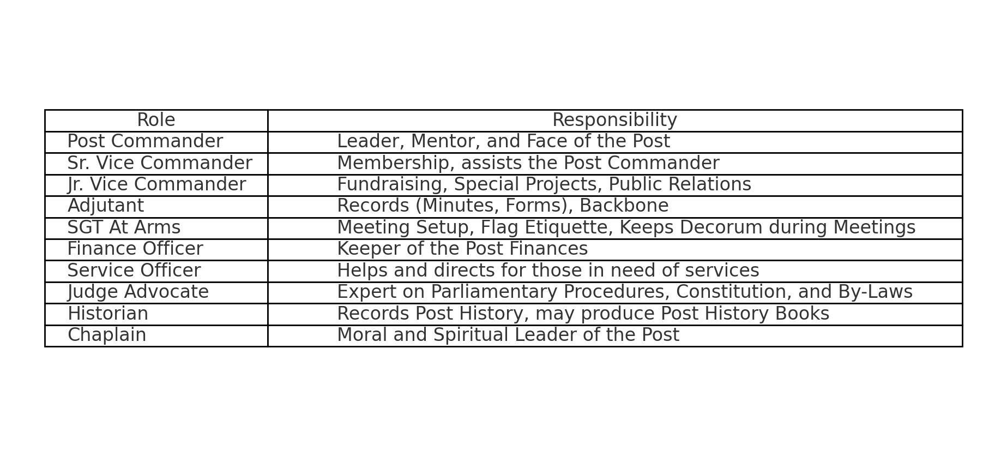
Post Officers
Suggested Roles
Every Post is Different

Slide 11
Post Officers
Sgt-At-Arms- Meeting Set up, Flag Etiquette, Keeps Decorum during Meetings
Finance Officer-Keeper of the Post Finances
Service Officer-Helps and directs for those in need of services
Judge Advocate-Expert on Parliamentary Procedures, Constitution, and By Laws
Historian-Records Post History and may produce a Post History Books
Chaplain-Moral and Spiritual Leader of the Post

Slide 12
PROGRAMS
Connecting people in service to nation

Slide 13
Programs
Does Your Community Know You’re There? Here’s How.
Blood
Drives
Volunteering
Americanism
The 4-Pillars

Slide 14
The Backbone of Success
Where Are My Volunteers
Know Interests: Identify members’ hobbies and passions
Involve Everyone: Use activities like scouting, baseball and oratorical
Be flexible: Adjust meeting times and formats
Balance Committees: Ensure even participation with a tie-breaker

Slide 15
The Backbone of Success
Needs a Committee
Identify Committees: Determine which committees are essential.
Define Responsibilities: Clearly outline duties in By-Laws.
Appoint Leaders: Select and approach potential chairpersons.
Provide Training: Train all committee chairpersons effectively.
Mentor Successors: Prepare future leaders for smooth transitions.

Slide 16
MONEY
How are we paying for things and staying out of trouble?

Slide 17
Records & Procedures
Keep all records, receipts, bank statements
Organize your financial records by month and year
If possible, keep records at the Post not at any individual home/house.
Invest in computer, printer, and fireproof safe to keep records.
Create a check & balance system – internal controls
Internal Controls makes it clear to the membership who is responsible at each stage of the process.
Do not make the same person responsible for signing checks or deposits. Delegation of responsibility prevents misuses.
Transparency is a GOOD thing. This helps all involved from the Post Finance Officer, Finance Committee, and members
Helps prevent fraud

Slide 18
Fraud
It is a Real Thing
Effective Internal Controls help prevent Fraud
Protects the Post, Officers, and Members of the Post
Insurance as a safety net

