Slide 1
Training Tuesday
#BeTheOne: Talking About Suicide Without Stigma

Slide 2
#BeTheOne: Talking About Suicide Without Stigma Presenter: Jason Murrey
Tonight’s Topic:

Slide 3
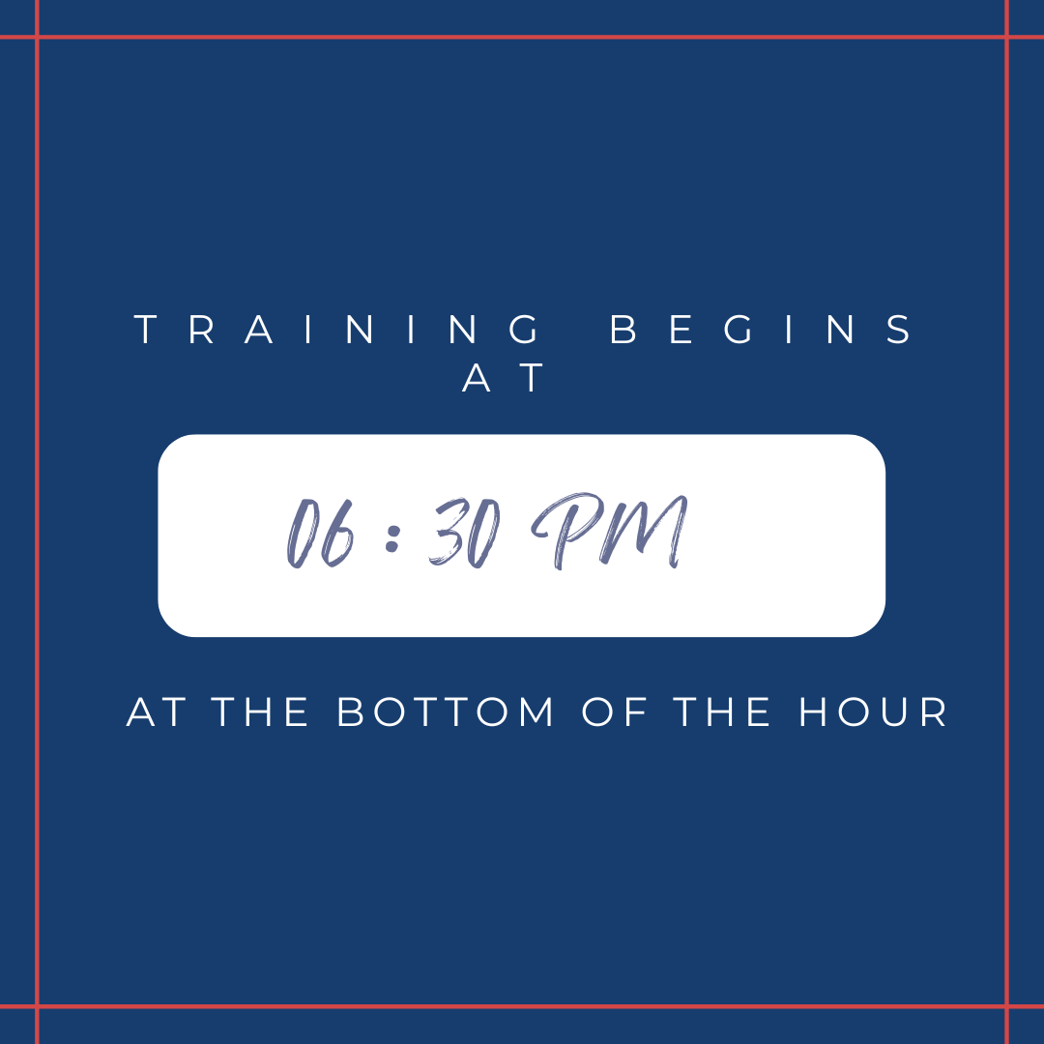
TRAINING TUESDAY
THE LAST TUESDAY OF EVERY MONTH
APRIL 25, 2023 - #BeTheOne: Talking About Suicide Without Stigma
MAY 30, 2023 - Posts: Community Engagement
JUNE 27, 2023 - #BeTheOne Resilience Through Fitness

Slide 4
Training Tuesday
For questions or comments, send a message via the Q&A live chat so moderators can respond
During the presentation, all attendees need to be muted
See photos on the next slide

Slide 5
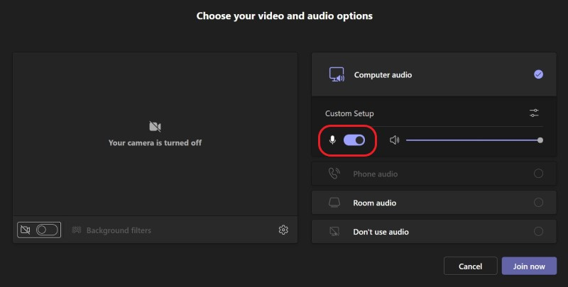
Mute or unmute before entering
Mute or unmute before a meeting
Before joining a meeting, you can turn your mic on or off by selecting the toggle next to Mic Mute button on the right side of your screen.

Slide 6
Mute or unmute during a meeting
To turn on your mic during a meeting, select Mic teams unmute icon in meeting controls at the upper-right area of your screen. To turn off your mic, select Mic Mute button again to mute yourself.
You can also toggle your Mic on and off by pressing the global shortcut keys Ctrl+Shift+M once.

Slide 7
Will this session be available to view later?
After editing, this session will be available in a few days for viewing and download at:
www.legion.org/training/training-tuesdays

Slide 8
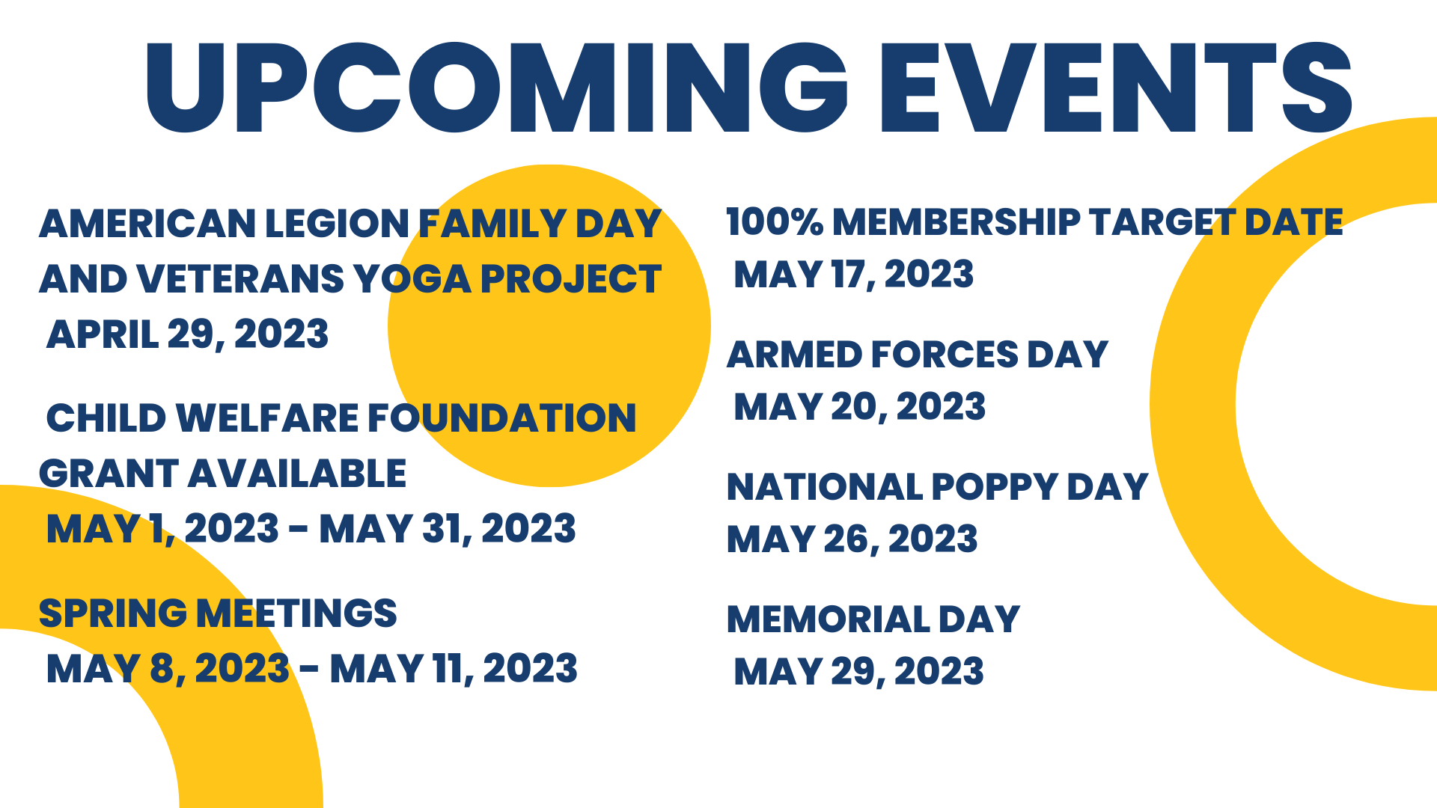

Slide 9
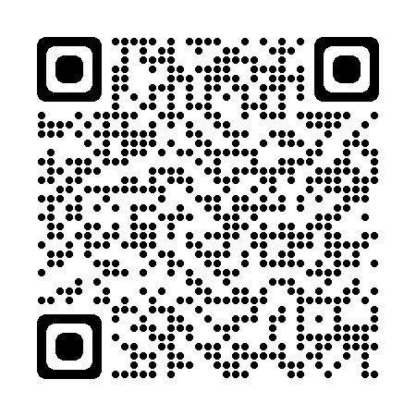
DOWNLOADABLE TRAINING MATERIALS
Training Modules contain easy-to-follow lesson plans to assist trainers of all experience levels. The topics can be taught individually at post meetings or combined to conduct larger district or department wide training seminars.
Visit: legion.org/training
Click on: Training In A Box

Slide 10
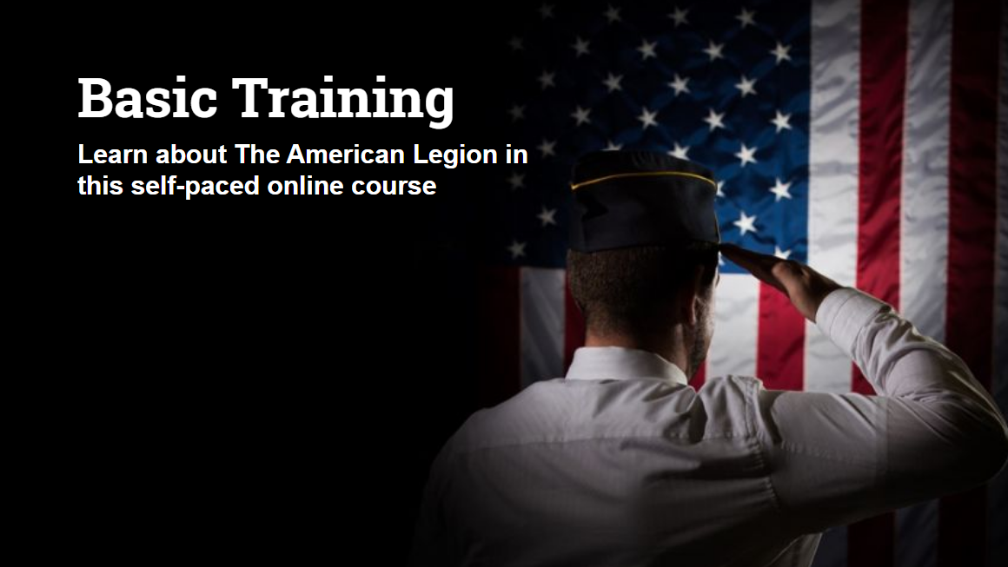
Click the TAKE BASIC TRAINING link at: legion.org/training
Already taken the old course? The American Legion Extension Institute has been rewritten, updated, streamlined and enhanced with videos, digital photos, clickable links, a historical timeline and additional features.

Slide 12
Media Alliance Training Tips
VISIT: https://www.youtube.com/watch?v=0RRWYVUtXJU&list=PLHMR9MmnivfOWyhsIFyXA076m1DH8c4zX
Style Guide
Texting to communicate with membership
Photography
Social Media
#BeTheOne

Slide 13
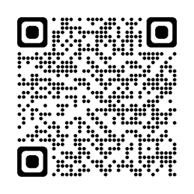
FOUNDATION OF HOPE
When children of military personnel and veterans face urgent, unexpected hardships the American Legion opens their pockets and assist from the Foundation of Hope. Originally founded in 1925 as the American Legion endowment fund, the foundation has rigorous training and accreditation costs for American Legion claims experts who provide free representation for veterans and families applying for benefits, survivor assistance, and other opportunities.
legion.org/donate

Slide 14
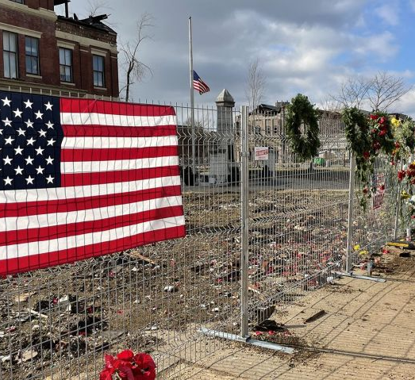
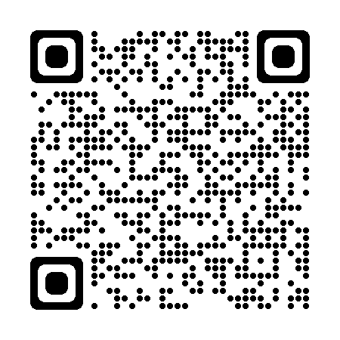
NATIONAL EMERGENCY FUND
The American legions national emergency fund, NEF, is available to help American Legion members and posts, and sons of the American Legion members, who have been impacted by natural disasters.
Apply or donate at:
legion.org/emergency

Slide 15
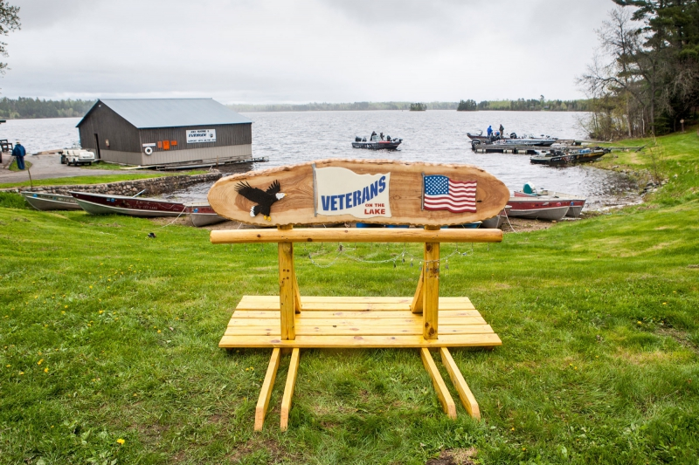
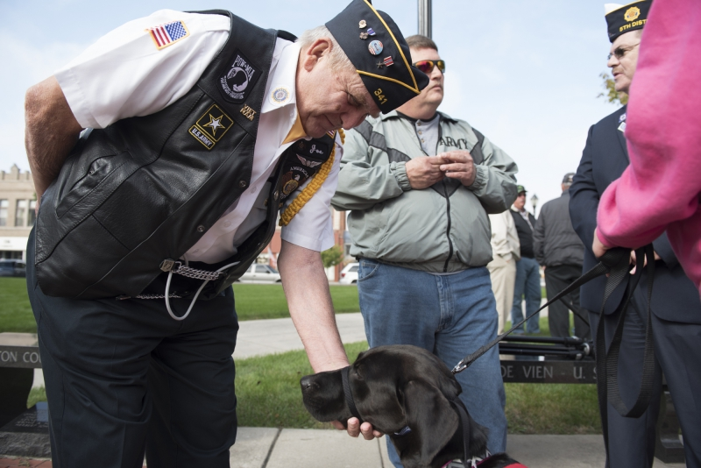
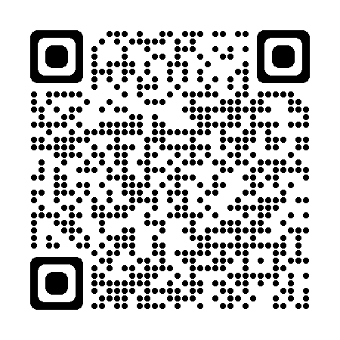
OPERATION COMFORT WARRIORS
Today, wounded warriors need a variety of items to help in their recovery. These gifts will not make our wounded warriors whole again, but they do express the Legion's gratitude.
The program relies on funds, which are used to purchase items for the servicemembers.
Donate or Apply at:
legion.org/operationcomfortwarriors

Slide 17
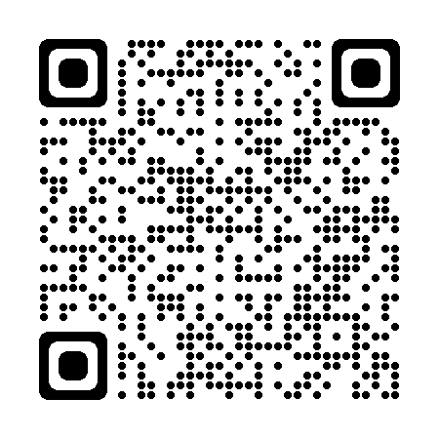
AMERICAN LEGION VEHICLE
DONATION PROGRAM
TAX-DEDUCTIBLE AUTO DONATIONS NOT ONLY GET RID OF THAT OLD CLUNKER …. THEY HELP AMERICAN LEGION PROGRAMS AND SERVICES.
www.legion.careasy.org
or
Call: 1-844-4LEGION

Slide 18
Pledge to Be the One at betheone.org by signing up for email updates.
For Yourself - Be the One to:
Talk with others about how you are feeling.
Ask for help when you know you need it.
Know there are millions of people ready to help you.
Remember your family and friends care!
For Family & Friends - Be the One to:
Ask veterans in your life how they are doing.
Listen when a veteran needs to talk.
Reach out when a veteran is struggling.

Slide 19
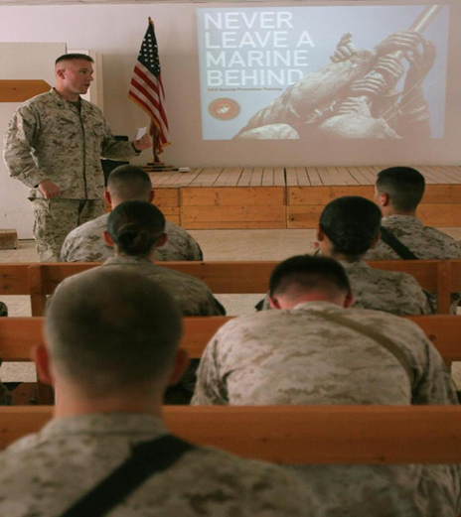
Talking About Suicide Without Stigma

Slide 20
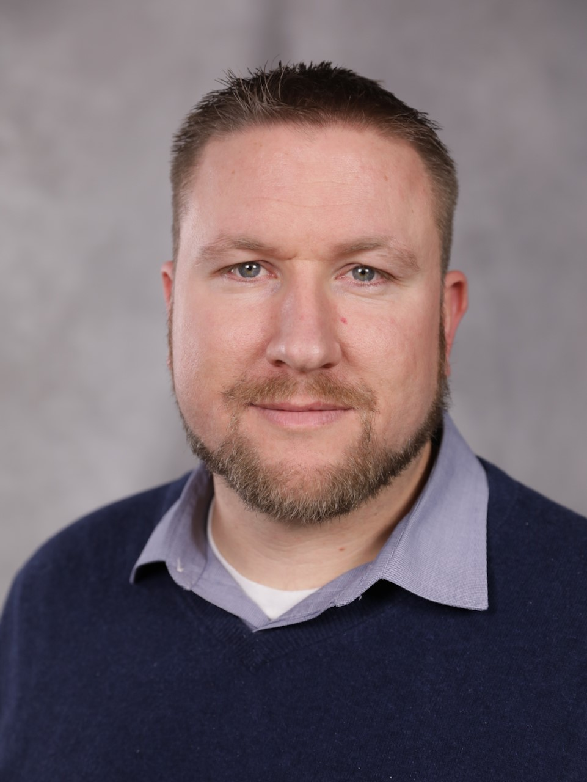
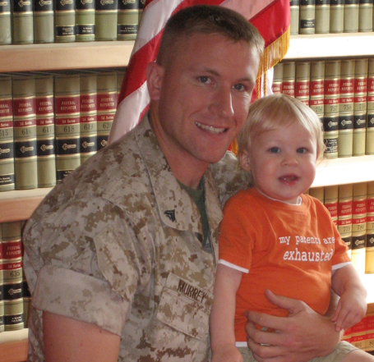
Jason Murrey
Husband & Father
Served in USMC (03-2010)
OIF Veteran (2009)
Homeless Veteran Case Manager
Addictions Group Facilitator
Mentor/Advocate
Contact: JRMURREY@GMAIL.COM

Slide 21
Objectives
Gain an understanding for the frequency of suicide and self-injury among veterans.
Breaking down stigma to learn about interventions that are used for preventing and treating self injury and suicidality in veteran populations.

Slide 22
2022 National Veteran Suicide Prevention Annual Report, VA Suicide Prevention, Office of Mental Health and Suicide Prevention, September 2022
In each year from 2001 through 2020, age- and sex-adjusted suicide rates of Veterans exceeded those of nonVeteran U.S. adults. The differential in adjusted rates was smallest in 2002, when the Veteran rate was 12.1% higher than for non-Veterans, and largest in 2017, when the Veteran rate was 66.2% higher. In 2020, the rate for Veterans was 57.3% higher than that of non-Veteran adults.
In each year from 2001 through 2020, age- and sex-adjusted suicide rates of Recent Veteran VHA Users exceeded those of Other Veterans. The differential in adjusted rates was smallest in 2018, when the rate for Recent Veteran VHA Users was 9.4% higher, and largest in 2002, when the rate was 80.9% higher. In 2020, the age and sex-adjusted suicide rate of Recent Veteran VHA Users was 43.4% higher than for Other Veterans
In 2020, suicide was the 13th leading cause of death among Veterans overall, and it was the second leading cause of death among Veterans under age 45.

Slide 23
In 2020, there were 6,146 Veteran suicides. This was on average 16.8 per day. In 2020, there were 343 fewer Veteran suicides than in 2019, and the number of Veteran suicides was lower than each prior year since 2006. In 2020, adjusting for population age and sex differences, the suicide rate for Veterans was 57.3% greater than for non-Veteran U.S. adults. Among U.S. adults who died from suicide in 2020, firearms were more commonly involved among Veterans (71.0%) than non-Veterans (50.3%). What do these #’s mean?
Continued

Slide 24
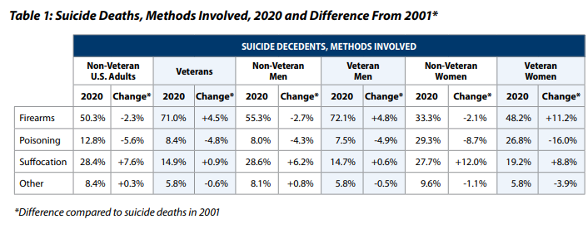
Lethal Means Involved in Suicide Deaths
Table 1 above provides information on lethal means involved in suicide deaths of non-Veteran U.S. adults and veterans in 2020, and a measure of change compared to suicides in 2001

Slide 25
Suicide Rates by Age
Figure 5 presents unadjusted suicide rates for veterans, by age categories in year, 2001 to 2020. From 2001 to 2020, the unadjusted suicide rate among veterans between the ages of 18 and 34 increased by 95.3%. For those ages 35 to 54, the rate increased by 12.9%; For those age 55 to 74, the rate increased by 58.2%; And for those age 75 and older, the rate increased by 21.2%. From 2019 to 2020, suicide rates among veterans between the ages of 18 and 34 increased while rates for other age group decreased.

Slide 27
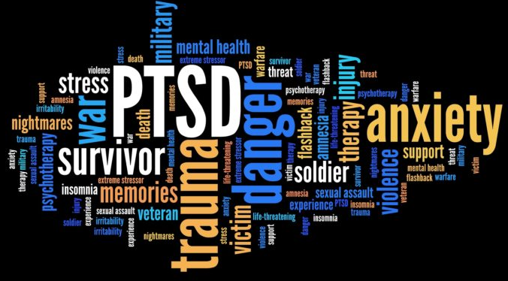
PRIDE
YOU WOULDN’T UNDERSTAND
BROKEN
ISOLATION
IDENTITY CRISIS
WEAK
HOPELESS
SUCK IT UP
ONLY ME
BURDEN

Slide 28
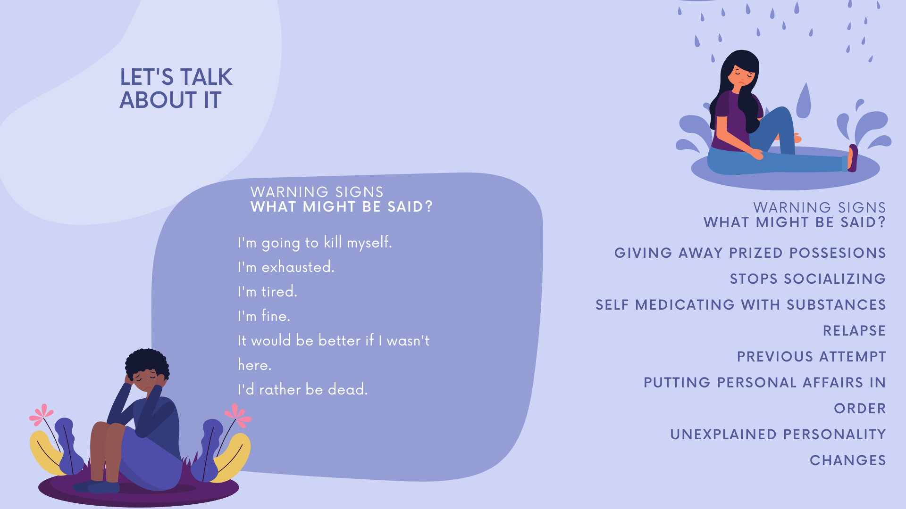

Slide 30
“ICEBERG DEAD AHEAD!”
2020 Veteran Pop: 19,397,944
Reported Suicides: 6146
Unreported: 5% - 25% (where does it sit with veterans?)
Non-Fatal Suicide Behaviors: 40x to 100x # of suicides
Number of People Affected: Many
Ideations: 3x population

Slide 31
LET’S TALK ABOUT IT
Ask the questions
Are you thinking about suicide?
Do you have a plan?
What it your plan?
Counseling on Access to Lethal Means / Means Removal
One of the most important things you can do is identify to the person in crisis that you see them, empathize with their crisis and listen to how they became to be in the crisis – Oftentimes, it leads to identifying what/who is important to them and other protective factors.

Slide 32
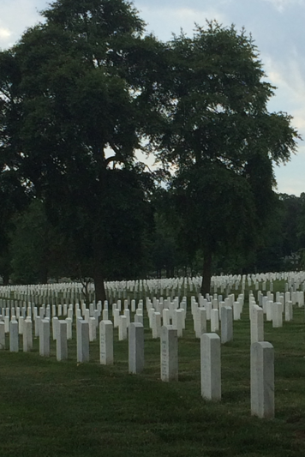
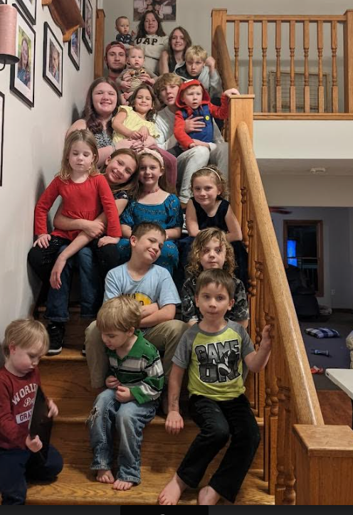
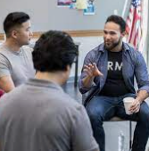
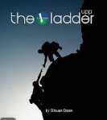
Protective Factors
Purpose
Family
Accountability
Resiliency
Great self-evaluation and purpose finding resource.
Challenge Cards
WHO IS YOUR JARVIS?

Slide 33
National Resource
988, Veterans press 1
Suicide & Crisis Lifeline

Slide 34
National Resources
741741

Slide 35
National Resources
Pledge to Be the One at betheone.org by signing up for email updates.

Slide 36
National Resources
va.gov/REACH: Life has its challenges. You don’t have to solve them alone. That’s true whether it’s an everyday struggle, or something more complicated.This site was designed for Veterans to proactively seek support and resources. You’re not alone. You’ve got this. Don’t wait. Reach out.

Slide 37
National Resources
Vet Centers are counseling centers that provide social and psychological services, including professional readjustment counseling to eligible Veterans, active duty service members, including National Guard and Reserve components, and their families. They offer individual, group, marriage, and family counseling, as well as referrals to other VA or community services. Vet Center staff, many of whom are Veterans, are experienced and prepared to discuss war-related issues and trauma.

Slide 38
Regional Resources
State Department of Veteran Affairs
Vet Centers
VA Hospital
Community Mental Health Center
Local American Legion / VFW Posts
Local Wellness Programs
Local AFSP Chapter
Local Suicide Prevention (grassroots)
Vet2Vet Programs (Grassroots – normally found on state VA website)
VSO – Veteran Service Officer (found on state VA website)
Systems of Care – (Local Health Department)

Slide 39
Any questions…suggestions…final thoughts?

Slide 40
email: legiontraining@legion.org
Questions
Comments
Suggestions

Slide 41
TRAINING TUESDAY
THANK YOU FOR ATTENDING

Slide 42
Will this session be available to view later?
After editing, this session will be available in a few days for viewing and download at:
www.legion.org/training/training-tuesdays

Slide 44
Pledge to Be the One at betheone.org by signing up for email updates.
For Yourself - Be the One to:
Talk with others about how you are feeling.
Ask for help when you know you need it.
Know there are millions of people ready to help you.
Remember your family and friends care!
For Family & Friends - Be the One to:
Ask veterans in your life how they are doing.
Listen when a veteran needs to talk.
Reach out when a veteran is struggling.

