Slide 1
COMMUNITY ENGAGEMENT EVENTS
THE IMPACT OF COLLECTIVE ACTION

Slide 2
WHAT TO EXPECT
CORE FRAMEWORKS – Understanding the ‘Sea of Goodwill’
PLAN HIGH-IMPACT EVENTS – Set clear goals, engaging stakeholders, and create measurable outcomes.
PROTECT & ELEVATE THE LEGION BRAND – Build marketing strategies that strengthen trust and visibility.
EXECUTE WITH EXCELLENCE – Organize spaces, manage flow, and deliver a compelling program.
MAXIMIZE POST-EVENT IMPACT – Control the narrative, capture stories, and sustain partnerships.
LEAVE WITH A REPLICABLE FRAMEWORK – Gain templates, tools, and a clear strategy to lead successful Legion-led events in your community.

Slide 3
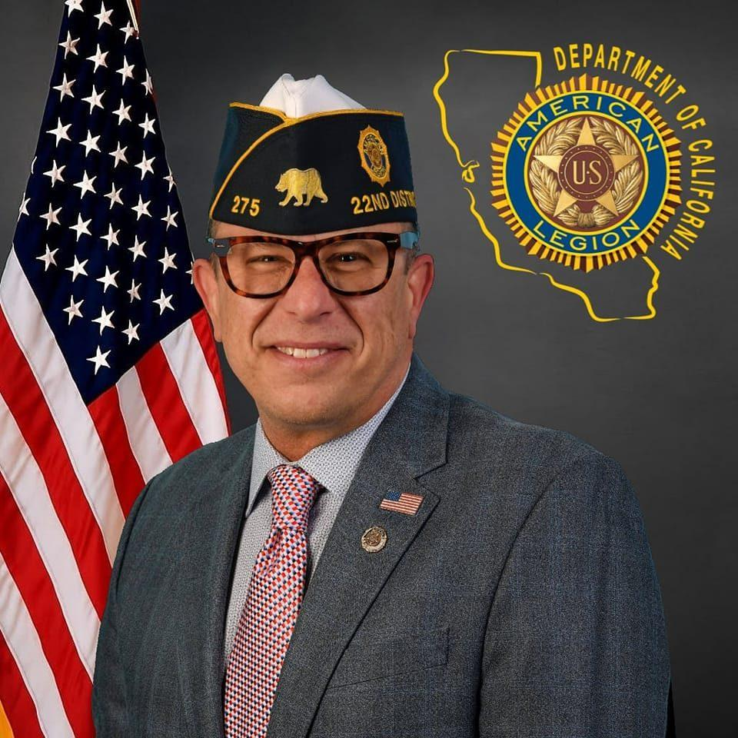
INTRODUCTION
VIC MARTIN, US NAVY (RET.)
District Commander, Department of CA District 22 (San Diego County) 2024-2026
Serving second term as District Commander for San Diego County’s 25 American Legion Posts.
2022–2024 Post Commander, La Jolla Post 275.
Advocate for protecting the Legion brand, fostering collaboration, and growing veteran engagement.

Slide 4
CORE FRAMEWORK
UNDERSTANDING THE "SEA OF GOODWILL"
A broad expanse of government agencies, nonprofits, grassroots groups, and corporate partners — all committed to serving veterans and their families. While these efforts are often genuine and impactful, the lack of coordination can turn this sea into uncharted waters. Veterans may find themselves adrift, facing duplicate services, unclear pathways, or even harmful misdirection. To truly serve, we must chart a clear course, vet our partners, and create structured, navigable channels that lead veterans directly to the support they need.

Slide 5
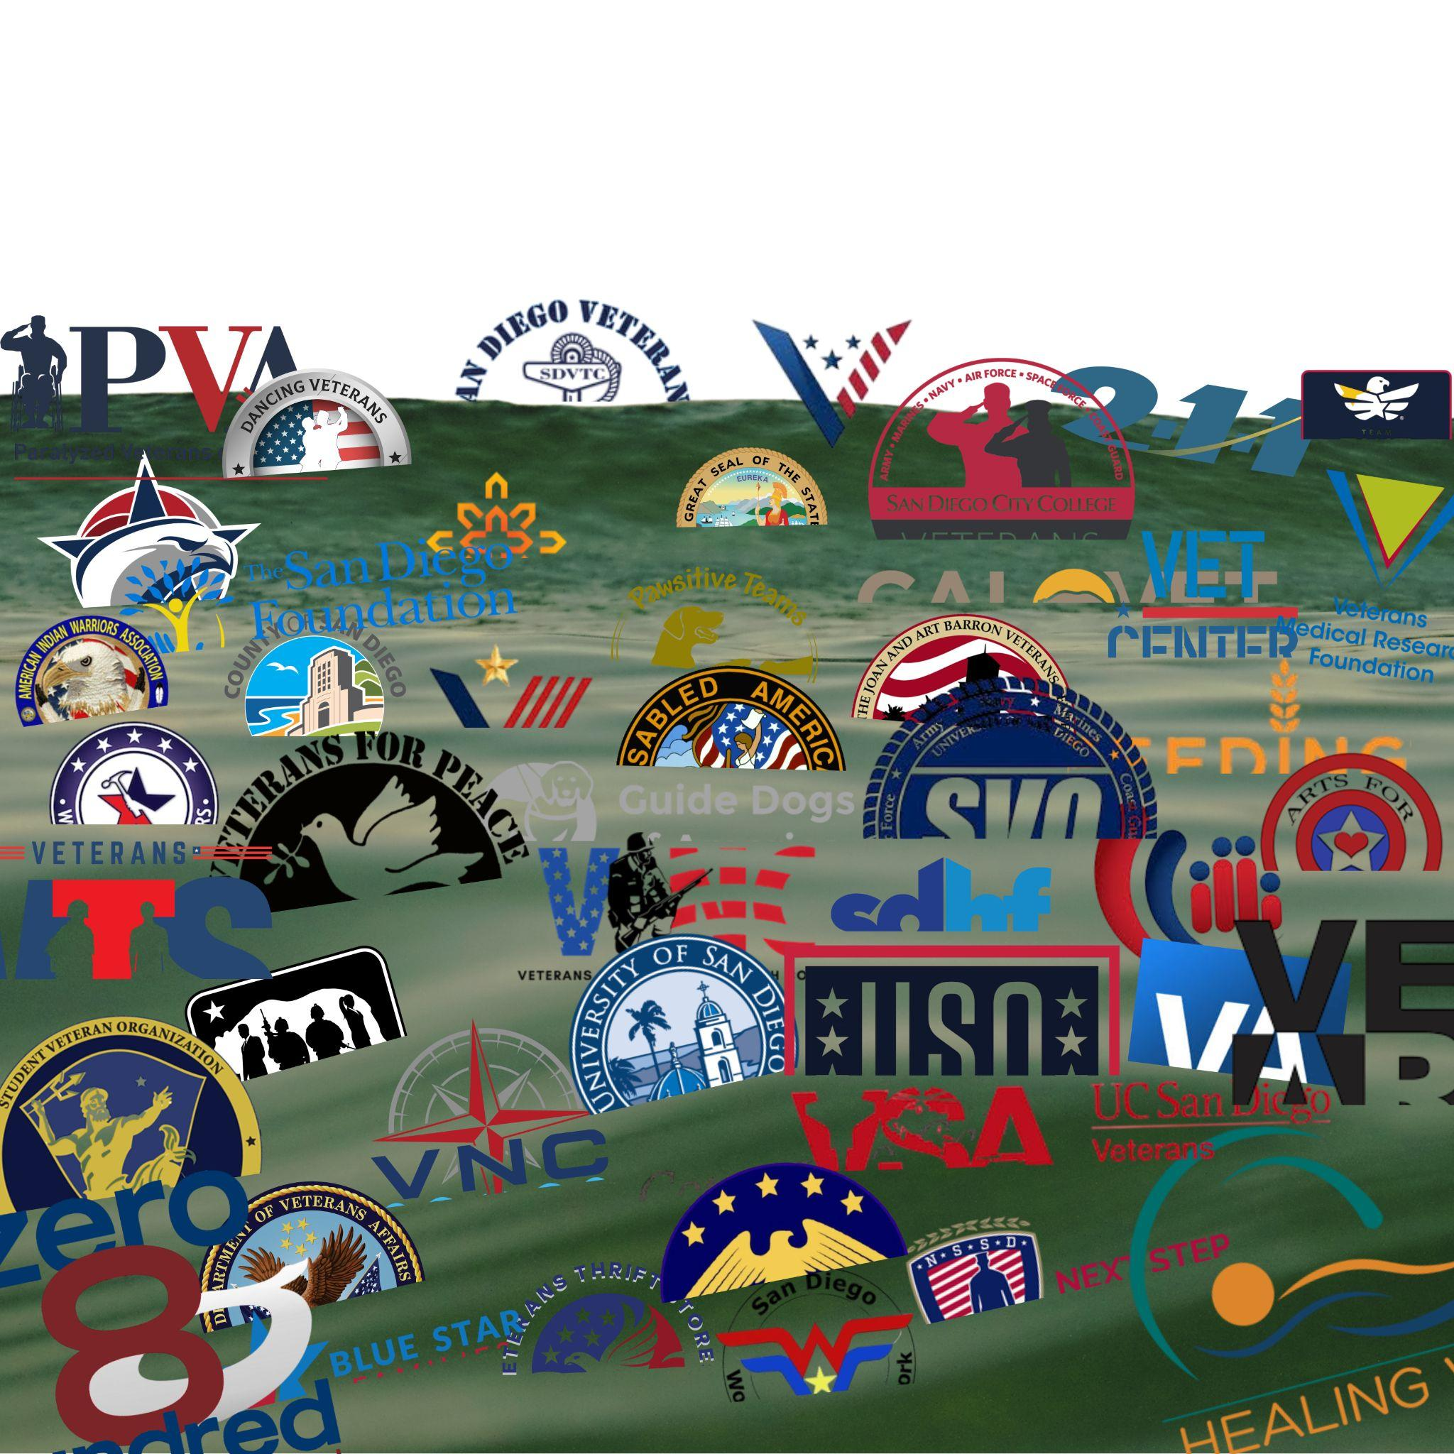
CORE FRAMEWORK
"SEA OF GOODWILL"
Without a clear understanding of roles and responsibilities, organizations risk duplicating efforts—solving problems that are already addressed or concentrating resources in overserved areas—while other critical needs go unmet.

Slide 6
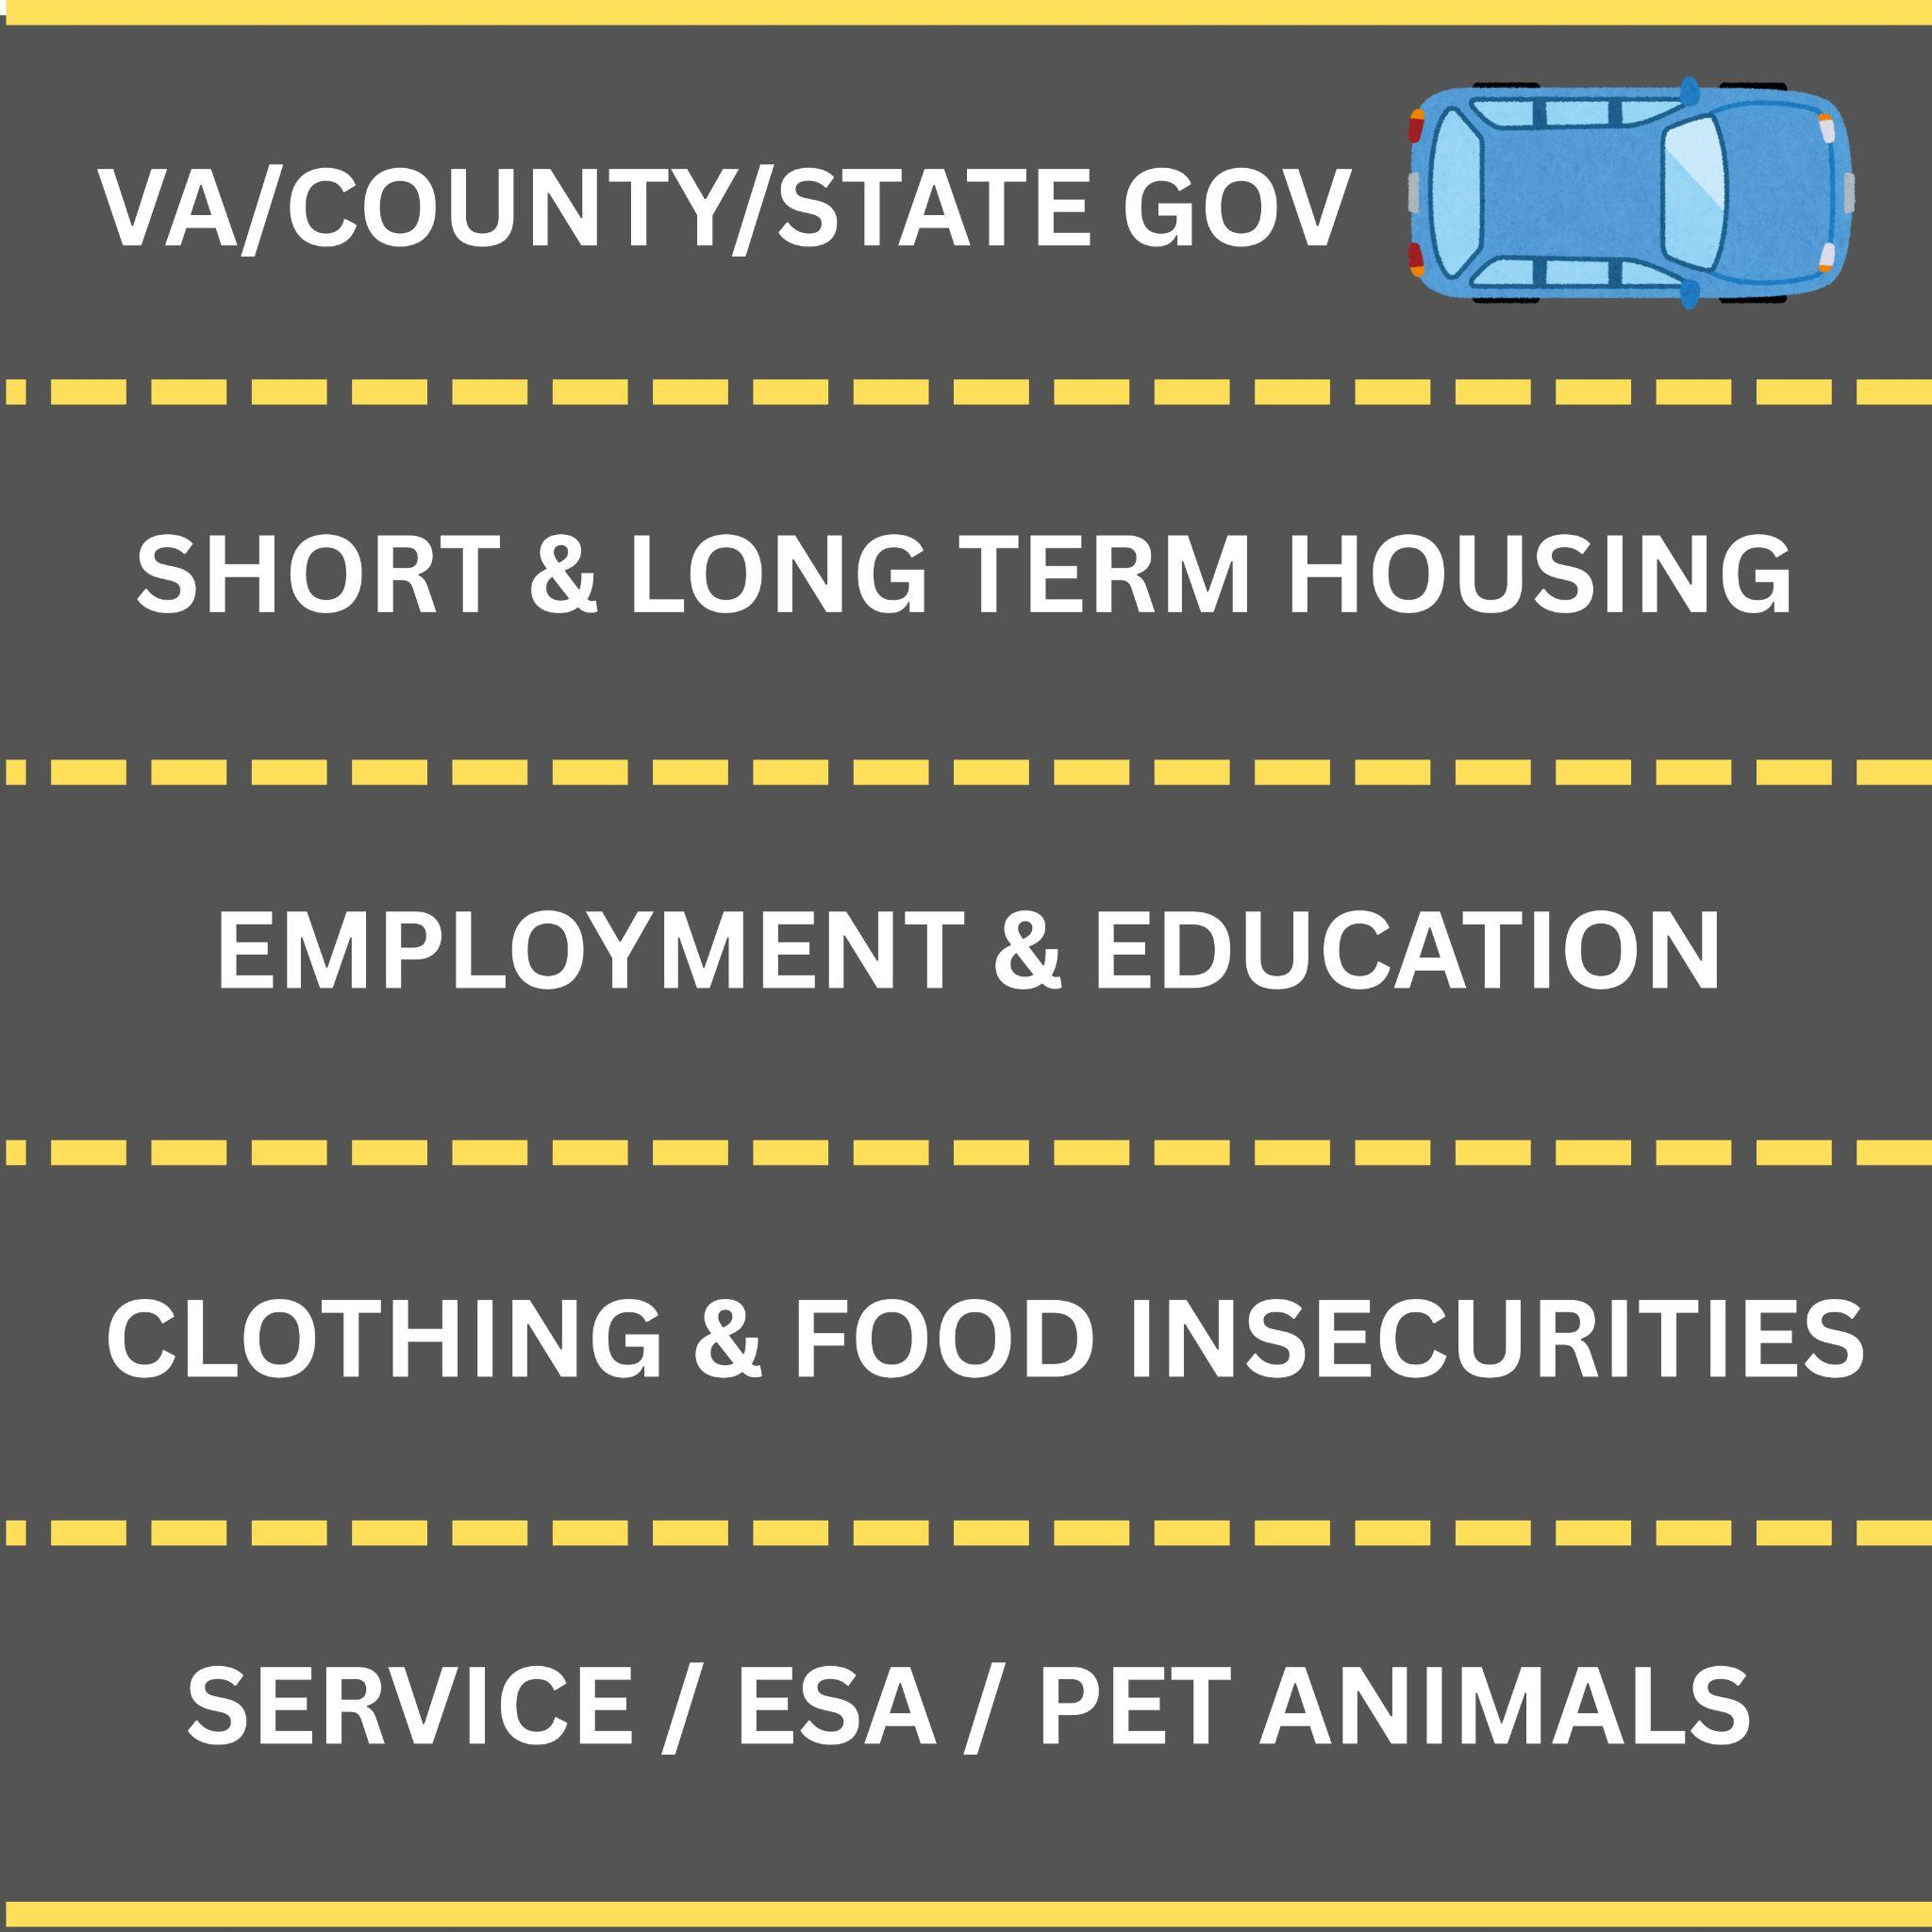
CORE FRAMEWORK
NAVIGATING THE GOODWILL
When you truly understand the Sea of Goodwill, you begin to see the distinct “service lanes” that run through your community — healthcare, housing, education, employment, mental health, legal aid, and more. Recognizing these lanes allows you to align the right partners in the right roles, reduce duplication, and ensure veterans and their families travel a clear, direct path to the support they need.

Slide 7
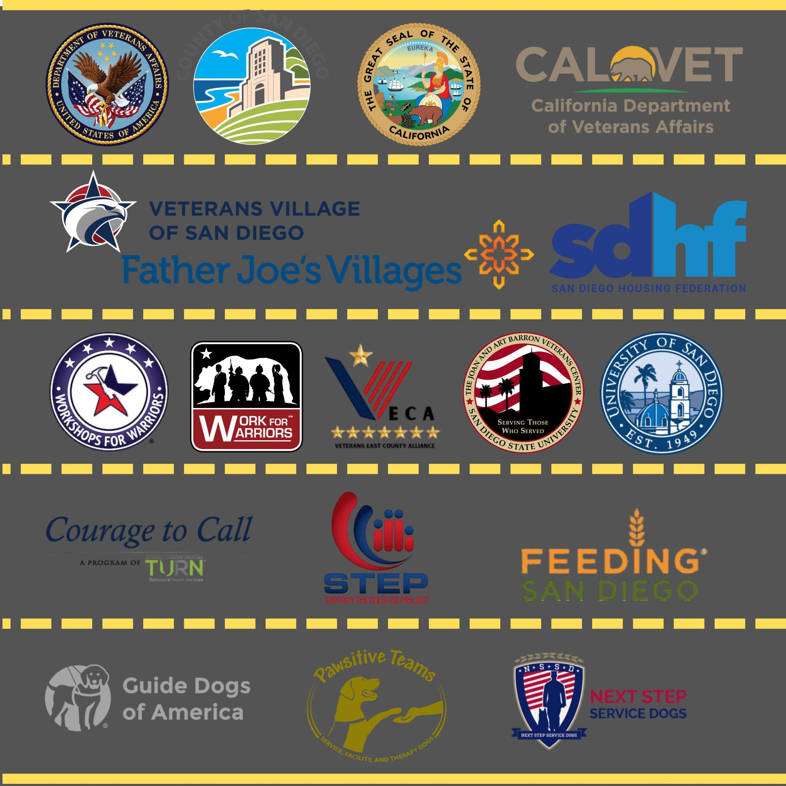
CORE FRAMEWORK
CLARITY OF THE GOODWILL
With a clear view of the service lanes, you can identify exactly where each organization operates and what specific needs they serve. This clarity transforms the Sea of Goodwill from uncharted waters into a navigable map — ensuring every veteran and family is guided to the right resource, at the right time, with confidence.

Slide 8
CORE FRAMEWORK
STANFORD UNIVERSITY’S COLLECTIVE IMPACT MODEL
Stanford University’s Collective Impact Model - A proven framework for solving complex social challenges through structured, cross-sector collaboration. It is built on five core elements:
Common Agenda – All participants share a unified vision, clearly defined problem, and agreed-upon approach to solving it.
Shared Measurement Systems – Partners track progress using consistent metrics, ensuring accountability and transparency.
Mutually Reinforcing Activities – Each organization focuses on its strengths while aligning efforts toward the common goal.
Continuous Communication – Regular, structured communication fosters trust, alignment, and problem-solving.
Backbone Organization – A dedicated, neutral entity (such as your Post or District) coordinates efforts, manages logistics, and sustains momentum.

Slide 9
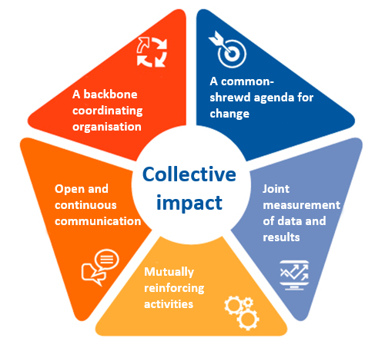
CORE FRAMEWORK
STANFORD UNIVERSITY’S COLLECTIVE IMPACT MODEL
This model transforms fragmented good intentions into coordinated, high-impact action by aligning organizations around a shared purpose and clear roles. Instead of duplicating efforts or working in silos, partners leverage their strengths in a deliberate, organized way — maximizing resources, improving accountability, and closing service gaps.
The result is more efficient use of time and funding, reduced confusion for those seeking help, and communities receiving comprehensive, seamless, and truly impactful support.

Slide 10
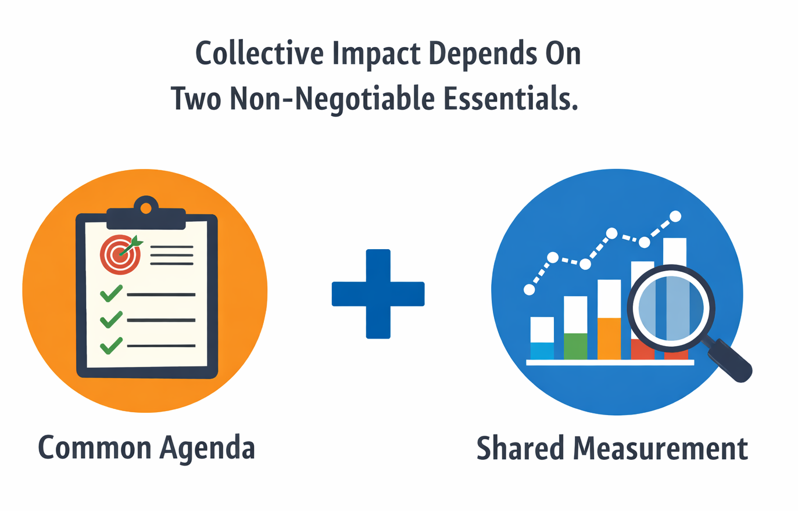
CORE FRAMEWORK
COLLECTIVE IMPACT: ALIGNING PURPOSE AND MEASUREMENT
Effective collective impact depends on two non-negotiable essentials: a common agenda and shared measurement. A common agenda aligns partners around the same goals and outcomes, while shared measurement ensures progress is tracked using the same indicators.
Together, they create accountability, enable learning across partners, and turn collaboration into measurable, collective results.

Slide 11
PLANNING EVENT
CLARIFY THE MISSION
Connecting to Local Resources
Employment
Camaraderie
Networking
Training
Seminar
Supportive Event
Health
Benefits Education
VA Enrollment
Physical Fitness
Clearly define what you aim to achieve — whether it’s recruitment, outreach, awareness, or improved service access.
Ensure these goals are specific, measurable, and shaped by stakeholder input, so every effort aligns with a shared purpose and impact can be tracked.

Slide 12
PLANNING EVENT
IDENTIFY & QUALIFY STAKEHOLDERS
Do they provide the same services as The American Legion?
Do they have a similar message to The American Legion?
Are they a competitor or collaborator?
Do they carry The American Legion’s water?
Engage partners across government, community, and business sectors — from the VA and local officials to faith-based groups, schools, grassroots organizations, employers, and funders. Ensure every stakeholder is aligned with American Legion values and meets our impact standards before bringing them to the table.

Slide 13
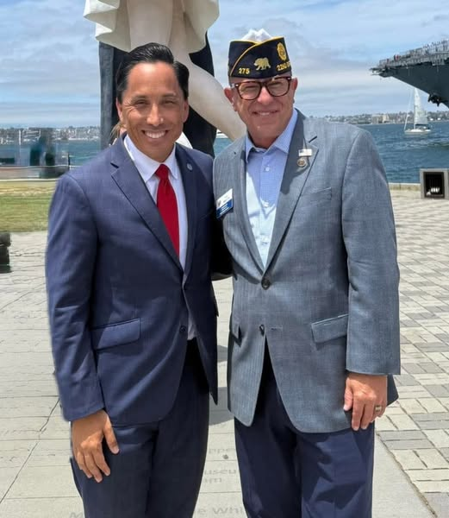
PLANNING EVENT
DEFINE A VALUE EXCHANGE
Clearly communicate what’s in it for each stakeholder and how the partnership benefits both sides.
What the Legion offers: access to a trusted veteran audience, legacy credibility, media exposure, and deep community trust.
What the Legion asks: event promotion, on-site participation, and contributions of services, materials, or staff.
Educate stakeholders on the Legion and their potential value and impact before inviting their engagement.
San Diego Mayor, Todd Gloria

Slide 14
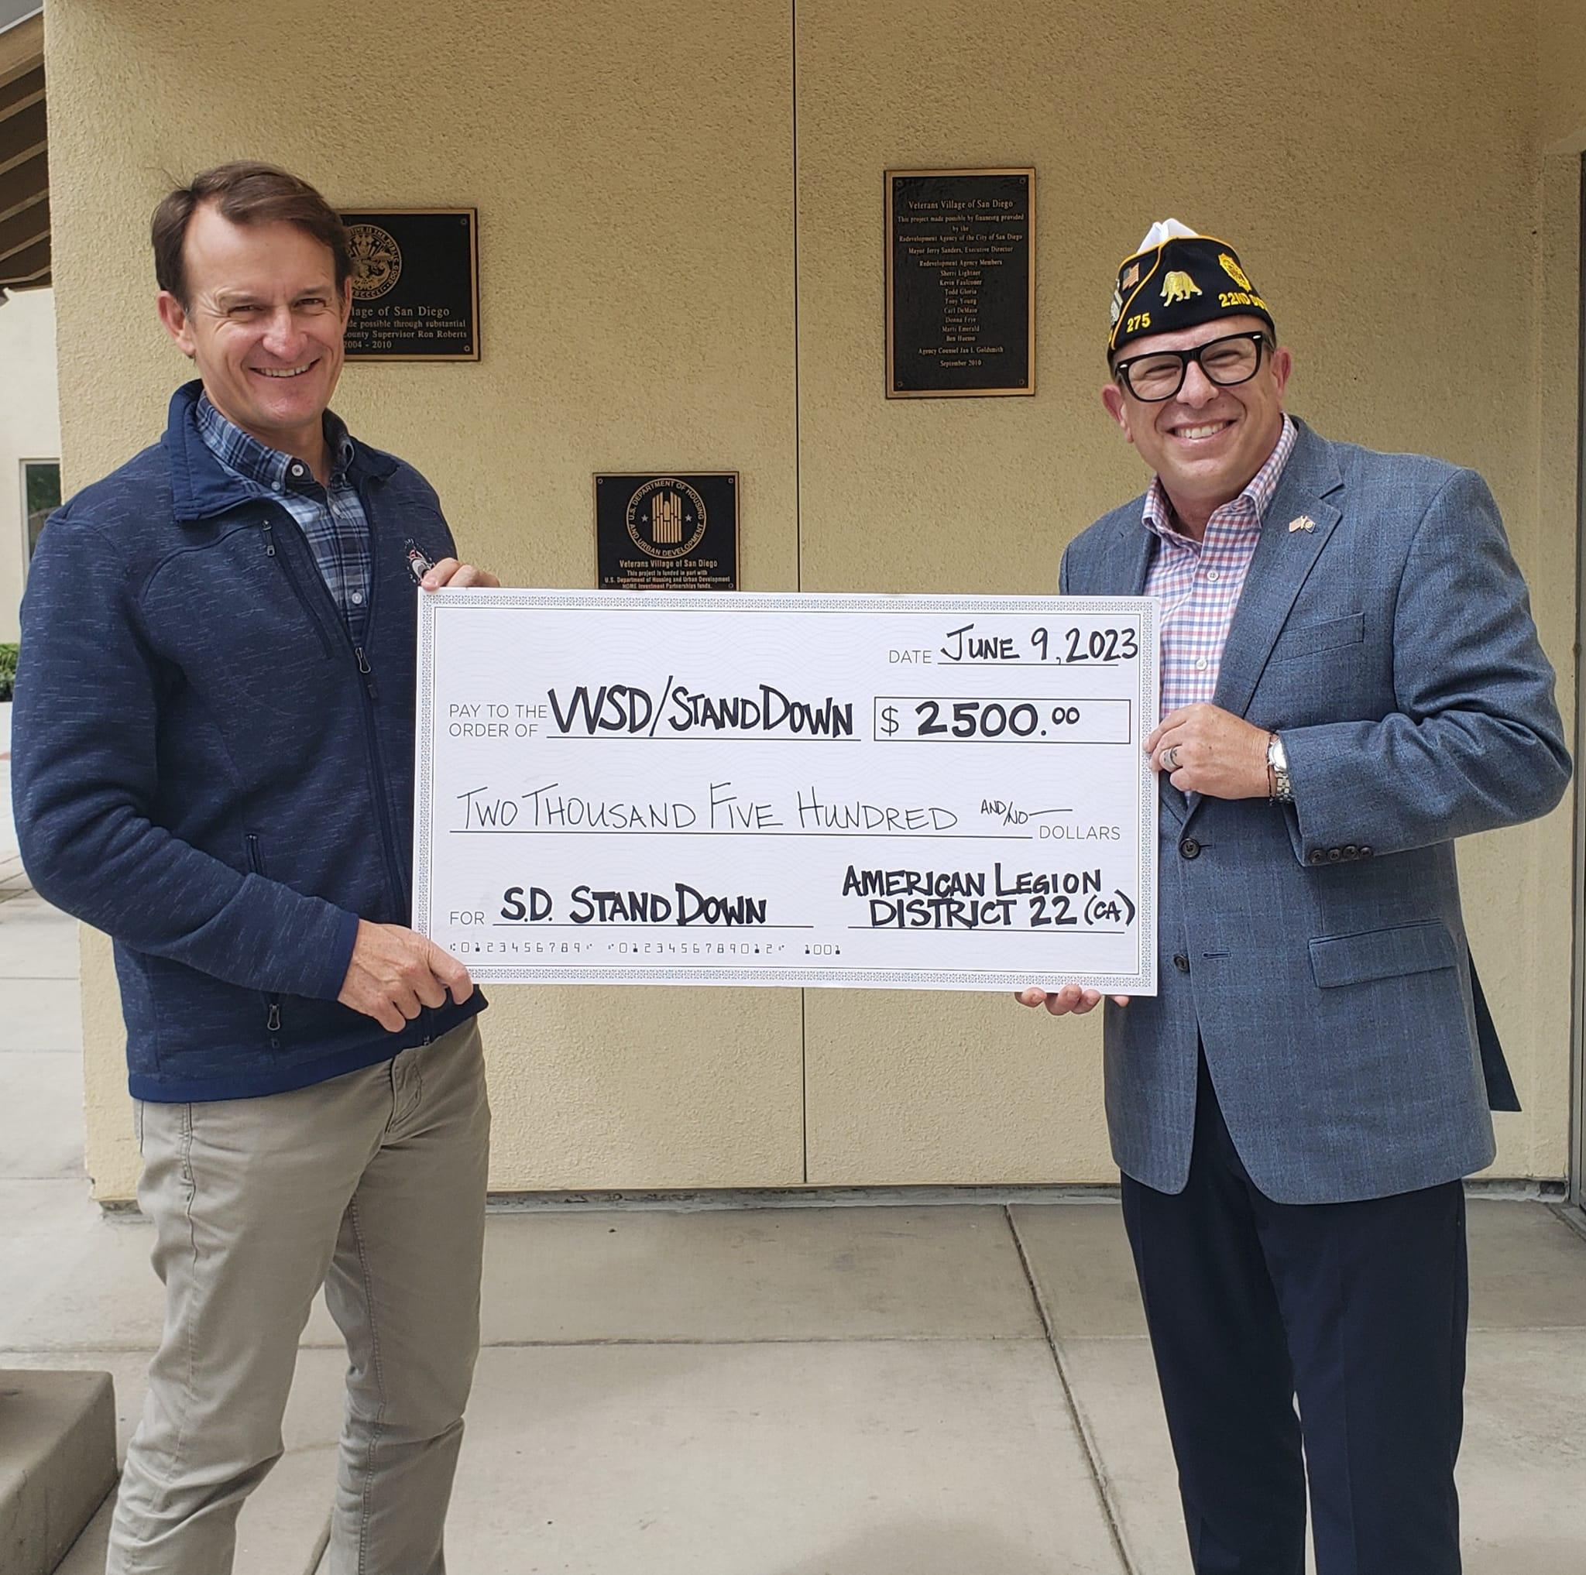
PLANNING EVENT
CRITICAL VALUE EXCHANGE
The veteran and their family are the most important stakeholders — and every partnership must deliver real, measurable value to them above all else. That means improved access to services, stronger community connections, and meaningful support they can see and feel.
Capt. Brett Crozier, Exec. Dir. at Veterans Village of San Diego

Slide 15
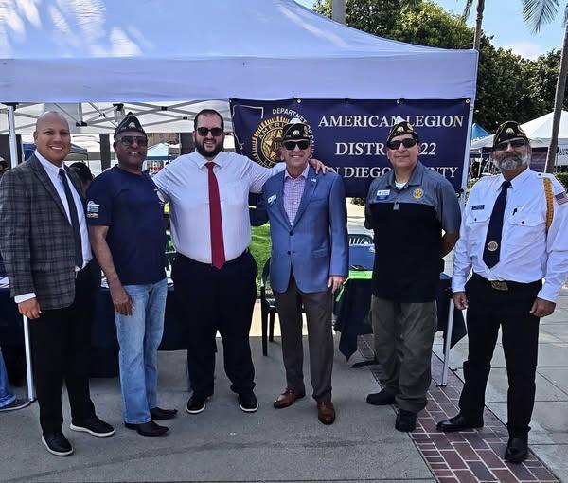
PLANNING EVENT
BUILD THE PLANNING TEAM
Bring together leaders from each stakeholder category — including veterans and families — to ensure every perspective is represented. Assign clear roles and responsibilities, set recurring meetings, and create shared deliverables and timelines so the team moves forward with unity, accountability, and purpose.
Jordan Marks, San Diego County Tax Assessor

Slide 16
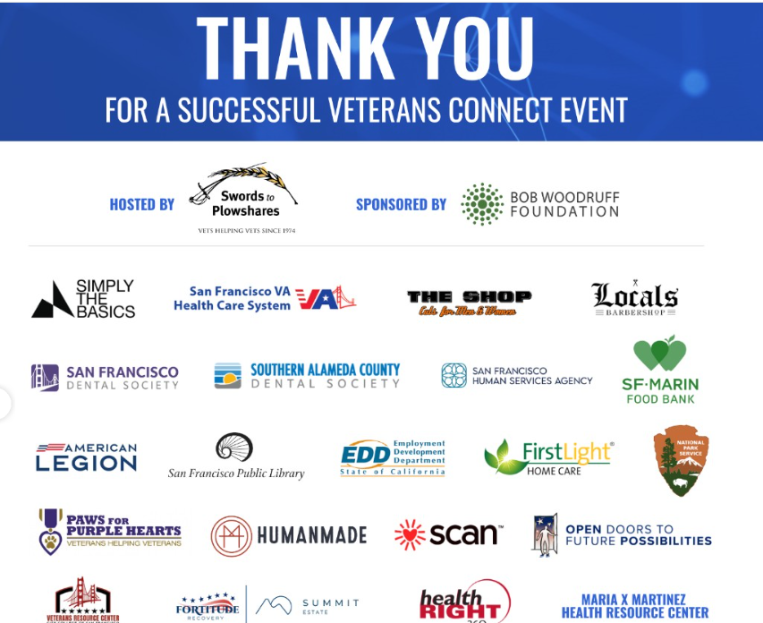
BRANDING & MARKETING
PROTECT THE LEGION BRAND
Ensure the Legion identity is always prominent, consistent, and respected. Co-brand only with partners whose missions align and whose role is clearly subordinate to Legion leadership. Avoid affiliations with any group that could misrepresent, politicize, or compromise the integrity of the American Legion.
Legion as a participating organization

Slide 17
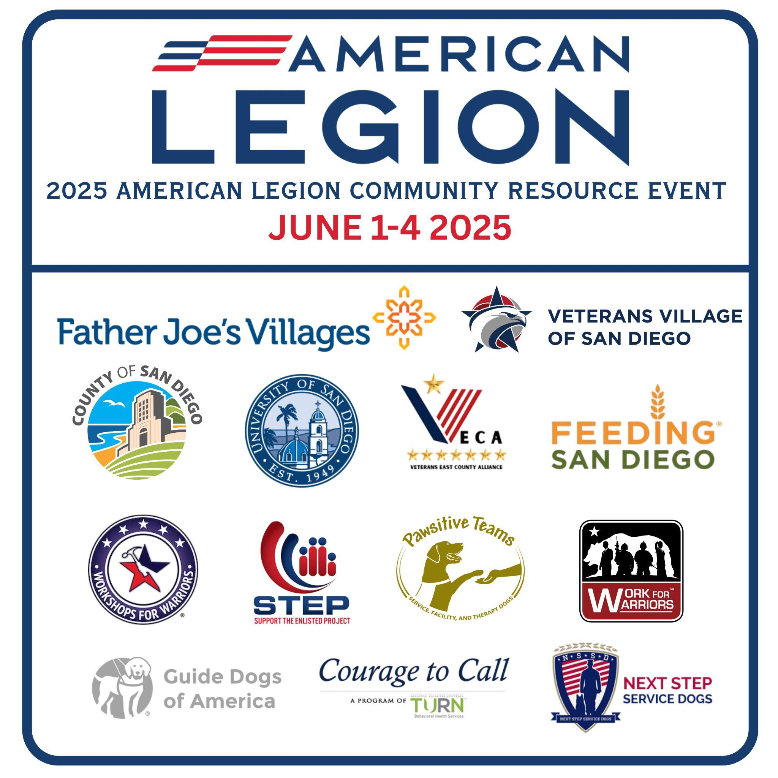
BRANDING & MARKETING
PROTECT THE LEGION BRAND
The way we present ourselves shapes how the public and our partners perceive us. The American Legion must always lead with a strong, consistent identity—never diluted, overshadowed, or confused. Co-branding should only occur with partners whose missions genuinely align with ours and whose role is clearly secondary to Legion leadership.
Legion hosting organizations

Slide 18
BRANDING & MARKETING
BUILD A MARKETING TIMELINE
6–8 weeks out: send save-the-date notices and teaser content.
4–6 weeks: launch flyers, email campaigns, and add to internal/external calendars.
3 weeks: roll out social media promotions and coordinate partner cross-promotion.
1 week: execute a final media push and deliver community-level reminders / News Interviews.
Create a structured outreach plan that builds momentum. It takes significant planning to prepare, only a split second to host the event, and dedicated follow-up to make it truly successful. Treat the marketing timeline as a full-cycle effort — before, during, and after the event.

Slide 19
BRANDING & MARKETING
ENGAGE STAKEHOLDERS IN PROMOTION
Leverage every partner’s network to amplify the event and keep messaging consistent.
Also, provide shareable graphics and messaging toolkits and guidance so all promotions align with the Legion’s brand and mission.
Legion messaging: “Proud to host [Partner] at our event.”
Partner messaging: “Excited to join the American Legion in serving our veterans.”

Slide 20
BRANDING & MARKETING
OWN THE NARRATIVE BEFORE IT BEGINS
Control the story from the start — don’t let others define it for you. Publicly frame the event with intention and clarity so the community knows:
Who is hosting — the American Legion’s leadership and role.
Why it matters — the veteran and family impact at the heart of the mission.
Who will be there — partners, stakeholders, and special guests.
What outcomes are expected — the tangible results the event will deliver.
By shaping the narrative early, you set expectations, inspire engagement, and protect the Legion’s message.

Slide 21
EVENT EXECUTION
VISUAL AND PHYSICAL SETUP & FLOW
Place the American Legion at the heart of the event — with the Legion table, signage, etc. front and center, surrounded by branded signage, banners, and attire that project unity and credibility. Design the space to reflect the “freeway model,” where service lanes are clearly defined and easy to navigate. Group similar services together, maintain logical station placement, and use schedules to guide attendees toward key areas. This intentional setup avoids confusion, ensures a smooth flow, and creates a professional, veteran-focused experience from the moment guests arrive.

Slide 22
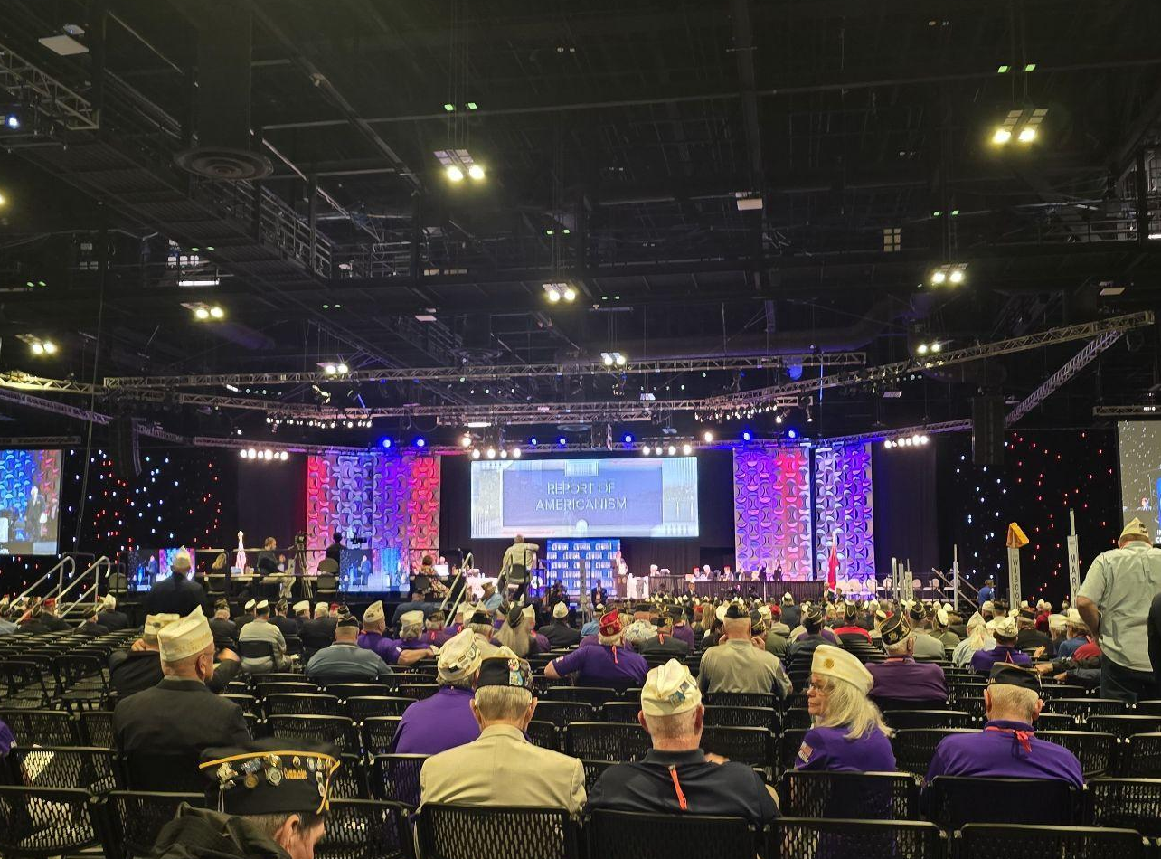
EVENT EXECUTION
DESIGN THE PROGRAM
Open with impact — a Presentation of Colors, the Pledge of Allegiance, and remarks that set the tone and purpose. Include heartfelt testimonials from veterans and families to keep the mission front and center. Recognize stakeholders and partners in ways that are sincere, visible, and memorable. Every element should flow with intention, honor the mission, and leave attendees inspired to act long after the event ends.

Slide 23
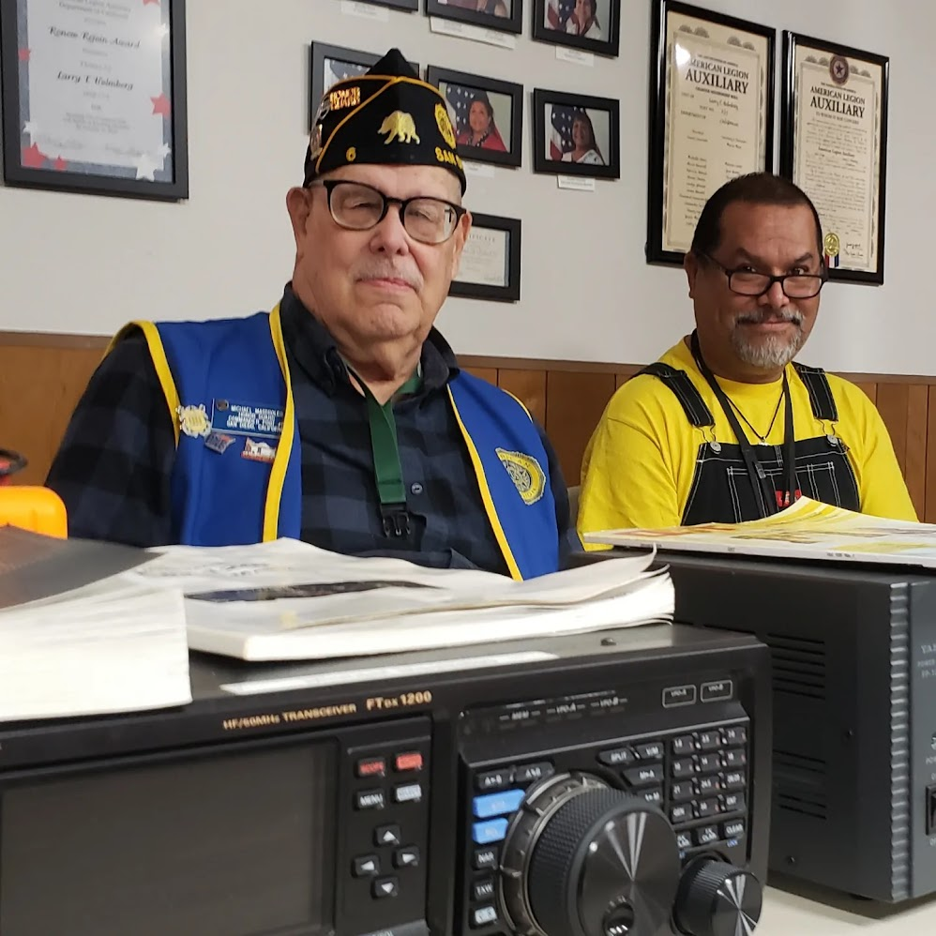
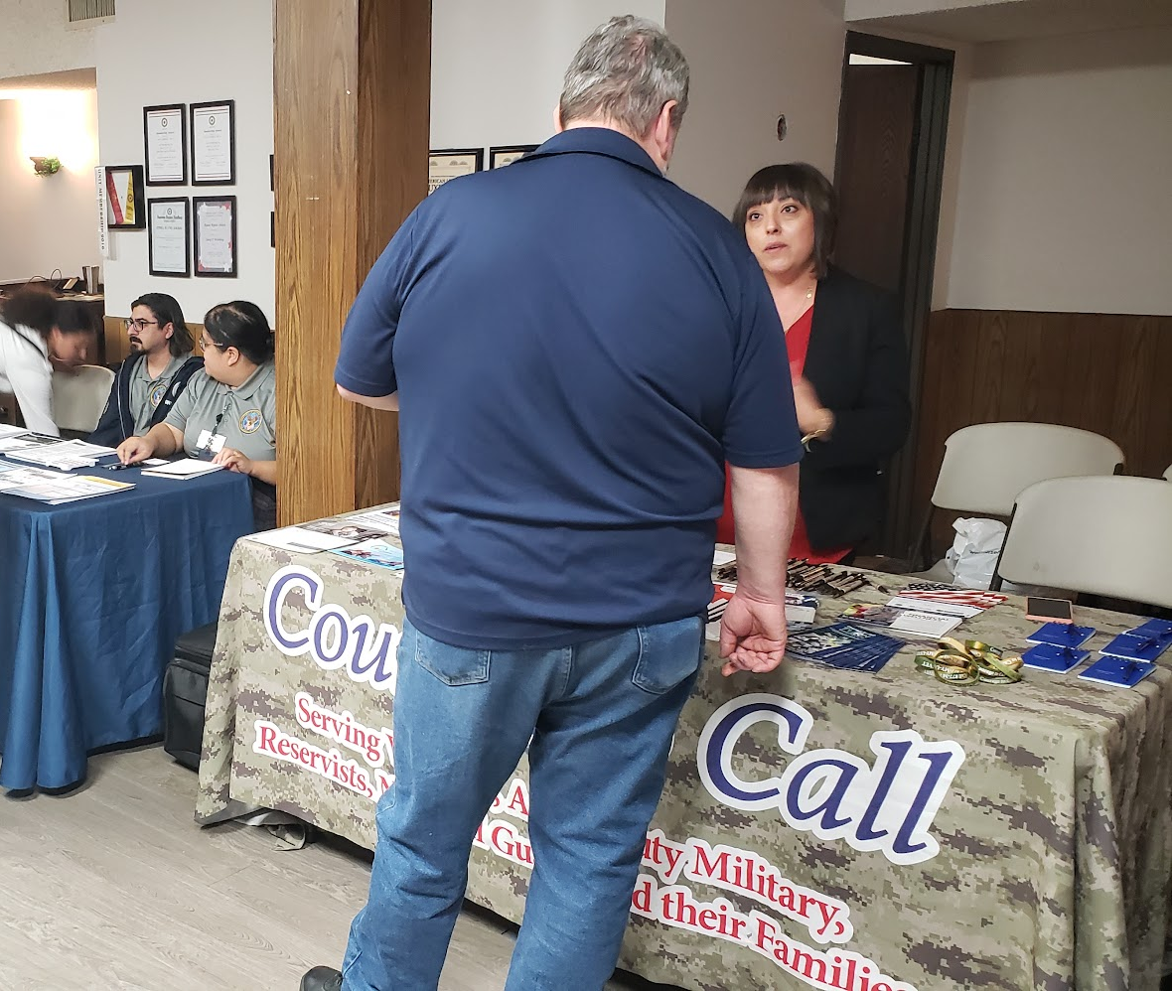
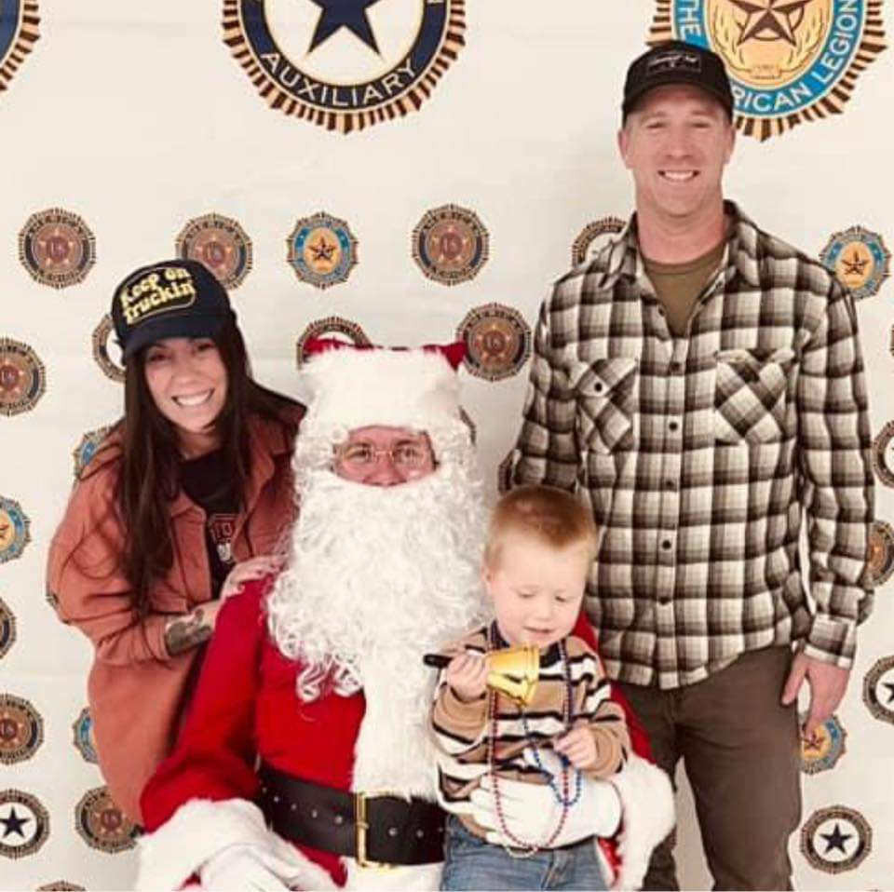
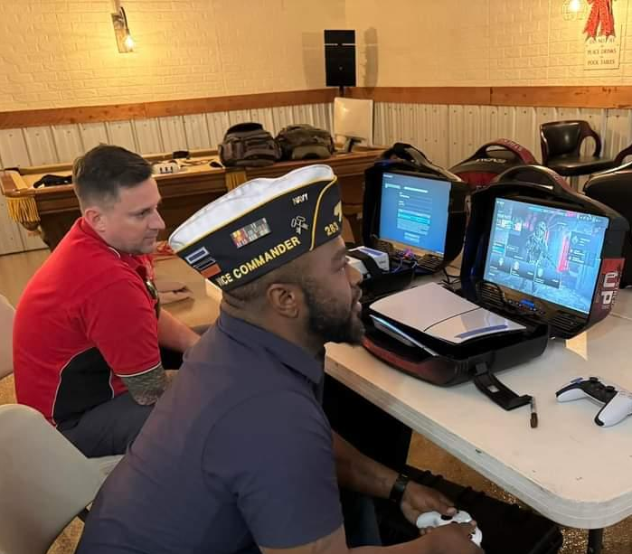
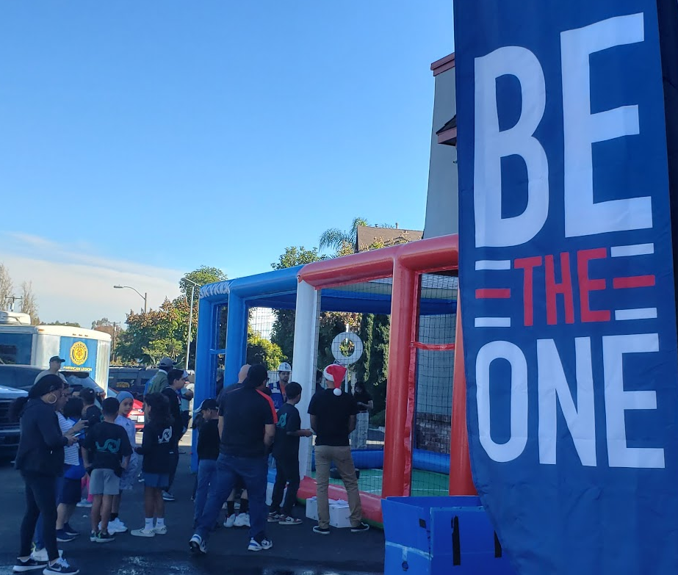
EVENT EXECUTION
MEDIA AND STORY CAPTURE
Assign a dedicated media team to document the event through photos, videos, and impactful quotes. Focus on capturing stories that show real veteran and family impact, not just activity. Share updates in real time to boost visibility, engage the community, and keep the mission alive both during and after the event.

Slide 24
POST-EVENT MEASUREMENTS
QUANTIFYING IMPACT THROUGH EFFECTIVE MEASUREMENT
Measures of Performance (MOP) - What was done
Measures of Effectiveness (MOE) - Results or Change
Conversion Metrics: Ratio of engagement to action
Qualitative Validation - Standardized feedback or surveys
Post-event outcomes should be measured using simple, consistent methods that quantify activity and impact. Measures of Performance track what was done, Measures of Effectiveness assess results or change, conversion metrics show movement from engagement to action, and qualitative validation supports the data. Together, these methods demonstrate value and enable informed decision-making and clear communication with stakeholders.

Slide 25
PLANNING EVENT
MEASURING IMPACT AT THE POST LEVEL
Measures of Performance (MOP) What did we do?
Veterans contacted
Events held
Claims or referrals assisted
Volunteer hours
Attendance or participation
Measures of Effectiveness (MOE) What changed because we did it?
Veterans re-engaged or supported
Veterans connected to care or benefits
Membership growth or renewals
Reduced isolation or crisis risk
Stronger community partnerships

Slide 26
POST-EVENT STRATEGY
DEVELOP A COMPREHENSIVE AFTER ACTION REPORT (AAR)
Create an AAR that doubles as a marketing tool. Capture objectives, outcomes, stakeholder contributions, media coverage, and public engagement. Include lessons learned, photos, stories, and impact statements to showcase results and highlight the Legion’s leadership, value, and impact.
Objectives and outcomes
Stakeholder list and contributions
Media and public engagement
Key lessons learned
Photos, stories, and impact statements

Slide 27
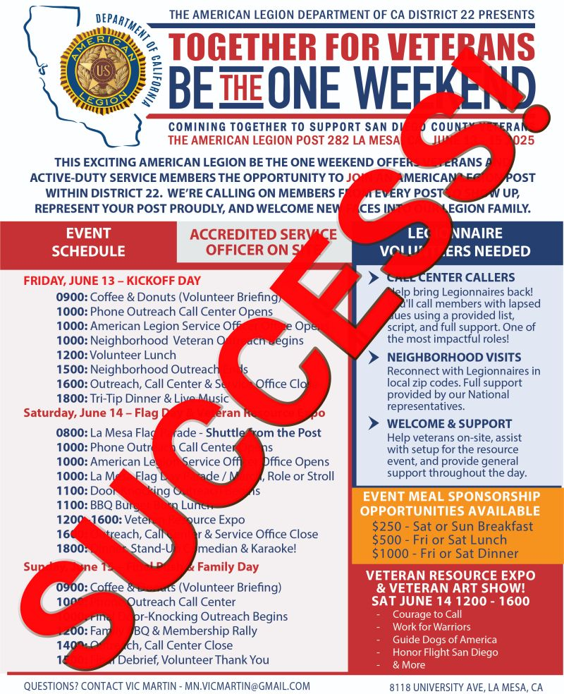
POST-EVENT STRATEGY
CONTROL THE POST-EVENT NARRATIVE
The story isn’t over when the event ends - in fact, this is when it matters most. Within 24–48 hours, release a strong recap with photos, heartfelt thank-yous, and early impact highlights that show how veterans and families were served. Reinforce your event’s success before anyone else defines it, ensuring the public sees the Legion’s leadership and purpose firsthand. Use this momentum as a launchpad for future events, turning post-event storytelling into the first step of your next success.

Slide 28
RECAP
RECAP KEY CONCEPTS
The Sea of Goodwill is vast but often disorganized — your role is to lead with structure and direction. The Pyramid of Collective Action ensures balanced, coordinated support centered on the veteran. The Freeway Model provides clear, logical lanes for collaboration. And the Collective Impact framework offers a proven structure for cross-sector success, uniting diverse stakeholders toward a shared mission.

Slide 29
RECAP
FINAL THOUGHTS
No single organization can meet every need — but together, we can close the gaps. The American Legion can lead by bringing partners together, fostering collaboration, and protecting the values that define our mission. Every event is more than a date on the calendar; it is a platform to unify our community, inspire action, and serve veterans and their families with purpose and pride.

Slide 30
QUESTIONS
QUESTIONS AND ANSWERS
VIC MARTIN
MN.VICMARTIN@GMAIL.COM

